Slide 1
COLLABORATIVE INTERACTION THROUGH THE LENS OF ACTIVITY THEORY
https://tedco.se/

Slide 2
Summary & Learning goals
SUMMARY:
The students are introduced to activity theory as a lens to understand collaborative interaction mediated by technology. Students describe the key concepts and principles accounted in activity theory and discuss its use in different cases in related fields that study information systems and technology design. Topics for the final discussions is on analysing the breakdown situations or contradictories in current collaborative activity systems and bring ideas to modify the system to enhance the collaborative interaction.
LEARNING GOALS:
With this lecture students will be able to;
• identify the underlying concepts and principles of activity theory
• explain different components or aspects of a system that mediate the collaborative interaction
• outline how to utilize activity theory as a framework for analysis of an existing collaborative activity system.
• discuss the breakdown situations or contradicting actions within or between collaborative activity system(s) to translate theoretical knowledge into interaction design practices.

Slide 3
Recommended readings
Bertelsen, O. and Bødker, S. (2003) Activity theory. In J. Carroll (ed.), HCI Models, Theories, and Frameworks: Toward a Multidisciplinary Science. Amsterdam: Morgan Kaufmann. Pp. 291–324.
Kaptelinin, Victor, and Bonnie A. Nardi. Acting with technology: Activity theory and interaction design. MIT press, 2006.

Slide 4
Content / Outline
A brief history of activity theory
Key concepts and principles in activity theory
Application of activity theory in technology design for collaborative interaction
Case Studies in HCI, CSCW, CSCL
Summary

Slide 5
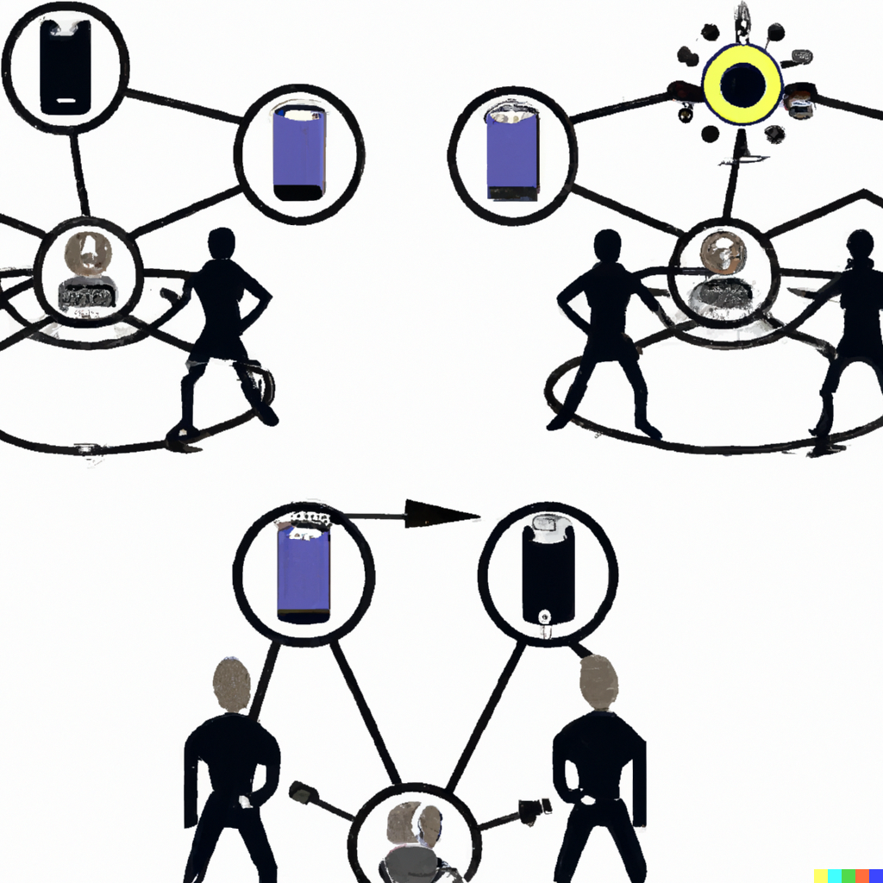
THEORETICAL APPROACHES TO COLLABORATIVE INTERACTION IN TECHNOLOGY DESIGN
Collaboration is a complex phenomenon and allowing people to have smooth collaborative interaction via technology have been a challenge for researchers.
Theories provide a lens to analyse collaborative interaction as a complex phenomenon and bring questions to be asked. For example, within various multidisciplinary research fields that focus on information systems and technology design.
image created by Dall-E with the description: "two collaborative activity systems in which people's interactions are mediated by technology", in January 2023
Notes:
Allowing people to collaborate and have successful social and collaborative interactions over computer networks is a goal of designers. However, using technology to facilitate conversations does not automatically produce communication and understanding.
Theories play an important role to bring assumptions about complex matters such as collaborative interaction (e.g., collaborative learning, collaborative gameplay, collaborative work, etc.) to be able to study and design for.

Slide 6
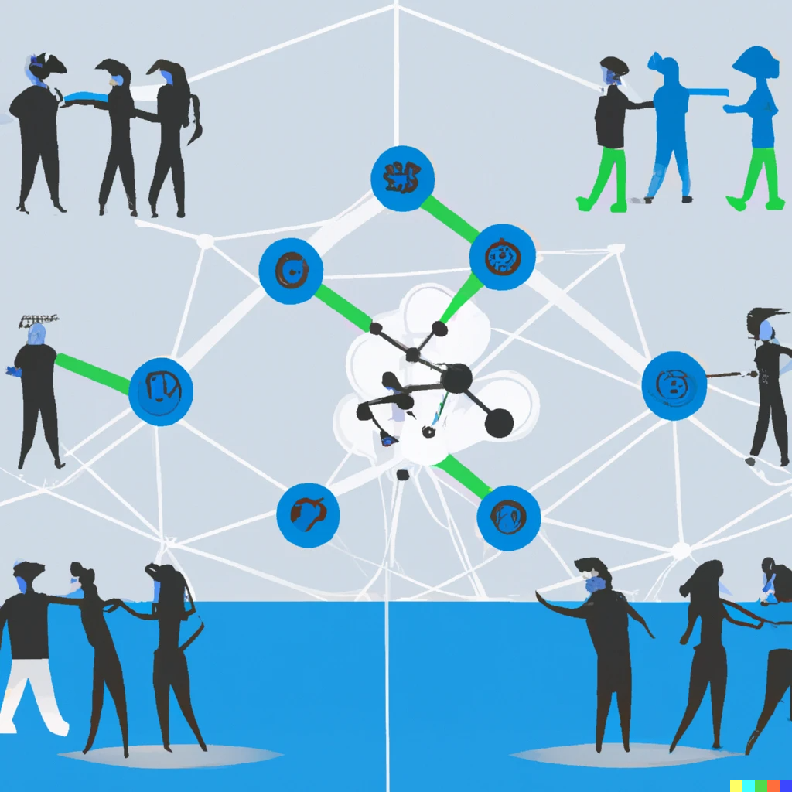
ACTIVITY THEORY: A FRAMEWORK FOR ANALYSIS
Activity theory is a framework that provides a theoretical lens, and it is used in descriptive, analytical and interpretive levels in human-computer interaction (HCI), computer-supported cooperative work (CSCW), and computer-supported collaborative learning (CSCL).
image created by Dall-E with the description: "collaborative activity system in which multiple people's interactions are mediated by technology", in January 2023
Notes:
One of the influential examples for a theoretical approach to understand collaborative interaction mediated by technology is activity theory. According to the activity theory, humans learn and develop when, in collaboration with others, people act on their immediate surroundings.
Activity Theory is a framework that provides a theoretical lens to analyse human activity and it can be used to inform the design of technology that supports collaborative interaction, but it's not a design method that guarantees a specific outcome.

Slide 7
ACTIVITY THEORY: OVERVIEW
A BRIEF HISTORY OF ACTIVITY THEORY:
➔ A psychological and socio-cultural framework
➔ Inspired by Marxist philosophies as well as Lev Vygotsky,
➔ Developed by Sergei Rubinstein, Alexei Leont’ev, and Yrjö Engeström to understand how
work activities were mediated and influenced by the tools
the resources (e.g. skills, tools, knowledge) that were used in the activities,
the social and cultural context in which the activities took place influence the human activity.
Notes:
Activity Theory is a psychological and sociological framework that originated in the Soviet Union in the 1920s influenced by Marxist philosophy. It was developed by a group of Soviet psychologists, including Lev Vygotsky, Alexei Leontiev, and Yrjö Engeström as a way to understand how work activities were influenced by the tools and resources that were used and the social and cultural context in which they took place.

Slide 8
ACTIVITY THEORY: OVERVIEW
TRAJECTORY OF KEY CONCEPTS OF ACTIVITY THEORY
➔ Principle of unity and inseparability of human cognition and activity (Rubinstein, 1947)
➔ Theory of mediation based on the idea of a triadic relationship between object (goal or purpose), a mental interpretant (subject), and a sign (language as a tool) (Gagnepain, 1960)
➔ Mediational aspect of tools for human activity (Vygotsky, 1978)
➔ Object-oriented analysis of human activities: activity-action-operation (Leont’ev, 1978)
➔ Three level notion of developmental forms of subject-object-subject relations: coordination, cooperation and communication in social learning (Fitchner, 1984)
➔ Exchange of information between an individual and their environment within an activity system; subject-object-community interaction (Engeström, 1987)
➔ Mediational means for subject-object-community interaction; tools/instruments/resources, rules/roles/skills, division of labour (Engeström, 1997)
Notes:
- Rubinstein is the founder pf principle of unity emphasizing that human cognition and activity are interconnected and influenced by each other.
-In 1960s Gagnepain (a semioticist in linguistics) introduced the theory of mediation based on the object-subject-sign relationship.
-Vygotsky paved the way for understanding human activity through the mediational aspect of socio-cultural environment for learning.
Then Leont’ev, a student and co-worker of Vygotsky, emphasized the object-orientedness of human activity which he analyzed in three levels; activity-action and operation.
Engeström fuRther extended the theory with the importance of community in the form of division of labor.
Bernd Fitchner, a Scandinavian psychologist (Denmark) in learning emphasized the methodological and epistemological aspects of activity theory by describing coordination, cooperation and communication as different levels of social learning. He suggested three level notion of developmental forms of epistemological subject-object-subject relations.
REFERENCES:
Engeström, Y. (1987) Learning by Expanding: An activity-theoretical approach to developmental research. Helsinki: Orienta-Konsultit.
Engeström, Yrjö, et al. (1997) "Coordination, cooperation, and communication in the courts: Expansive transitions in legal work." Mind, culture, and activity: Seminal papers from the Laboratory of Comparative Human Cognition (1997): 369.
Fichtner, B. (1984). Co-ordination, co-operation and communication in the formation of theoretical concepts in instruction. Learning and teaching on a scientific basis: Methodological and epistemological aspects of the activity theory of learning and teaching. Aarhus: Aarhus Universitet, Psykologisk institut.
Leont’ev, A.N. (1978): Activity, Consciousness, and Personality. NJ: Englewood Cliffs, Prentice-Hall.
Vygotsky, L. S. 1978, Mind in Society: The Development of Higher Psychological Processes (Cambridge: Harvard University Press).

Slide 9
ACTIVITY THEORY: OVERVIEW
ACTIVITY THEORY / CULTURAL HISTORICAL ACTIVITY THEORY
Activity theory also referred as Cultural-Historical Activity Theory (CHAT) exploring and understanding interactions in multiple contexts and cultures (e.g. social, historical, economic, political, etc.), and the dynamics and development of human activities such as learning and education, or work.
Cole, Michael, and Yrjö Engeström. "A cultural-historical approach to distributed cognition." Distributed cognitions: Psychological and educational considerations (1993): 1-46.
Sannino, A., & Engeström, Y. (2018). Cultural-historical activity theory: Founding insights and new challenges. Cultural-historical psychology.
Notes:
The Cultural-Historical approach is an offshoot of Activity Theory in the sense that it builds upon the basic principles of Activity Theory, but places a greater emphasis on the role of culture and history in shaping human activity. While Activity Theory focuses on how tools and resources, as well as the social and cultural context, shape human activity.

Slide 10
ACTIVITY THEORY: OVERVIEW
KEY PRINCIPLES OF ACTIVITY THEORY
Activity theory centered on three core concepts and principles;
➔ Subject (actor): Refers to a person engaged in an activity; humans act collectively, learn by doing, and communicate in and via their actions, and develop with their operations.
➔ Mediating artifacts, signs, and tools: Humans make, employ, and adapt tools of all kinds to learn and communicate
➔ Object (objectives, aims, goals): Refers to a motive or motivation towards a future-oriented objective.
Notes:
These three concepts and principles also lies in the basis of Vygotsky's famous triadic model of mediated action (stimulusi, response, and intermediate link as mediation), and its common reformulation as a triad of subject, object and mediated artifact that was further adapted and expended by other Activity Theorists, esp. Engeström.

Slide 11
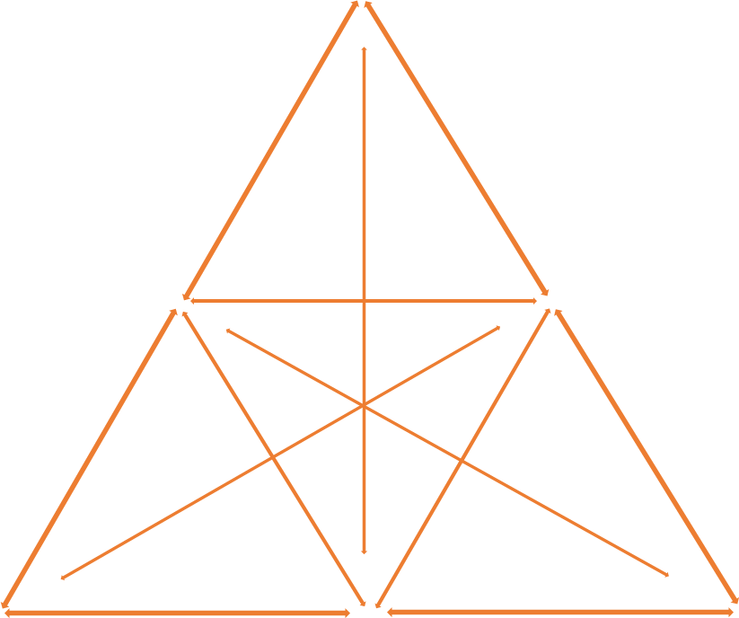
ACTIVITY THEORY: OVERVIEW
Engeström's expanded Activity Theory model
By what means are the subjects performing this activity?
Tools
Production
Who are involved in a common goal and carrying out this activity?
Why is this activity taking place?
Subject
Object
Outcome
Consumption
What is the desired outcome from carrying out this activity?
Exchange
Distribution
Rules
Community
Division of Labour
Are there any individual or group norms, rules and roles governing the performance of this activity?
What is the environment in which this activity is carried out?
Who is responsible for what, when carrying out this activity and how they are organized?
Notes:
Six nodes of of activity system triangle; subject – object – community – instruments – rules – division of labor which was modeled by Yrjö Engeström in late 90s. This diagram shows the generic structure of an activity system;
Subject refers to the individual or subgroup whose position and point of view are chosen as the perspective of the analysis.
Object is what the activity oriented towards. It refers to the raw material or problem space at which the activity is directed. The object is turned into outcomes with the help of instruments, that is, tools and signs.
Community comprises the individuals and subgroups who share the same general object. Division of labor refers to horizontal division of tasks and vertical division of power and status. Finally rules refer to the explicit and implicit regulations, norms, conventions and standards that constrain actions within the activity system.
The circle around the object in the diagram indicates at the same time the focal role and inherent ambiguity of the object of activity. The object is an invitation to interpretation, personal sense making and societal transformation. One needs to distinguish between the generalized object of the historically evolving activity system and the specific object as it appears to a particular subject, at a given moment, in a given action. The generalized object is connected to societal meaning, the specific object is connected to personal sense. For example, in medical work, the generalized object may be health and illness as societal challenges, whereas the specific object may be a particular condition or complaint of a particular patient.
Sanino & Engeström, Pp. 45-46

Slide 12
ACTIVITY THEORY: OVERVIEW
KEY PRINCIPLES FOR COLLABORATIVE INTERACTION IN ACTIVITY THEORY
➔ Social-cultural context specifity: Development of human cognition and behaviour is shaped by the interaction between an individual and their social and cultural environment (Vygotsky, 1978; Leont’ev, 1978), as well as being shaped by historical and cultural factors.
➔ Object-orientedness: Human consciousness and activity as the internal and the external, are closely interconnected and mutually determine one another (Rubinstein, 1947)
➔ Unit of analysis: Human activity is the fundamental unit of analysis, rather than the individual or group (Vygotsky, 1978; Leont’ev, 1978)
➔ Mediation: Human activity is a purposeful and goal-directed process that is mediated by socially produced artifacts, such as tools, language, and representations (Engeström, 2001, 2015).
➔ Division of labor: The social organization of activity play a key role in shaping human behavior and cognition, and depend on the actors' roles and resources, as well as their organizations (Engeström, 1997, 1999)
Notes:
Activity Theory suggests that the development of human cognition and behaviour is a dialectical process, meaning that it is shaped by the interaction between an individual and their social and cultural environment.
"Activity theory and cognitive science are not incompatible, but they embrace different underlying values and they prioritize conceptual and methodological issues differently. For example, in activity theory, understanding mental representations per se is a secondary issue." (Caroll, 2003, p. 5)

Slide 13
ACTIVITY THEORY: APPLYING THEORY INTO PRACTICE
HOW DO WE APPLY ACTIVITY THEORY IN COLLABORATIVE INTERACTION AND TECHNOLOGY DESIGN?

Slide 14
ACTIVITY THEORY: APPLYING THEORY INTO PRACTICE
The iterative design cycle that use activity theory as a lens begins with identifying the tensions, conflicts, contradictions, controversies, and/or breakdown situations that exit among components in the activity system(s) to create a collective force for development, change and innovation.
Gay, G. & Hembrooke, H. (2004) Activity-Centered Design: An Ecological Approach to Designing Smart Tools and Usable Systems. Massachusetts Institute of Technology, MIT Press.
Notes:
"Activities such as technology construction should not be perceived as statically structured entities but rather as dynamic processes that are characterized by ambiguity and change. Construction and renegotiation reoccur constantly within the system. The entire iterative design process rests on dynamic interactions between order and chaos, steady states and breakdowns, harmony and controversy. The activity system is constantly working through tensions within and between its components. The tensions and breakdowns that occur within activity systems can be used as points of reference for studying the social construction and design process."
Gay & Hembrooke (2004) p. 13

Slide 15
ACTIVITY THEORY: APPLYING THEORY INTO PRACTICE
Tools
What's wrong with the activity?
Subject
Object
Outcome: some of the actors do/cannot employ the action
Who got the expertise or tools to address/overcome the issue?
Rules
Community
Division of Labour
Adapted from; Sannino, A., & Engeström, Y. (2018). Cultural-historical activity theory: Founding insights and new challenges. Cultural-historical psychology. P. 49
Notes:
According to Engeström, activity systems develop as actors engage in object-oriented, contradiction provoked actions. Typical sequence of learning actions in an expansive cycle is:
1. questioning, criticizing, or rejecting some aspects of the accepted practice and existing wisdom;
2. analyzing the situation in order to identify causes or explanatory mechanisms by tracing its origin and evolution (historical-genetic analysis) or by constructing a picture of its inner systemic relations (actual-empirical analysis);
3. modeling the newly found explanatory relationship in some publicly observable and transmittable medium;
4. examining the model in order to grasp its dynamics, potentials, and limitations;
5. implementing the model through practical applications, enrichments, and conceptual extensions;
6. reflecting on and evaluating the process; and
7. consolidating its outcomes into a new, stable form of practice.
Foot, K. A. (2014). Cultural-historical activity theory: Exploring a theory to inform practice and research. Journal of Human Behavior in the Social Environment, 24(3), 329-347.

Slide 16
COLLABORATIVE INTERACTION
LEVELS OF COLLABORATIVE INTERACTION IN ACTIVITY THEORY (Engeström, 1997, 2015)
However, collaboration is a very complex skill/phenomenon which involves;
Coordination
Cooperation
Reflective Communication

Slide 17
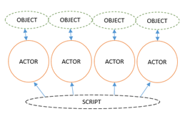
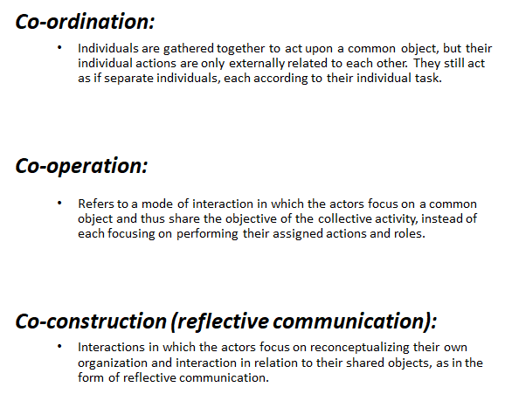
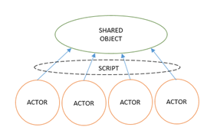
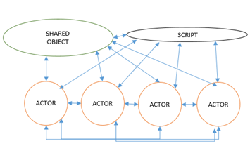
COLLABORATIVE INTERACTION
LEVELS OF COLLABORATIVE INTERACTION IN ACTIVITY THEORY (Engeström, 1997, 2015)
Baykal, G. E., Eriksson, E., Barendregt, W., Torgersson, O., & Bjork, S. (2020, October). Evaluating Co-located Games as a Mediator for Children’s Collaborative Interaction. In Proceedings of the 11th Nordic Conference on Human-Computer Interaction: Shaping Experiences, Shaping Society (pp. 1-11). https://dl.acm.org/doi/10.1145/3419249.3420118
Notes:
Based on Engeström's activity model, there are three levels within a Collaborative Activity described for developing and designing computer supported cooperative environments. These refer to the modes of interaction to understand the dynamics of inter-subjective collaboration:
Coordinated activity; individuals are gathered together to act upon a common object, but their individual actions are only externally related to each other - they still act as if separate individuals, each according to their individual task. Engeström describes this level as the most basic form of collaboration in which the actors are following their scripted roles, each concentrating on performing the assigned actions. The script is coded in written rules, in plans, in schedules or in tacit norms and traditions.
Cooperative activity refers to a mode of interaction in which the actors focus on a common object and thus share the objective of the collective activity, instead of each focusing on performing their assigned actions and roles. Thus, cooperation is described by Engeström as the more advanced form of collaboration, where actors need to relate their goals to the overall shared objective. On this level of collaboration the actors go beyond the confines of the given script, yet they do this without explicitly questioning or reconceptualizing the script.
Co-constructive activity in which the actors focus on re-conceptualizing their own organization and interaction in relation to their shared objects . This final mode is also named Reflective Communication by Engeström and was interpreted as the most complex form of collaborative interaction derived from monitoring and reflection, and harvesting of co-constructive knowledge building among the actors. Engeström describes this as a rare and complex level of collaborative interaction, in which both the object and the script are reconceptualized, as is the interaction between the actors.
Baykal, G. E., Eriksson, E., Barendregt, W., Torgersson, O., & Bjork, S. (2020, October). Evaluating Co-located Games as a Mediator for Children’s Collaborative Interaction. In Proceedings of the 11th Nordic Conference on Human-Computer Interaction: Shaping Experiences, Shaping Society (pp. 1-11).

Slide 18
ACTIVITY THEORY: APPLYING THEORY INTO DESIGN PRACTICE
APPLICATION OF ACTIVITY THEORY IN COLLABORATIVE INTERACTION AND TECHNOLOGY DESIGN
➔ Blended with Scandinavian approach to design; cooperation between technology design researchers and those being researched of an organization to help improve their situation, skills or activity (e.g., Ehn & Kyng, 1984; Bødker, 1987)
➔ Mediating role of physical artifacts (e.g., user interface) as well as social and cultural context in shaping human behaviour and cognition in terms of Human-Computer Interaction (Bødker, 1991), and artifact ecologies (Bødker & Klokmose, 2011)
➔ Ubiquitous activity-based computing (Bardram, 2007, 2009)
➔ Complex mediation of technical artifacts (Bødker,S. and Andersen,P.B., 2005)
Notes:
The rise of the personal computer challenged the focus, in traditional-systems developments, on mainframe systems for automation of existing work routines (Collins, p. 291-2).
Bødker's Utopia project was situated in a context where insights from social psychology and industrial sociology as well as being inspired by activity theory through German work psychology and Scandinavian critical psychology. For them, the cognitive science–based theories lacked means of addressing a number of issues that came out of the empirical projects.

Slide 19
ACTIVITY THEORY: APPLYING THEORY IN DESIGN PRACTICE
A CHECKLIST FOR DESIGN CONSIDERATIONS BASED ON ACTIVITY THEORY
(by Kaptelinin, Nardi, & Macaulay, 1999)
Queries to identify the main constituents of activity:
1a. Outcome: What services or products do we produce?
2a. Object and process: What raw materials or prerequisites do we start from? How do we produce the services or products from the inputs we have?
3a. Instruments: What kinds of physical tools and knowledge, skills, and so forth, do we need for this work?
4a. Subjects: Who are we—what different kinds of people are needed to produce these services or products?
5a. Social relations and means: When we work to produce the services of products, what kinds of rules, division of labor, communication, and so forth, apply between us?
Queries to identify the network of activities:
1b. Outcome: Who needs our services or products? Why do they need them—to produce some services or products for some others?
2b. Object: From whom do we get our “raw materials”? How do they produce what we need?
3b. Instruments: From whom do we get the tools and knowledge we need? How do they produce them?
4b. Subjects: Where do we come from—who educates and raises the kinds of people needed here? How does that happen?
5b. Social relations and means: Who sets the rules for us? How are the rules generated?
Notes:
Mediation is “folded in” with each of the other four principles, resulting in the four categories of concerns: means/ends, environment, learning/cognition/articulation, and development. For each category, a series of questions are asked with the purpose of understanding the use-context that the artifact is intended to support.
However, according to Bertelsen & Bodker (2003) the main problem with respect to this checklist is that it leaves out concerns for contradictions, thus disabling the theoretical framework’s analytical power. (Bertelsen & Bødker, S. (2003) p. 316-7.

Slide 20
ACTIVITY THEORY: APPLYING THEORY IN DESIGN PRACTICE
Examples for studies that used Activity Checklist in design, evaluation and analysis:
Design of a web-based information systems (e.g. Gould & Verenikina, 2003)
Evaluation of the use of tangible user interface (TUI) developed to facilitate collaboration between a group of designers and planners (e.g. Fjeld, Morf, & Krueger, 2004)
Analysis of empirical data gathered by means of ethnographic research (e.g. Maier, 2005)
Igira, F. T., & Gregory, J. (2009). Cultural historical activity theory. Handbook of research on contemporary theoretical models in information systems, p. 445.
Notes:
Activity Theory is a framework that provides a theoretical lens to analyse human activity and it can be used to inform the design of technology that supports collaborative interaction, but it's not a design method that guarantees a specific outcome.

Slide 21
ACTIVITY THEORY IN DESIGN
A CHECKLIST FOR SITUATING COMPUTER APPLICATIONS IN USE
(by Bertelsen & Bødker, 2003)
situate work and computer application historically,
situate the computer application in a web of activities where it is used,
characterize the use according to the stereotypes of systems, tools and media,
consider the support needed for the various activities going on around the computer application, and the historical circumstances of the computer application,
identify the objects worked on, in, or through the computer application,
consider the web of activities and the contradictions in and between activities.
Bertelsen,O. and Bødker, S. (2003) Activity theory. In J.Carroll (ed.), HCI Models, Theories, and Frameworks: Toward a Multidisciplinar
Science. Amsterdam: Morgan Kaufmann. p. 315.
Notes:
A checklist suggested by Bertelsen and Bødker.

Slide 22
CASES: ACTIVITY THEORY IN TECHNOLOGY DESIGN
CASE: IDENTIFYING COMMUNITY OF PRACTICE (Bødker, 1989)
A ground-breaking HCI work of Susanne Bødker which argued that the user interface cannot be seen independently of the use activity (i.e., the professional, socially organized practice of the users and the material conditions for the activity, including the object of the activity), and the user interface fully reveals itself only when in use.
Used human activity theory to analyse human experience and competence as being rooted in the practice of the group that conducts the specific work activity.
Presented a framework for the design of user interfaces that originates from the work situations in which computer-based artifacts are used. The framework deals with the role of the user interface in purposeful human work.
Bødker, S. (1989). A human activity approach to user interfaces. Human Computer Interaction, 4(3), 171-195. https://doi.org/10.1207/s15327051hci0403_1
Notes:
Activity Theory was introduced in HCI research in 1980s to provide viable means for analyzing the context and practice of the use of technologies in workplaces.

Slide 23
CASES: ACTIVITY THEORY IN TECHNOLOGY DESIGN
CASE: UNDERSTANDING THE ACTIVITY SYSTEM (Engeström, 1999):
One of Engeström's pioneering studies in CSCW which was about transformation of work in the children’s hospital. He combined activity theory with expansive visibilization of work from individual actions to collective activity system to examine and understand the contradictions.
By doing so, he identified a set of developmental tensions and troubles in the activity system of the outpatient clinic, presented key points of the vision for the clinic's activity system, and iterative steps in redesigning the system.
The study concludes with reconceptualization of object and transformation of the motive of work and reorganization of the activity system which he argues that is not a straightforward process, but rather a cycle of work activites.
Engeström, Y. Expansive Visibilization of Work: An Activity-Theoretical Perspective. Computer Supported Cooperative Work (CSCW) 8, 63–93 (1999). https://doi.org/10.1023/A:1008648532192

Slide 24
CASES: ACTIVITY THEORY IN TECHNOLOGY DESIGN
CASE: IDENTIFYING THE ACTIVITY'S GOAL AND MEDIATING ARTIFATCS (Bardram & Houben, 2017):
Bardram & Houben inspired by Engeström and utilized activity theory to identify how collaborative actions can be afforded by physical and digital artifacts in a specific socio-cultural context of a hospital setting.
Introduced the concept of "collaborative affordances" and identified core types of affordances (i.e., portability, collocated access, shared overview, and mutual awareness) and analysed paper-based, electronic and hybrid medical records accordingly.
Argued that the concept of Collaborative Affordances may be used to design collaborative digital and hybrid technologies both in the medical domain but also in others.
Bardram, J.E., Houben, S. Collaborative Affordances of Medical Records. Comput Supported Coop Work 27, 1–36 (2018). https://doi.org/10.1007/s10606-017-9298-5

Slide 25
ACTIVITY THEORY IN TECHNOLOGY DESIGN: FURTHER INSTANCES
➔ Work (e.g., Kuutti, K., & Arvonen, T. Identifying potential CSCW applications by means of activity theory concepts: A case example. In Proceedings of the 1992 ACM conference on Computer-supported cooperative work (pp. 233-240). https://dl.acm.org/doi/pdf/10.1145/143457.150955)
➔ Learning (e.g. Timmis, S. The dialectical potential of Cultural Historical Activity Theory for researching sustainable CSCL practices. Intern. J. Comput.-Support. Collab. Learn. 9, 7–32 (2014). https://doi.org/10.1007/s11412-013-9178-z)
➔ Leisure
Museums (Rahm, J. (2012). Activity Theory as a Lens to Examine Project-Based Museum Partnerships in Robotics. In: Davidsson, E., Jakobsson, A. (eds) Understanding Interactions at Science Centers and Museums. SensePublishers. https://doi.org/10.1007/978-94-6091-725-7_10 ),
Libraries (e.g., Spasser, M.A. Realist Activity Theory for Digital Library Evaluation: Conceptual Framework and Case Study. Computer Supported Cooperative Work (CSCW) 11, 81–110 (2002) https://doi.org/10.1023/A:1015288305397 ),
Games (Baykal et al. Evaluating Co-located Games as a Mediator of Children’s Collaborative Interaction. In Proceedings of the 11th Nordic Conference on Human-Computer Interaction: Shaping Experiences, Shaping Society, pp. 1-11. 2020 https://doi.org/10.1145/3419249.3420118 )
➔ Organizations
Health care organizations (Bardram, J.E., Houben, S. Collaborative Affordances of Medical Records. Comput Supported Coop Work 27, 1–36 (2018). https://doi.org/10.1007/s10606-017-9298-5 ),
Education (Nussbaumer, D. (2012) An overview of cultural historical activity theory (CHAT) use in classroom research 2000 to 2009, Educational Review, 64:1, 37-55, DOI: 10.1080/00131911.2011.553947)

Slide 26
Summary/take home
Overall, incorporating activity theory into the design process helps to ensure that technology for collaborative interaction is designed with the social and cultural context in mind. Activity theory framework helps to begin with identifying the tensions or breakdowns within and between the activity systems to understand what aspect of the activity system is to be developed in the mediating technology with respect to how people collaborate in that context.

Slide 27
References
Bertelsen, O. and Bødker, S. (2003) Activity theory. In J. Carroll (ed.), HCI Models, Theories, and Frameworks: Toward a Multidisciplinary Science. Amsterdam: Morgan Kaufmann. Pp. 291–324.
Engeström, Y. (1987) Learning by Expanding: An activity-theoretical approach to developmental research. Helsinki: Orienta-Konsultit.
Engeström, Y., et al. (1997) "Coordination, cooperation, and communication in the courts: Expansive transitions in legal work." Mind, culture, and activity: Seminal papers from the Laboratory of Comparative Human Cognition (1997): 369.
Engeström, Yrjö. (2001) "Expansive learning at work: Toward an activity theoretical reconceptualization." Journal of education and work 14.1 (2001): 133-156.
Engeström, Yrjö. (2015) Learning by expanding. Cambridge University Press.
Fichtner, B. (1984). Co-ordination, co-operation and communication in the formation of theoretical concepts in instruction. Learning and teaching on a scientific basis: Methodological and epistemological aspects of the activity theory of learning and teaching. Aarhus: Aarhus Universitet, Psykologisk institut.
Foot, K. A. (2014). Cultural-historical activity theory: Exploring a theory to inform practice and research. Journal of Human Behavior in the Social Environment, 24(3), 329-347. https://doi.org/10.1080/10911359.2013.831011
Gay, G., & Hembrooke, H. (2004). Activity-centered design: An ecological approach to designing smart tools and usable systems. Mit Press.
Igira, F. T., & Gregory, J. (2009). Cultural historical activity theory. Handbook of research on contemporary theoretical models in information systems, 434-454. DOI: 10.4018/978-1-60566-659-4.ch025
Notes:
Bertelsen, O. and Bødker, S. (2003) Activity theory. In J. Carroll (ed.), HCI Models, Theories, and Frameworks: Toward a Multidisciplinary Science. Amsterdam: Morgan Kaufmann. Pp. 291–324.
Engeström, Y. (1987) Learning by Expanding: An activity-theoretical approach to developmental research. Helsinki: Orienta-Konsultit.
Engeström, Yrjö, et al. (1997) "Coordination, cooperation, and communication in the courts: Expansive transitions in legal work." Mind, culture, and activity: Seminal papers from the Laboratory of Comparative Human Cognition (1997): 369.
Engeström, Yrjö. (2001) "Expansive learning at work: Toward an activity theoretical reconceptualization." Journal of education and work 14.1 (2001): 133-156.
Engeström, Yrjö. (2015) Learning by expanding. Cambridge University Press.
Fichtner, B. (1984). Co-ordination, co-operation and communication in the formation of theoretical concepts in instruction. Learning and teaching on a scientific basis: Methodological and epistemological aspects of the activity theory of learning and teaching. Aarhus: Aarhus Universitet, Psykologisk institut.
Gay, G., & Hembrooke, H. (2004). Activity-centered design: An ecological approach to designing smart tools and usable systems. Mit Press.
Leont’ev, A.N. (1978): Activity. Consciousness. Personality. NJ: Englewood Cliffs, Prentice-Hall.
Sannino, A., & Engeström, Y. (2018). Cultural-historical activity theory: Founding insights and new challenges. Cultural-historical psychology.

Slide 28
References
Kuutti, K. (1996). Activity theory as a potential framework for human-computer interaction research. Context and consciousness: Activity theory and human-computer interaction, 1744, 9-22.
Leont’ev, A.N. (1978): Activity. Consciousness. Personality. NJ: Englewood Cliffs, Prentice-Hall.
Nardi, B. A., & Engeström, Y. (1999). A web on the wind: The structure of invisible work. Computer supported cooperative work, 8(1-2), 1-8.
Sannino, A., & Engeström, Y. (2018). Cultural-historical activity theory: Founding insights and new challenges. Cultural-historical psychology. doi:10.17759/chp.2018140304
Notes:
Bertelsen, O. and Bødker, S. (2003) Activity theory. In J. Carroll (ed.), HCI Models, Theories, and Frameworks: Toward a Multidisciplinary Science. Amsterdam: Morgan Kaufmann. Pp. 291–324.
Engeström, Y. (1987) Learning by Expanding: An activity-theoretical approach to developmental research. Helsinki: Orienta-Konsultit.
Engeström, Yrjö, et al. (1997) "Coordination, cooperation, and communication in the courts: Expansive transitions in legal work." Mind, culture, and activity: Seminal papers from the Laboratory of Comparative Human Cognition (1997): 369.
Engeström, Yrjö. (2001) "Expansive learning at work: Toward an activity theoretical reconceptualization." Journal of education and work 14.1 (2001): 133-156.
Engeström, Yrjö. (2015) Learning by expanding. Cambridge University Press.
Fichtner, B. (1984). Co-ordination, co-operation and communication in the formation of theoretical concepts in instruction. Learning and teaching on a scientific basis: Methodological and epistemological aspects of the activity theory of learning and teaching. Aarhus: Aarhus Universitet, Psykologisk institut.
Gay, G., & Hembrooke, H. (2004). Activity-centered design: An ecological approach to designing smart tools and usable systems. Mit Press.
Leont’ev, A.N. (1978): Activity. Consciousness. Personality. NJ: Englewood Cliffs, Prentice-Hall.
Sannino, A., & Engeström, Y. (2018). Cultural-historical activity theory: Founding insights and new challenges. Cultural-historical psychology.

Slide 29
Disclaimer: The European Commission's support for the production of this publication does not constitute an endorsement of the contents, which reflect the views only of the authors, and the Commission cannot be held responsible for any use which may be made of the information contained therein
https://tedco.se/

