Slide 1
Designing for MDE:s Designing for Collaborative Co-Located Multi-Display Environments
https://tedco.se/

Slide 2
Summary & Learning goals
The students are introduced to using the taxonomy for MDE: in practice.
Learning goals:​
Recognize Topology, Coupling and Interaction as aspects for design of collaborative technology in MDE:s
Analyze Topology, Coupling and Interaction as aspects for design of collaborative technology in MDE contexts. ​
Reflect on Topology, Coupling and Interaction as aspects for design of MDE:s and the framework’s potential as a tool for ideation.

Slide 3
Recommended readings
F. Garcia-Sanjuan, J. Jaen and V. Nacher, Toward a General Conceptualization of Multi-Display Environments, Frontiers in ICT 2016 Vol. 3, https://www.frontiersin.org/article/10.3389/fict.2016.00020

Slide 4
Exercise
Select an application you are working on or some other collaborative software you find interesting.
Think of what a multi-display version of the system could be like and in what situations it would be useful
Try to come up with several ideas!
Make sketches of your solutions and try to come up with a usage scenario

Slide 5
Exercise
Go back to the taxonomy for Multi-Display Environments and try to describe your solution using the terms from the taxonomy.
E.g., is it homogenous or heterogenous?,
Foot or yard sized?
etc
If there’s time left, pick some other dimensions from the taxonomy and try to come up with a solution that fits those.
E.g., if your first solution is yard-sized make a foot version
If it was regular, make an irregular design
etc

Slide 6
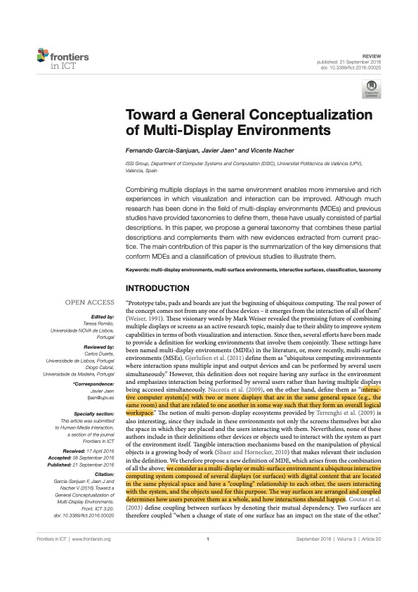
Mapping out Multi-Display Environments (MDE:s)
General description of MDE:s along 3 perspectives
Topology
Coupling
Interaction

Slide 7
Topology Perspective
Describes the dimensions relative to the physical appearance of the MDE.
Homogeneity – homogeneous, heterogeneous
Spatial form – planar, volumetric
Shape regularity – regular, irregular
Size – inch, foot, yard, perch, chain
Mobility – fixed, mobile
Scalability – bounded, unbounded

Slide 8
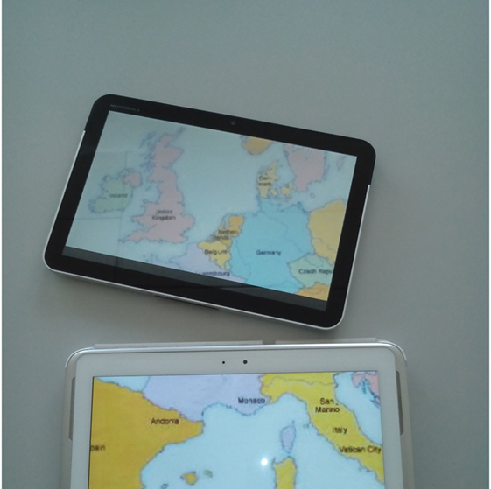
Coupling Perspective
Creation - implicit, manual, assisted, automatic
Mutability – static, dynamic
Logical View – discrete, redundant, extended-continuous, extended-discontinuous
Privacy - private, personal, public

Slide 9
Interaction Perspective
Describes the available interaction modes once the devices have been organized and couple together
Interaction availability – inexistent, partial, total
Input directness – direct, indirect
Interaction medium – on-device, around-device
Interaction instruments - body-based, surface-based, tangible
tangible includes e.g., mice and keyboards
Input Continuity – punctual, gestural

Slide 10
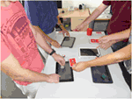
Examples
homogeneous, planar, irregular, yard topology
heterogeneous, volumetric, regular, and perch topology, with redundant logical view

Slide 11
References
F. Garcia-Sanjuan, J. Jaen and V. Nacher, Toward a General Conceptualization of Multi-Display Environments, Frontiers in ICT 2016 Vol. 3, https://www.frontiersin.org/article/10.3389/fict.2016.00020

Slide 12
Disclaimer: The European Commission's support for the production of this publication does not constitute an endorsement of the contents, which reflect the views only of the authors, and the Commission cannot be held responsible for any use which may be made of the information contained therein
https://tedco.se/

