Slide 1


Designing for Collaborative Co-Located Multi-Display Environments
https://tedco.se/
Notes:
Requirements – to understand and use this lecture it is recommended to have a fair idea of the contents of
F. Garcia-Sanjuan, J. Jaen and V. Nacher, Toward a General Conceptualization of Multi-Display Environments, Frontiers in ICT 2016 Vol. 3, https://www.frontiersin.org/article/10.3389/fict.2016.00020
Hello,
Today we will be talking about the concept Multi-Display Environments, that is how several displays can be combined to form an interactive environment.

Slide 2
Summary & Learning goals
The students are introduced to the concept of Multi-display environments (MDE), i.e., the coupling of several displays together to form a shared interactive environment. The concept is described through a taxonomy categorising MDE:s and illustrative cases.
Learning goals:​
recognize multi-display environments (MDE:s)
describe relevant factors influencing the design of MDE:s
analyse the design of MDE:s. ​
reflect on the potential consequences of MDE:s for collaborative interaction.
Notes:
The concept of Multi-display environments is introduced through a taxonomy categorising MDE:s and illustrative cases.
The learning goals are
recognize multi-display environments (MDE:s) which will be reached through this presentation and can be deepened by reading the recommended literatur
describe relevant factors influencing the design of MDE:s, which will be reached by learning about how MDE:s can be categorized and what the possibilities are
analyse the design and collaborative aspects of MDE:s, which will reached by considering how the general taxonomy can be applied to existing MDE:s for analysis
reflect on the potential consequences of MDE:s for collaborative interaction., this learning goal is dealt with by practicing reflection and design based the the general taxonomy of MDE:s. We will also look into one specific MDE designed to support collaborative interaction

Slide 3
Recommended readings
F. Garcia-Sanjuan, J. Jaen and V. Nacher, Toward a General Conceptualization of Multi-Display Environments, Frontiers in ICT 2016 Vol. 3, https://www.frontiersin.org/article/10.3389/fict.2016.00020
Weiser, M. (1991). The Computer for the 21 st Century. Scientific American, 265(3), 94–105. http://www.jstor.org/stable/24938718
Notes:
There are two main readings related to this presentation, the first one is the one that defines MDE:s and presenta a general taxonomy describing the design space of MDE:s
The second paper by Weiser is interesting since it presents a 30 year old vision that has been very influential for the development of the concept of MDE:s

Slide 4
Contents
The Computer for the 21st centrury
Definition – Multi-Display Environment
Examples
A taxonomy describing properties of MDE:s
Perspectives
  Topology
  Coupling
  Interaction
Case 4in1
Summary
Notes:
Here is an outline of what we will talk about today

Slide 5
The Computer for the 21st century
“Prototype tabs, pads and boards are just the beginning of ubiquitous computing. The real power of the concept comes not from any one of these devices – it emerges from the interaction of all of them”
Mark Weiser, 1991
30+ year old idea of combining several displays allowing new possibilities
Notes:
In 1991 Mark Weiser published the very influential paper The Computer for the 21st Century where he presented a vision for future computer use.
The paper was based on work performed at Xeroc Parc, a research center in Stanford that was very influential at the time.
One of the things Weiser suggested was that in the future there would be many devices of different sizes: tabs, pads and boards and that
”The real power of the concept comes not from any one of these devices – it emerges from the interaction of all of them”

Slide 6
The Computer for the 21st century
Ubiquitous Computing
  Computing everywhere
  From 1 person 1 device
  To 1 person many devices
  All interacting
    Collaborative
    Picture from 1991
Many different experiments have been
carried out
One-device-one-display-one-user still
dominating context
Do you agree?
Notes:
The ideas for the future presented by Mark Weiser have been very influential in the formation of Ubiquitous computing.
The basic idea was that computing technology will be an integral part of our daily lives. Weiser also saw a transformation from a situation wehre there was 1 device for each person to environments with many computational devices for each person.
In this picture from 1991 we see a Multi-Display Environment with four persons working together on a shared task using av variety of devices of different sizes that are all connected and interacting with each other. The devices are prototypes developed at Xerox parc
During the last 30 years many experiments have been carried out and several steps have been taken towards Weiser’s visions.
It is not hard to think of a current version of the picture where the prototype devices are replaced with a large screen, some tablets, smartphones and perhaps a laptop.
In many ways the hardware is there, but the idea that all these devices would be seamlessly integrated and support the group’s collaborative task is perhaps still more of a vision than reality.
Rather than using the devices we have to form Multi-Display Environments, the dominating use is still One-device-one-display-one-user
Or am I wrong? What do you think, have the ideas started to become realo? Are we using many devices together in any collaborative manner?
Ask students for feedback

Slide 7
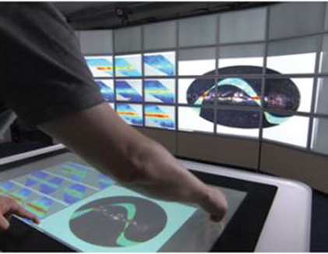
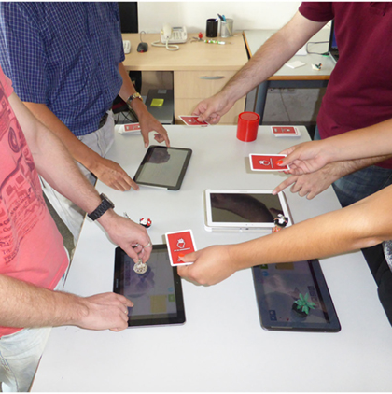
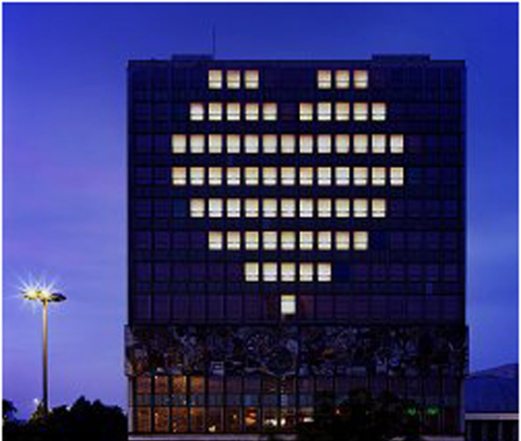
Multi-Display Environments
“Prototype tabs, pads and boards are just the beginning of ubiquitous computing. The real power of the concept comes not from any one of these devices – it emerges from the interaction of all of them”
Mark Weiser, 1991
30+ year old idea of combining several displays allowing new possibilities
Notes:
The challenge of using many displays together presented by Weiaer 30 years has been taken up by many researchers that explored the possibilities in many different ways.
The research and development that has been carried out ranges from using entire walls as displays like in Blinkenlights (bottom right) to using ordinary devices like tablets and smart phones in innovative ways in order to let several persons perform tasks together.
Over time these sort of design where several devices are used together have come to be called Mult-Display environments

Slide 8
Multi-Display Environments
”we consider as a multi-display or multi-surface environment a ubiquitous interactive computing system composed of several displays (or surfaces) with digital content that are located in the same physical space and have a “coupling” relationship to each other, the users interacting with the system, and the objects used for this purpose. The way surfaces are arranged and coupled determines how users perceive them as a whole, and how interactions should happen.”
Coupling – binding of 2 or more entities to provide a set of functions they cannot provide indivdually
Garcia-Sanjuan, F., et al. (2016). Toward a General Conceptualization of Multi-Display Environments.
Notes:
Garcia Sanjuan et al defines the concept of Multi-Display Environments like this
”we consider as a multi-display or multi-surface environment a ubiquitous interactive computing system composed of several displays (or surfaces) with digital content that are located in the same physical space and have a “coupling” relationship to each other, the users interacting with the system, and the objects used for this purpose. The way surfaces are arranged and coupled determines how users perceive them as a whole, and how interactions should happen.”
Where coupling means a binding between 2 or more entities that provides a set of functions the units cannot provide individually

Slide 9
Multi-Display Environments
Break down
  Interactive computing system
  Several displays
  Showing digital content
  Located in the same physical space
  Coupling relationship
    Displays
    Users
    Objects used for interaction
As a whole – an interactive environment
Garcia-Sanjuan, F., et al. (2016). Toward a General Conceptualization of Multi-Display Environments.
Notes:
The defintion of MDE:s is a bit complex so it might be useful to break it down into several statements
The key factors of an MDE are
It is an inyteractive computing system, which rules out static displays always showing the same content
There should be several displays involved
Showing digital content
Further they displays should be located in the same physical space. This is an important limitartion that shows that an MDE is a local environment.
On the other hand the size of the physical space can vary from for instance a desktop to large outdoor areas.
The devices must also be coupled. Simply placing a number of displays into a room does not make the room into an MDE. The displays and the persons interacting with them must also be connected somehow to form an interactive whole. Sometimes there can be dedicated objects used for interacting with the system. In such cases they must also be be part of the whole to form an interactive environment.

Slide 10
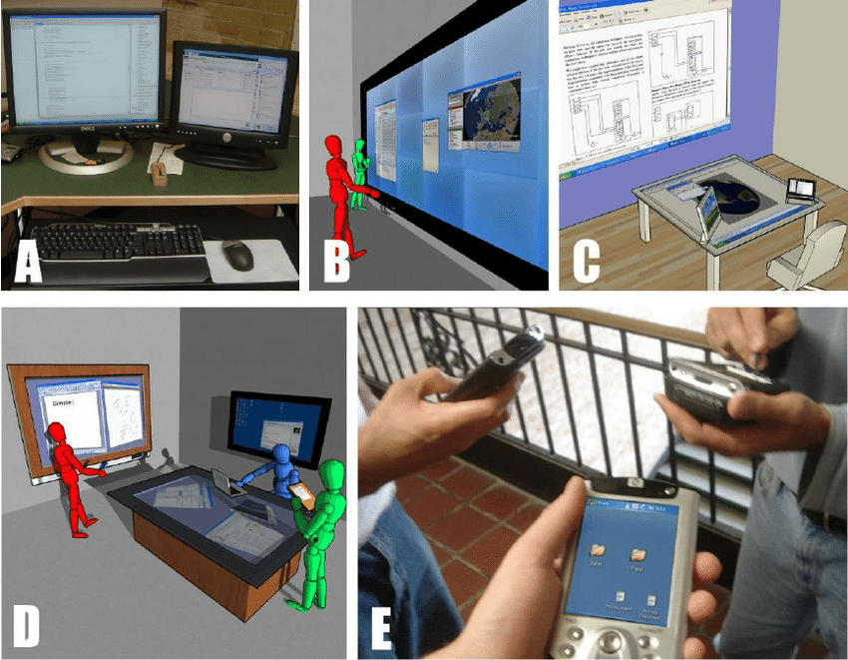
Examples
A - Several monitors
B - Composite display
C - Advanced office
D - Meeting room
E - Linked mobiles
Nacenta, M. A., Gutwin, C., Aliakseyeu, D., & Subramanian, S. (2009). There and Back Again: Cross-Display Object Movement in Multi-Display Environments. Human–Computer Interaction, 24(1-2), 170-229.
Notes:
Now that we have introduced the basic idea of MDE:s it is good to look at some examples
A shows a rather basic example where two monitors are connected to the same computer to form one combined display environment.
When you hook several displays like this the computing system often lets the user couple the displays in different ways, e.g., to show tha same conten or to extend the view to a larger space.
Example B shows how many displays have been arranged together to form one big wall-sized display allowing several person to interact at the same time.
Example C and advanced office space where the environment is made up of four displays supporting work
Example D illustrates a collaborative MDE where several peaople work together on a shared object
In all these cases it is central that the displays are coupled and show synchronized content.
Finally the last examples illustrates how several users link their mobiles together in a shared activity.
(As a side note It also shows that ideas around multi-dsiplays and mobile devices have been around since before the introduction of touch phones in 2007)

Slide 11
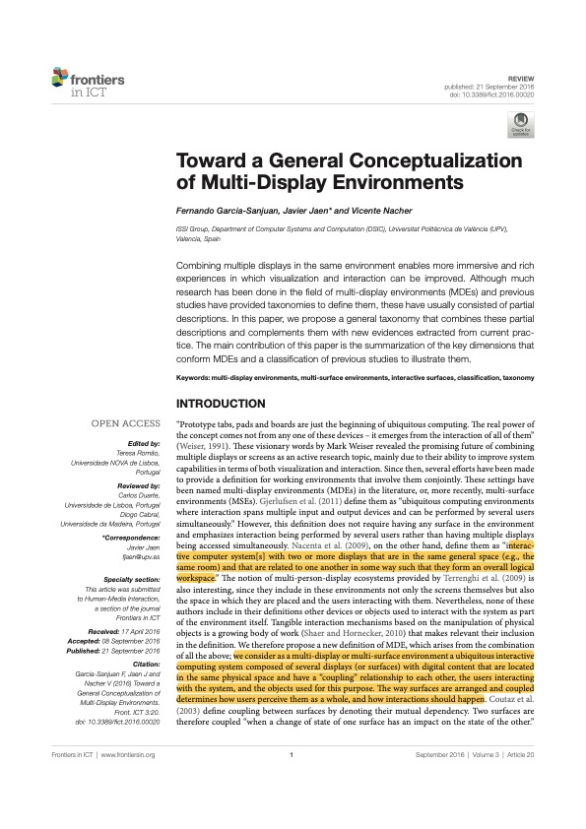
Mapping out Multi-Display Environments (MDE:s)
A taxonomy of MDE:s
  Maps out the design space
Description of MDE:s along 3 perspectives
Topology
Coupling
Interaction
Notes:
When we work with and study various phenomena we always tend to seek generalizations and knowledge that lets us understand what we are doing, learn from it and make use of what we have learned in other contexts.
A goal is also to find generalisations ad desciptions that make it possible for others to apply what we have learned.
Here is and example of this process of trying to describe, organize, generalize and spread knowledge. In this case around MDE:s
The paper shown here looks at a wide range of MDE:s and attempts to categorize and describe these in a useful manner.
The result is a taxonomy describing the general nature of MDE:s that can be used to analyse existing MDE:s and also serve as an inspiration when designing new MDE:s.
The taxonomy is organized into three different perspectives
Topology
Coupling
Interaction
Each of the perspectives describes one key element of an MDE. We look further inte each of the perspectives i the following slides

Slide 12
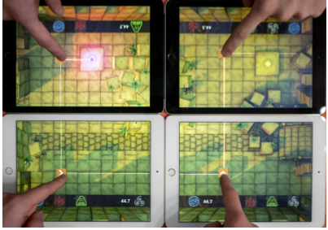
MDE Taxonomy
MDE
Topology
Coupling
Interaction
Perspectives
Homogenity
Spatial form
Shape regularity
Size
Dimensions
Homogenous
Planar
Regular
Foot
Values
Notes:
This slide shows the overal organosation of the taxonomy descibing MDE:s
At the top there is an MDE.
Below that there are the threee different perspectives.
Each perspectives is made up of a number of dimensions. The
The different perspectives each consist of a number of dimensions that can take different values. Here we show most of the dimensions from the topology perspective.
Each dimension can have different values. The values shown here are based on an analysis of the MDE showm in the lower right corner where four tablets are combined into one big display.

Slide 13
Topology Perspective
Describes the dimensions relative to the physical appearance of the MDE.
Homogeneity – homogeneous, heterogeneous
Spatial form – planar, volumetric
Shape regularity – regular, irregular
Size – inch, foot, yard, perch, chain
Mobility – fixed, mobile
Scalability – bounded, unbounded
Notes:
The topology perspective describes how the displays involved are organised and what their main physical characteristics are.
The first dimension is about whether all the displays are of the same kind or if many different types can be involved.
The second, spatial form is about if the displays are planar, that is flat or if they have some otheer kind of shape.
The third dimension, shape regularity, is about how the displays are organised,
The fourth dimensiopn describes the size of the environment
The fifth dimension, mobility, indicates if the environment is fixed into one place or if it can be moved around
And finally, sclability is about the number of displays in the environment. Can it be any number of displays or is there a limit?

Slide 14
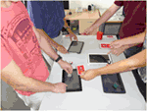
Example
Topology
  Homogeneity – homogeneous
  Spatial form – planar
  Shape regularity – irregular
  Size – yard
Notes:
Here is an example showing how a number of tablets are organised into an MDE, the topology is
Homogeneity – homogeneous
Spatial form – planar
Shape regularity – irregular
Size – yard

Slide 15
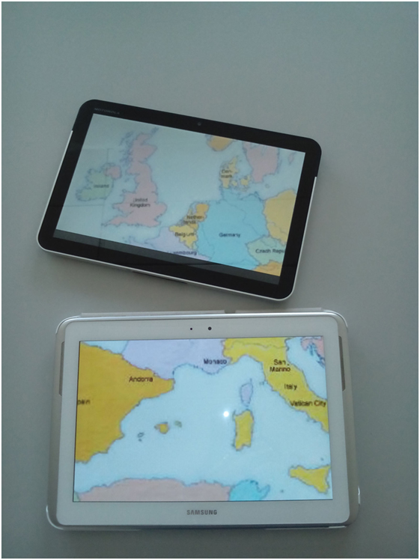
Coupling Perpective
Describes the dimensions related to how the displays inte the MDE connect to each other.
Creation - implicit, manual, assisted, automatic
Mutability – static, dynamic
Logical View – discrete, redundant,
extended-continuous, extended-discontinuous
Privacy - private, personal, public
Notes:
The coupling perspective describes the dimensions related to how the displays inte the MDE connect to each other
The creation dimension is about what is need to have a number of displays connect and form an MDE. For instance with automatic coupling the users do not need to do anything and with assisted coupling ther are guided through the process of setting up the environment.
Mutability deals with if the environment, e.g., the number of displays it consists of can change or not. It also involves if the displays can be moved around or not.
Logical view is about the way the displays work together to show information. The picture show an example of an extended continous view. As you can see the view shows parts of a map of Europé where the displays show the parts represented by the tablets’ position. As another example redundant logical view means that the same information is displayed (redundantly) on several screens
The privacy dimension is about is about who can see and interact with what
private, where data are not visible or accessible to others; personal, where information can be visible to others but not accessible; and public, where everything is available to all users.
As examples, tabletops are often private while interactive walls are public.

Slide 16

Example
Topology
  Homogeneity – heterogeneous
  Spatial form – volumetric
  Shape regularity – regular
  Size – perch
Coupling
  Mutability – static
  Logical View – redundant
Notes:
Here’s an example of an MDE where the coupling dimension mutability is static with redundant logical view
Rthe example also show values for the topology dimension

Slide 17
Interaction Perspective
Describes the available interaction modes once the devices have been organized and coupled together
Interaction availability – inexistent, partial, total
Input directness – direct, indirect
Interaction medium – on-device, around-device
Interaction instruments - body-based, surface-based, tangible
  tangible includes e.g., mice and keyboards
Input Continuity – punctual, gestural
Notes:
The interaction perspective describes the available interaction modes once the devices have been organized and coupled together
This about what users can do in the multi-display environment and how.
We look at a couple of examples and refer to the paper for descriptions of the rest
The interaction availability dimension is about to what degree the displays allow interaction. It can be inexistent if the displays are only used for visualization and cannot be interacted with, partialö if some screens allow interaction and total if all screens are interactive.
Interactium medium is about where the interaction takes place. It can be eiter on-device, for instance touch displays or around device whicg can be diverse things like making gestures in the air or using a mous located close to a display.

Slide 18
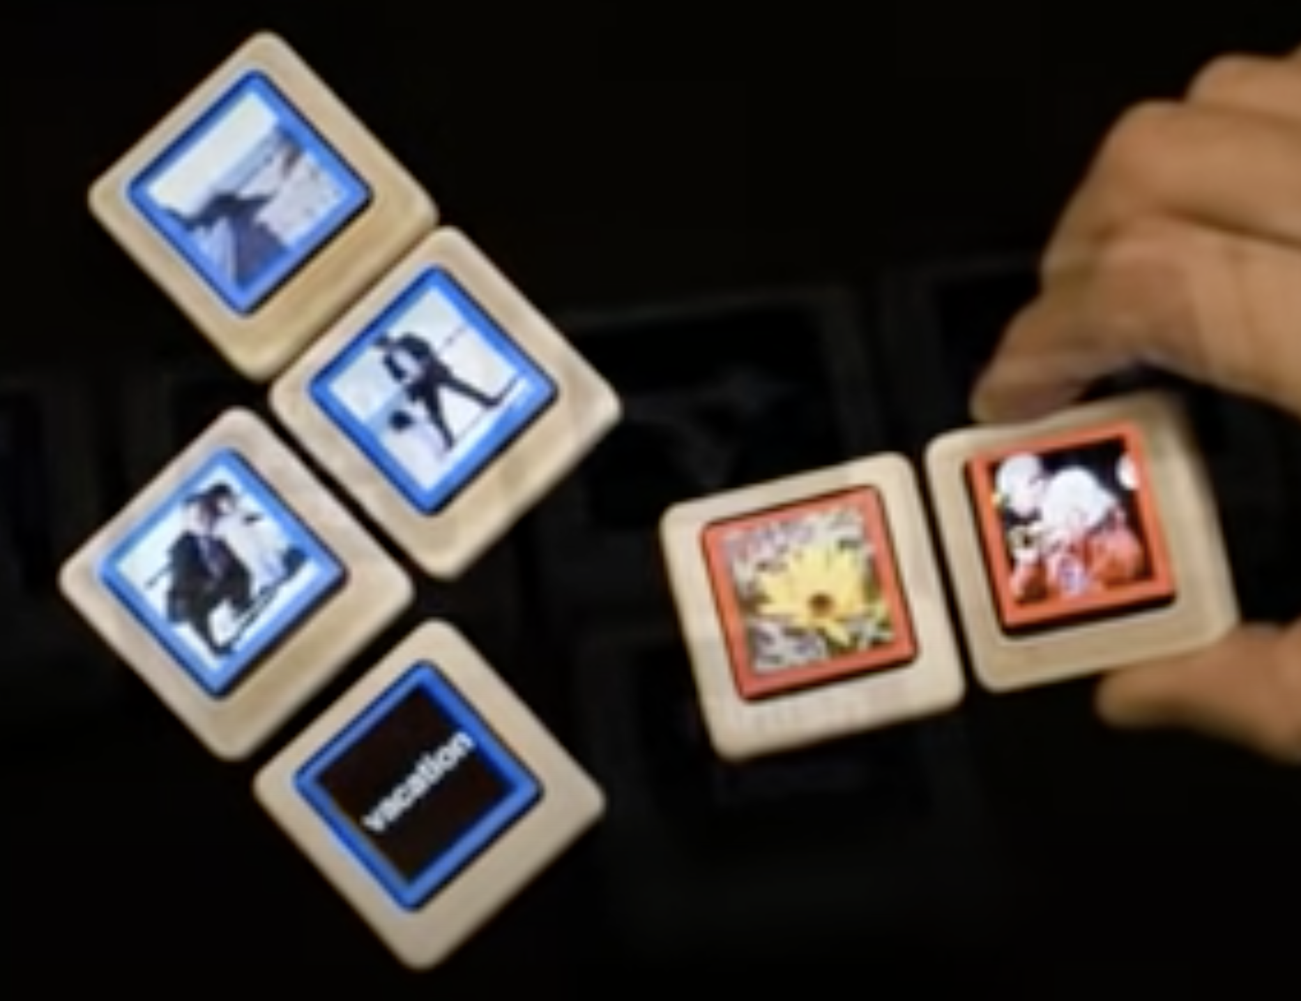
Example
Topology
  Homogeneity – homogeneous
  Spatial form – volumetric
  Shape regularity – irregular
  Size – foot
Interaction
  Interaction Availability – total
  Input Directnesss – direct
  Interaction Medium – on-device
  Interaction Instruments - surface-based
  Input Continuity – punctual, gestural
Siftables: https://www.youtube.com/watch?v=vbwzBBHtNGI
Notes:
As an example we look at the siftables from MIT. These are small interactive devices with a tiny screen that can be manipulated and interacted with in different ways.
Check out the video in the link for a demo
The topology and interaction dimensions can be describes as
Topology
Homogeneity – homogeneous
Spatial form – volumetric
Shape regularity – irregular
Size – foot
Interaction
Interaction Availability – total – all devices are interactive
Input Directnesss – direct
Interaction Medium – on-device – the interaction takes place on the device
Interaction Instruments - surface-based
Input Continuity – punctual, gestural

Slide 19
Why is the Taxonomy Useful?
Analysis & Ideation
Analysis
  Categorize
  Compare
  …
Ideation
  Provide ideas
  Pick dimensions from the perspectives and ideate
    E.g., planar, foot, on-device or volumetric, yard, tangible
Notes:
We have now introduced the concept of multi-display environments and a taxonomy that attempts to classify such environments along three perspectives and a number of dimensions.
But why is useful for us as designers?
The two main thinhgs that the taxonomy can be used for are analysis and ideation.
If we want to analyse existing MDE:s the taxonomy can be useful. By using the taxonomy it is for instance possible to see what the most common features of MDE:s are, create groups of related MDE:s, find areas for innvention by identifying what is missing and so on. Analysis like this is perhaps mostly a tool for understanding existing artefacts but understandning the current situation is also valuable when designing new systems.
When it comes to design and ideation it is possible to use the taxonomy as a generative tool to come up with new ideas.
One way to do this is to pick a number of dimensions from the perspectives and ideate from that.
For instance if we select planar, foot, on-device and use these values as input in the design process it’s likely that we will come up with very different results comparted to if we base the design on
volumetric, yard, tangible

Slide 20
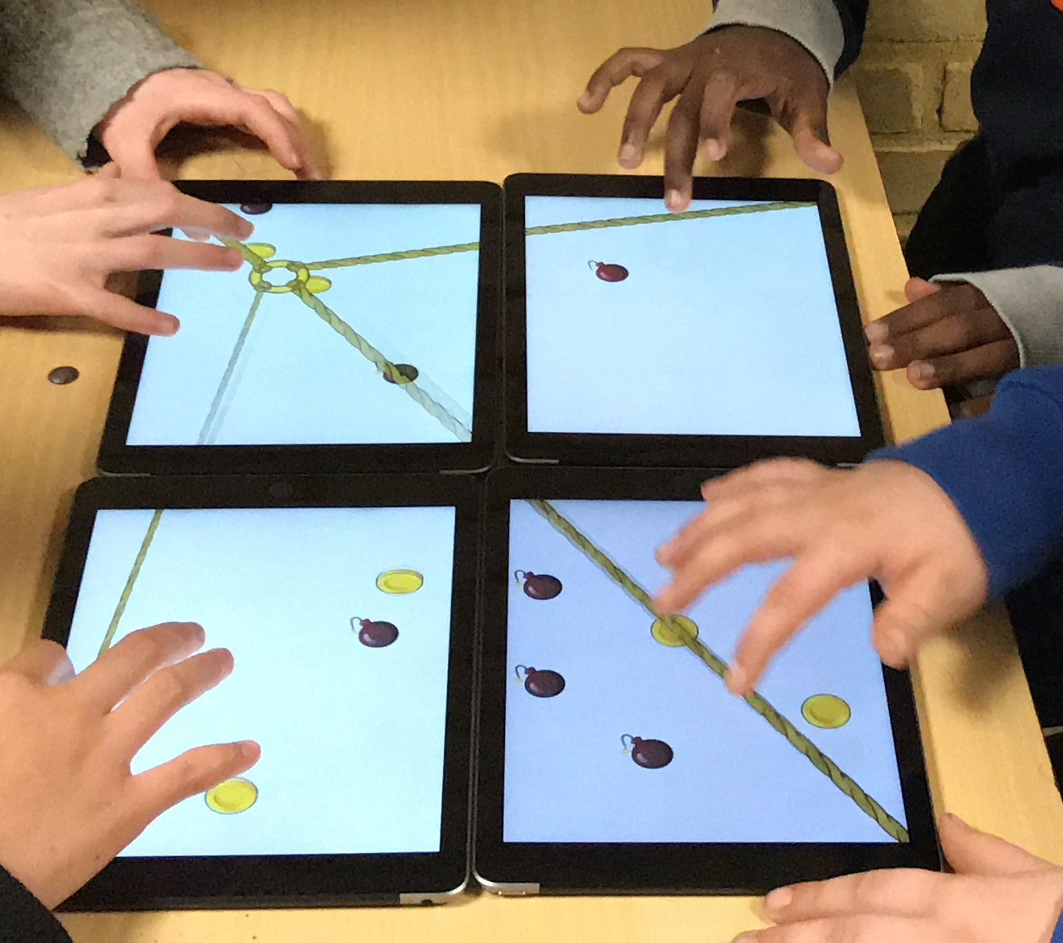
4in1 Activities – a collaborative Multi-Display Environment
A 4in1 activity is defined as an application involving 4 participants that play out on 4 tablets coupled together to form one large display
Can function as a low-cost tabletop solution
Barendregt, W., Börjesson, P., Eriksson, E., & Torgersson, O. (2017). StringForce: A Forced Collaborative Interaction Game for Special Education. In Proceedings of the 2017 Conference on Interaction Design and Children (IDC '17).
Notes:
We will now move on from talking about MDE:s in general to instead talk about one specific case namely 4in1 activities.
The picture to the right shows 4 children involved in the 4in1 actiity Stringforce
A 4in1 activity is defined as an application involving 4 participants that play out on 4 tablets coupled together to form one large display
Using the tablets together to form a large display can function as a low-cost alternative tabletop solution and also opens up for using the tablets for collaborative interaction in environments where there are many tablets around like schools
(the concept can also be traced back clearly to Weiser’s vision where his idea was that in the future there would be lots of pads lying around for anyone to pick uo and use)

Slide 21
4in1 - Bursting the Mobile Bubble
Use tablets to do things together
Laser Lunacy
  Course project
  Bachelor thesis
Movie
  https://www.youtube.com/watch?v=5uSsxlLu1zk&feature=youtu.be
Notes:
4in1 is a collaborative mult-display environment where the basic idea is to explore how mobile devices like tablets can be used to do things together.
The goal is to break the mobile bubble that users easily end up in when interacting with devices like smart phones
By coupling the devices together and designing collaborative tasks it becomes possible to instead turn the tablets into tools for collaboration.
The picture and vidoe linked here illustrates the concept with a game developed by a group of students in Gothenburg, Sweden

Slide 22
Design of 4in1 Activities
4 co-located participants
The spatial organisation of tablets induces expecations of shared use
All participants have the focus on the same object (the tablets)
A shared goal is established between the participants
Assymetry between particpants in terms of different capabilities can be used giving them different roles but the efforts of all participants are accounted for and valued
The design should encourage human-human interaction between participants
Notes:
There are some guidelines to consider when designing for the multi-display environment 4in1
The guidelines are about things that can contribute to making a 4in1 activity collaborative and are needed since simply connecting the tablets together does not lead to collaboation
4in1 activities are designed for 4 co-located participants and the MDE is organised in such a way that the placement of the tablets gives the participants on expectation of shared use.
The collaborative aspect is strengthened by having all participants focus on the same object, the MDE formed by the tablets
By doing something together a shared goal is established between the participants
One design solution that has proven useful is assymetry between particpants in terms of different capabilities.
This can be used to give the participants different roles while the efforts of all participants are accounted for and valued
Finally, since since the aim is to support collaboration the design should encourage human-human interaction between participants

Slide 23
Analysis of 4in1 Using the Framework
Perspective | Dimension | State(s)
TOPOLOGY | Homogenity | homogeneous
 | Spatial Form | planar
 | Shape Regularity | regular
 | Size | foot,yard
 | Mobility | mobile
 | Scalability | bounded
COUPLING | Creation | assisted
 | Mutability | static
 | Logical View | extended-continuous
INTERACTION | Privacy | public
 | Interaction availability | total
 | Input Directness | direct
 | Interaction Medium | on-device
 | Interaction Instruments | surface-based
 | Input Continuity | punctual, gestural
Notes:
As we’ve talked about one of the purposes of the taxonomy for MDE:s is to be able to analyse MDE:s in a systematic manner.
Since 4in1 is an example of a multi-display environment we can describe using the terminology introduced in the taxonomy.
Here’s an overview of what it looks like .We will show each perspective separately. Looking at this concrete application of the taxonomy can hopefully ne useful for a better understanding.

Slide 24
Topology
Perspective | Dimension | State(s)
TOPOLOGY | Homogenity | homogeneous
 | Spatial Form | planar
 | Shape Regularity | regular
 | Size | foot,yard
 | Mobility | mobile
 | Scalability | bounded
Notes:
Here’s an analysis of the toplogy perspective of 4in1 activities
The MDE set-up is homogenous since it consists of four similar tablets
The shape form is planar, with four flat tablets on a flat surface
The shape regularity is regular and the size can be describes as foot & yard
The environment is mobile since the tablets can be used together anywhere
And the scalability is bound, since it is limited to 4 tablets

Slide 25
Coupling
Perspective | Dimension | State(s)
COUPLING | Creation | assisted
 | Mutability | static
 | Logical View | extended-continuous
Notes:
The coupling perspective can be described like this
The set-up is assisted, most of it can be automatic but the participants need to take part since current tablet technology does make it hard to decide how the tablets are positioned
The mutability is static, the idea is to have four participants throughout the activity
And thej logical view is extended-continous. Logically there is one view that extends over the 4 involved displays

Slide 26
Interaction
Perspective | Dimension | State(s)
INTERACTION | Privacy | public
 | Interaction availability | total
 | Input Directness | direct
 | Interaction Medium | on-device
 | Interaction Instruments | surface-based
 | Input Continuity | punctual, gestural
Notes:
The interaction perspective looks like this
The activity is publics, all paricipants see tha same thing and a person observing the activity also gets all information
The interaction activity is total since all tablets are interactive
The interaction takes place on the device and is surface-based
The input continuity can be both punctual (like taps) and gestural.

Slide 27
Reflection
Take a few minutes to reflect on the
collaborative MDE 4in1
Some things to discuss:
  Is there a potential in combining devices?
  Can you think of a scenario for
    Work?
    Leisure?
  Weiser saw this kind of use of combined
  displays 30 years ago
    Was he right?
    What will it be 30 years from now?
Notes:
We have now presented the concept of multi-display environments, a taxonomy to describe them and showed a concrete exampel where four tablets are combined into one big display.
Let’s take a few minutes and reflect on the collaborative multi-display environment 4in1.
You can talk wwith the neighbours around you and then we’äll talk about what you came up with in a few minutes
Some things to discuss:
Is there a potential in combining devices? Basically is this a good idea?
Can you think of a scenario for
Work? Could there be situations in work ituatiojns where this could be valuable?
Leisure?
Weiser saw this kind of use of combined
displays 30 years ago
Was he right?
What will it be 30 years from now? 30 years is a very long time

Slide 28
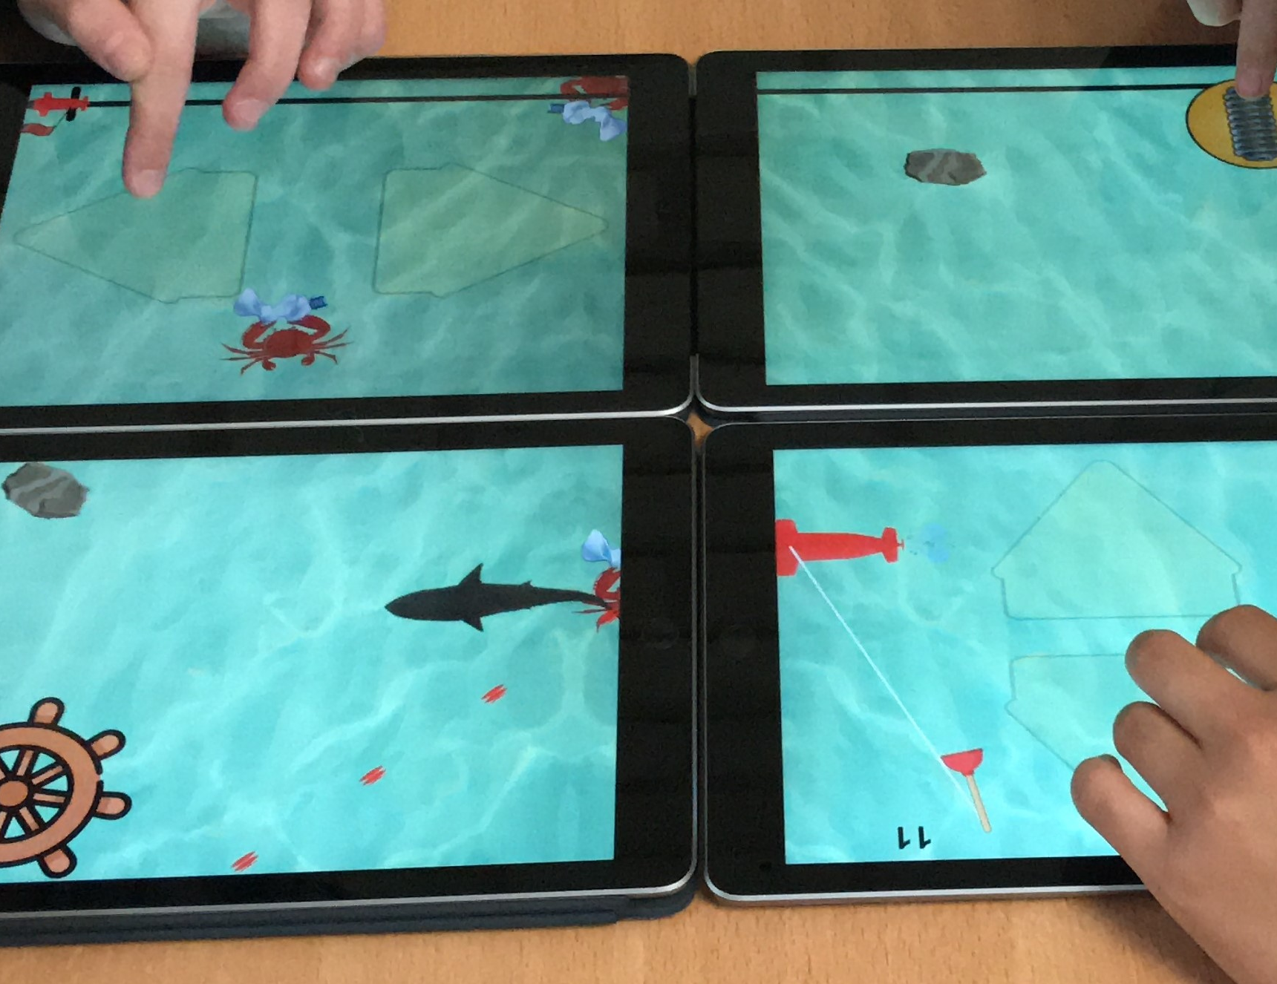
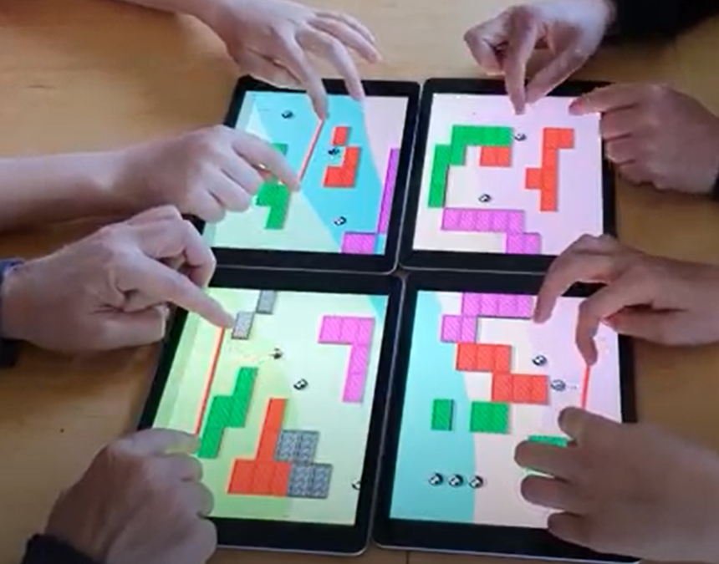
4in1 Sample Applications
So far Games
StringForce (1)
Subventure (2)
QuadroPong (3)
3
2
1
Notes:
Let’s wrap up this session by a very brief look at some 4in applications debleop in Gothenburg, Sweden and Aarhus, Denmark
StringForce (1)
Subventure (2)
QuadroPong (3)

Slide 29
StringForce
Shared goal – catch coins & avoid bombs
Collaborative action – move ring by pulling and releasing rope
Coordination through verbal communication
Symmetrical interaction
  All players have the same skills
Fast-paced
Notes:
StringForce is a fast-paced collaborative game where the shared goal is to use the ring attached to the four ropes to ctch coins and avoid bombs.
The main task in the game is to perform the collaborative action to move the ring around. This is done by pulling and releasing rope and requires involvement of all the participants.
The coordination of what to do is handled by verbal human-human interaction among the paricipants who must agree on where to move the ring
The game is based on symmetrical interaction where all players have the same skills and are equally important

Slide 30
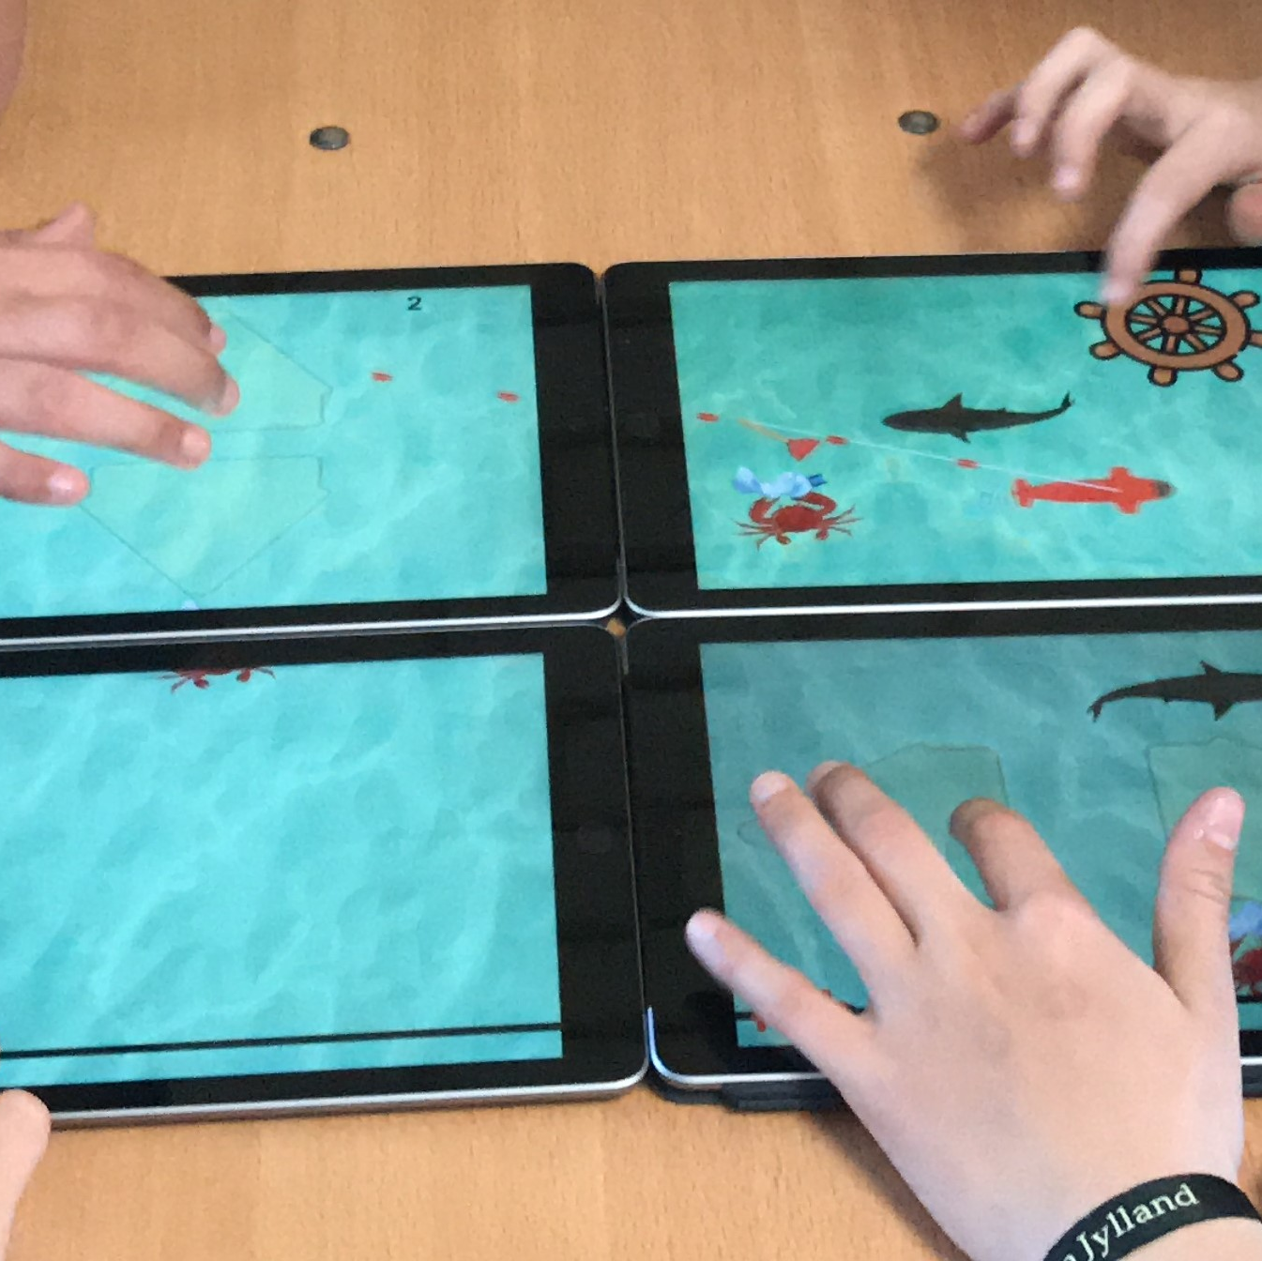
Subventure
Shared goal – collect trash
Collaborative action – move
submarine using controls
Coordination through verbal communication
Assymetrical interaction– each person has one task
Medium paced
Notes:
Subventure is a medium paced collaborative game where the shared goal is to collect trash.
The main collaborative action is to move a submarine (red) and place it where the trash is to collect it.
The players must coordinate their action to move the submarine since they control different aspects, e.g, steering, speed etc
Like in StringForce the players need to communicate and collaborate around what to do next to be able to reach the goal.

Slide 31
Quadropong
Shared goal – clear the board
No collaborative action
Order and resources matter
Coordination through verbal communication
Explores interdependency between players’ actions
Notes:
Quadropong is a variation of the classic pong game for four players.
Here the shared goal is to clear the board which is done by destroying the bricks with the use of balls.
In Quadropong there is no collaborative action instead collaboration is triggered by the distribution of reseources.
The players must use verbal human-human communication to discuss how to solve the problem of clearing the board and the levels of the game explore interdependency between players actions

Slide 32
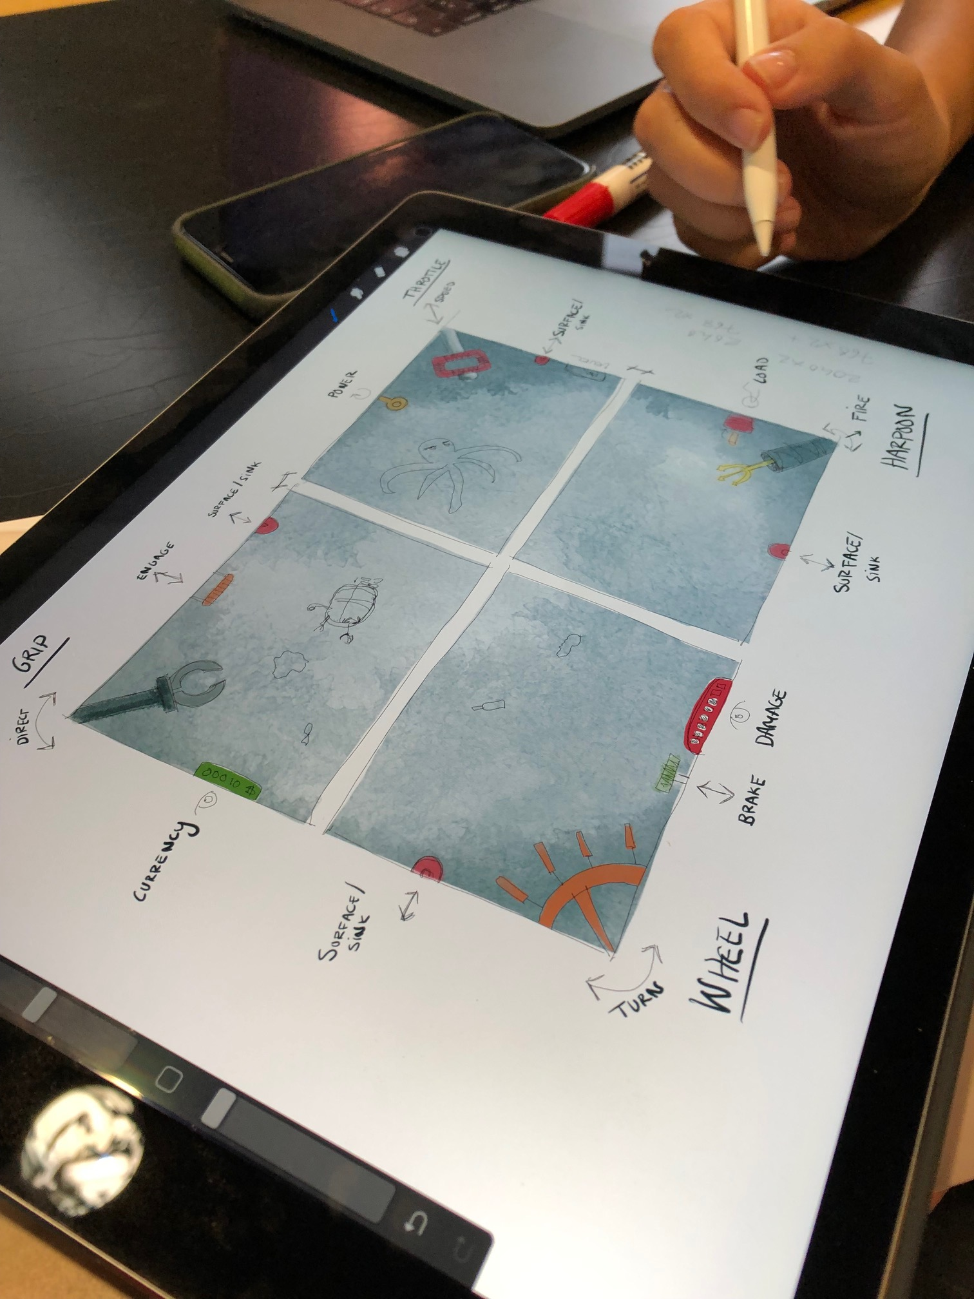
Summary
Combining many different devices is on old idea
Many different experiments have been carried out
One-device-one-display-one-user still dominating context
Taxonomy helps organising analysis and ideation
  Topology
  Coupling
  Interaction
4in1 Activities one concrete example
  Alternative low-cost tabletop
  Fully realizable using existing technologies
Endless possibilities
Notes:
To sum it all up.
We have been talking about combining several displays in various ways to form a combined interactive multi-display environment.
This is an old idea that was thouroughl discussed by Weiser in a very influential paper more than 30 years ago.
Since then many different experiments have been carried out.
While there are contexts where MDE:s are used, e.g., big screens in concerts, it is fair to say that the dominating use is still sne-device-one-display-one-user
We have also presented a general taxonomy for MDE:s
This is an effort to organize the knowledge around MDE:s which can be an aid for further research and development
The taxonomy is organised in three perspectives
Topology
Coupling
Interaction
Two of the main uses of the taxonomy are analysis and ideation. When the taxonomy is used for analysis it can for instance be a way to group and categorise MDE:s
When it’s used for ideation the different persoectives and their dimensions can be used to set up constraints and bring the design process forward
Last we presented a concreta example the collaborative multi-design environment 4in1 activities.
This can be seen as a low-cost tabletop and is fully realisable using existing technologies.
Still we have only scratched the surface and the possibilities for what can be done by combining severl displays are endless

Slide 33
References
Barendregt, W., Börjesson, P., Eriksson, E., & Torgersson, O. (2017). StringForce: A Forced Collaborative Interaction Game for Special Education. In Proceedings of the 2017 Conference on Interaction Design and Children (IDC '17). Association for Computing Machinery, New York, NY, USA, 713–716. https://doi.org/10.1145/3078072.3091987
Garcia-Sanjuan, F., Jaen, J., & Nacher, V. (2016). Toward a General Conceptualization of Multi-Display Environments. Frontiers in ICT, 3. doi:10.3389/fict.2016.00020
Eriksson, E., Petersen, J. O., Bagge, R., Kristensen, J. B., Lervig, M., Torgersson, O., & Baykal, G. E. (2022). Quadropong - Conditions for Mediating Collaborative Interaction in a Co-located Collaborative Digital Game using Multi-Display Composition. In Adjunct Proceedings of the 2022 Nordic Human-Computer Interaction Conference (NordiCHI '22). Association for Computing Machinery, New York, NY, USA, Article 25, 1–2. https://doi.org/10.1145/3547522.3547721.
Weiser, M. (1991). The Computer for the 21 st Century. Scientific American, 265(3), 94–105. http://www.jstor.org/stable/24938718

Slide 34

Thanks for listening
Disclaimer: The European Commission's support for the production of this publication does not constitute an endorsement of the contents, which reflect the views only of the authors, and the Commission cannot be held responsible for any use which may be made of the information contained therein

