Slide 1


Working with CoCe
Designing for Collaborative Games
https://tedco.se/
Notes:
Requirements – to understand and use this lecture it is recommended to have a reasonable understanding of design patterns and the contents of the recommended readings
Hello,
Today we will be working with designing for collaborative games with focus on the use of gameplay design patterns

Slide 2
Summary & Learning goals
The students are introduced to using a design space as a generative tool for design of collaborative games.
Learning goals:​
Recognize a few gameplay design patterns that are relevant for the design of collaborative games
Analyze how a framework in the form of a design space can be useful for design of a collaborative game
Reflect on how gameplay design patterns can influence design of collaborative games

Slide 3
Recommended readings
Eriksson, E., Baykal, G. E., Torgersson, O., & Bjork, S. (2021). The CoCe Design Space: Exploring the Design Space for Co-Located Collaborative Games that Use Multi-Display Composition. In Designing Interactive Systems Conference 2021 (pp. 718–733): Association for Computing Machinery.
Notes:
There are the main readings related to this presentation, the first one is interesting since it defines the concept collaborative games and also identifies a number of factors relevant for design.
The second uses gameplay design pattern to create design space relevant for designing collaborative games

Slide 4
Exercise
Have a look at the CoCe design space and select at least one gameplay design pattern from each of the four perspectives
  This can be done randomly or by picking patterns that seem promising
Check the descriptions of the patterns at
http://gameplaydesignpatterns.org
Invent a concept for a co-located collaborative game that makes use of the select patterns
Check the CoCe framework to see if there are any more patterns that are relevant for your design and list these

Slide 5
Delivarable
Prepare a few slides where you
List the selected properties and values for your concept
Give a brief presentation of your concept. Using one or more sketches can be a good idea.
Describe how the selected gameplay design patterns affected your design concept
Good luck!

Slide 6
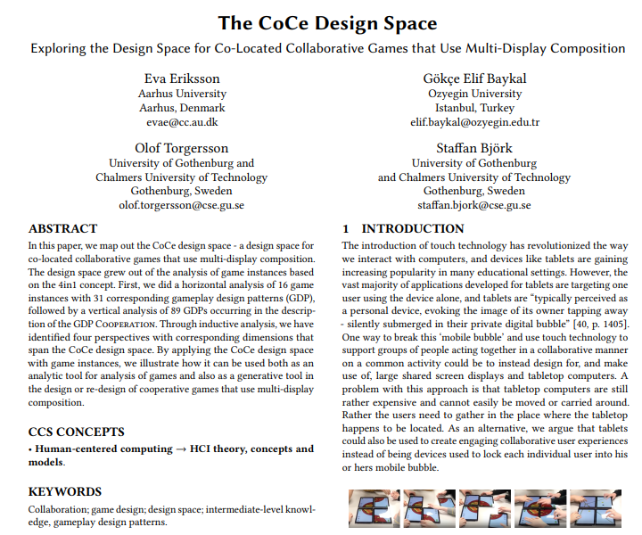
Designing for Co-located Collaborative Games
Presented the
concept collaborative game
Presented the concept
gameplay design pattern
Look at how patterns can be
used to form a design space
for collaborative games
Notes:
The remaining slides are only included for reference

Slide 7
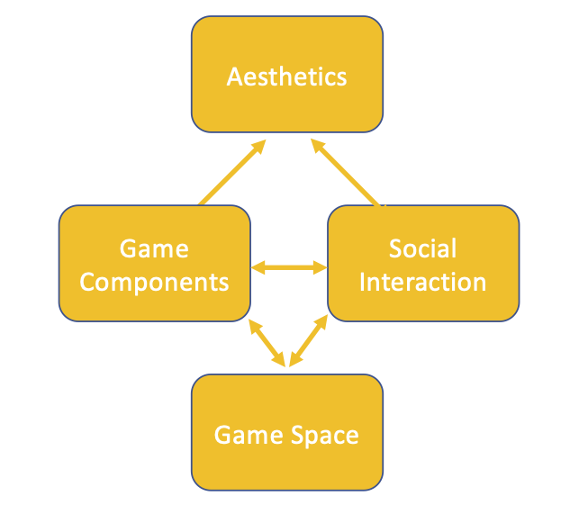
The CoCe Design Space
Four perspectives of collaborative games
where each perspective has several
dimensions
A design space spanned by gameplay
design patterns
A tool for analysis and design
Notes:
The CoCe design space is an attempt to create a design space capturing relevant properties of collaborative games
The design space consists of four different perspectives where each perspective provides a specifica way to look at collaborative games
The space spanned by design patterns, which means that in each perspective there are several dimensions ate for each dimension the design patterns are potential valiues
The desigfn space can be used for both analysis and design

Slide 8
CoCe Design Space Overview
GAME SPACE
Set-up | Mechanics
MULTI-PLAYER GAMES SPLIT SCREEN VIEWS | SYMMETRIC GAMEPLAY ASSYMETRIC GAMEPLAY
SOCIAL INTERACTION
Roles & Skills | Actions | Goals & Planning
TEAMS SOCIAL SKILLS AVATARS ABILITIES | COLLABORATIVE ACTIONS SYMBIOTIC PLAYER RELATIONS ALTRUISTIC ACTIONS | MUTUAL GOALS ASYMMETRIC GOALS TACTICAL PLANNING STIMULATED PLANNING
GAME COMPONENTS
Roles & Skills | Actions | Goals & Planning
NEW ABILITIES HANDLES COMPETENCE AREAS | GAME ITEMS FOCUS LOCI MOVEMENT | LEVELS RESOURCES SHARED REWARDS
AESTHETICS
Game space | Social Interaction | Game Components
TENSION COMPLEX GAMEPLAY | COMPLMENTARITY REFLECTIVE COMMUNICATION | GAMEPLAY MASTERY
Perspective
Dimensions
Gameplay design Patterns (examples)
Notes:
Herer is an overview showing how CoCe is divided into four perspectives, each consisting of some dimensions and each dimension contains patterns games can implement

Slide 9
The Game Components Perspective
3 dimensions
  Roles & Skills
  Actions
  Goals & Planning
28 patterns
Notes:
The game components perspective deals with matters related to the basics of gameplay and contains several patterns that are of a more general nature.,
that is they are not very specific for collaborative games.
In total there are 28 patterms in this perspective

Slide 10
The Social Interaction Perspective
3 dimensions
  Roles & Skills
  Actions
  Goals & Planning
24 patterns
Notes:
The social interaction perspective contains patterns about how things are done together.
For instance Teams talk about that one does things together and mutual goals about having the same goal to reach.
In total there are 24 patterms in this perspective

Slide 11
References
Barendregt, W., Börjesson, P., Eriksson, E., & Torgersson, O. (2017). StringForce: A Forced Collaborative Interaction Game for Special Education. In Proceedings of the 2017 Conference on Interaction Design and Children (IDC '17). Association for Computing Machinery, New York, NY, USA, 713–716. https://doi.org/10.1145/3078072.3091987
Bjork, S., & Holopainen, J. (2004). Patterns in game design (game development series). Charles River Media, Inc..
Eriksson, E., Baykal, G. E., Torgersson, O., & Bjork, S. (2021). The CoCe Design Space: Exploring the Design Space for Co-Located Collaborative Games that Use Multi-Display Composition. In Designing Interactive Systems Conference 2021 (pp. 718–733): Association for Computing Machinery.
Zagal, J. P., Rick, J., & Hsi, I. (2006). Collaborative games: Lessons learned from board games. Simulation & Gaming, 37(1), 24-40.

Slide 12
Disclaimer: The European Commission's support for the production of this publication does not constitute an endorsement of the contents, which reflect the views only of the authors, and the Commission cannot be held responsible for any use which may be made of the information contained therein
https://tedco.se/

