Slide 1
COLLABORATIVE SOCIETY: A CRITICAL PERSPECTIVE
https://tedco.se/

Slide 2
Summary & Learning Goal
The students are introduced with various cases of collaborative society (e.g., sharing economy, peer production, collaborative media consumption and production, collaborative knowledge) as described in the “Collaborative Society” book by Jemielniak & Przegalinska (2018). Students select one of the cases and discuss the influence of the collaborative case’s influence on different areas such as economy, culture, intimacy, safety, and social relationships. Topics for the final discussions is on how students would envision the controversies and the opportunities in the future of the collaborative society with respect to the current trends, the dilemma between positive and negative effects of collaborative society’s advances, and possible intermediating technologies on the future of collaboration.
Students will be able to:
• describe different cases of collaborative society.
• critically evaluate the influence of collaborative cases on different aspects of human interactions.
• elicit insight into the opportunities and challenges of the selected collaboration cases, and develop design ideas to improve current effects of collaborative society.
• build knowledge that combines theories around collaborative interaction into interaction design practices.

Slide 3
Content / Outline
Introduction to the concept of collaborative society
Modes of interaction in a technology mediated collaborative society
Cases of collaborative society: Discussion about the positive and negative influences
Future directions: opportunities and challenges

Slide 4
Recommended readings
Jemielniak, D. and Przegalinska, A. (2020) Collaborative Society. MIT Press

Slide 5
ORIGINS OF COLLABORATIVE SOCIETY
WHAT LIES BENEATH?
Prosocial behaviour such as helping, sharing, protecting or cooperating with others show its first signs as early as infancy ages in human life (Van de Vondervoort & Hamlin, 2018).
Recent views suggest prosociality lies in the basis of how human species evolved via selection, described as the "survival of the friendliest" (Hare, 2017).
Van de Vondervoort, J. W., & Hamlin, J. K. (2018). The early emergence of sociomoral evaluation: Infants prefer prosocial others. Current Opinion in Psychology, 20, 77 81. https://doi.org/10.1016/j.copsyc.2017.08.014
Hare, B. (2017). Survival of the friendliest: Homo sapiens evolved via selection for prosociality. Annual review of psychology, 68, 155-186. https://doi.org/10.1146/annurev-psych-010416-044201
Notes:
Studies show that the preference for prosocial behaviour in humans begins as early as infancy.
Thus, collaboration may be an evolutionary mechanism that emerged as a result of the way our early ancestors acquired cooperative practices regarding foods Sharing resources seems natural to us; indeed, much human sharing follows strong social norms of equity and fairness.

Slide 6
ORIGINS OF COLLABORATIVE SOCIETY
WHAT GOVERNS PROSOCIAL BEHAVIOR?
Desire to help to / ask for help from others as an intrinsic motivation.
Cost-benefit analysis as an altruistic motivation, for the sake of others' wellbeing.
Hepach, R., Vaish, A., & Tomasello, M. (2013). A new look at children’s prosocial motivation. Infancy, 18(1), 67-90. https://doi.org/10.1111/j.1532-7078.2012.00130.x
Sommerville, J. A., Enright, E. A., Horton, R. O., Lucca, K., Sitch, M. J., & Kirchner-Adelhart, S. (2018). Infants’ prosocial behavior is governed by cost-benefit analyses. Cognition, 177, 12-20. https://doi.org/10.1016/j.evolhumbehav.2022.10.003
Notes:
But what motivates the prosocial behaviour?
Some research suggests that mutualistic collaboration in human is an intrinsic motivation to survive that is a result of interdependence within a group, which also allows for skills specialization.
Some research suggests that infants’ prosocial behaviour is actually governed by basic cost-benefit analyses, and governed also by altruism, regarding other.

Slide 7
COLLABORATIVE SOCIETY
WHAT IS COLLABORATIVE SOCIETY? (according to Jemelniak & Przegalinska, 2020)
"Collaborative society is an emerging trend that changes the social, cultural, and economic fabric of human organization through technology fostered cooperative behaviours and interactions.
Emerging technologies, thanks to their direct collaboration-enabling features and their engagement of much broader populations, act as super-multipliers for many effects of collaboration that would otherwise be less noticeable."
Jemielniak, D. and Przegalinska, A. (2020) Collaborative Society. MIT Press, p. 4
​
Notes:
Collaborative society can also be viewed as a series of services and startups that enable peer-to-peer exchanges and interactions through technology.

Slide 8
COLLABORATIVE SOCIETY: MODES OF INTERACTION
COLLABORATIVE SOCIETY RELIES ON DIFFERENT MODES OF INTERACTION
➔ Sharing economy
➔ Joint creation
➔ Production
➔ Distribution
➔ Trade
➔ Consumption of goods and services by people, communities, and organizations.
Jemielniak, D. and Przegalinska, A. (2020) Collaborative Society. MIT Press
​
Notes:
Human collaboration enabled by technology can occur in specific contexts such as peer production and collaborative consumption, or more generally through online sharing and exchange platforms.
Emerging technologies, thanks to their direct collaboration enabling features and engagement of much broader populations, act as super-multipliers for many effects of collaboration that would otherwise be less noticeable.
●What are those direct collaboration enabling features?
●What do they rely on?

Slide 9
COLLABORATIVE SOCIETY: MODES OF INTERACTION
SHARING ECONOMY
The notion of sharing has become a marketing strategy
Economic transactions play a role in technology-enabled cooperation.
Proponents of open collaboration argue that online connectivity allows provisioning based on access rather than ownership
Something less corporate-driven and more equality based, or?
Jemielniak, D. and Przegalinska, A. (2020) Collaborative Society. MIT Press, p. 4
​
Notes:
Sort of a deconstruction of capitalism.
Proponents of open collaboration argue that online connectivity allows provisioning based on access rather than ownership, which enables better use of previously underutilized assets like cars, private rooms, apartments, and tools.
transform the capitalistic system and the whole of society into something much less corporate driven and more equality based.

Slide 10
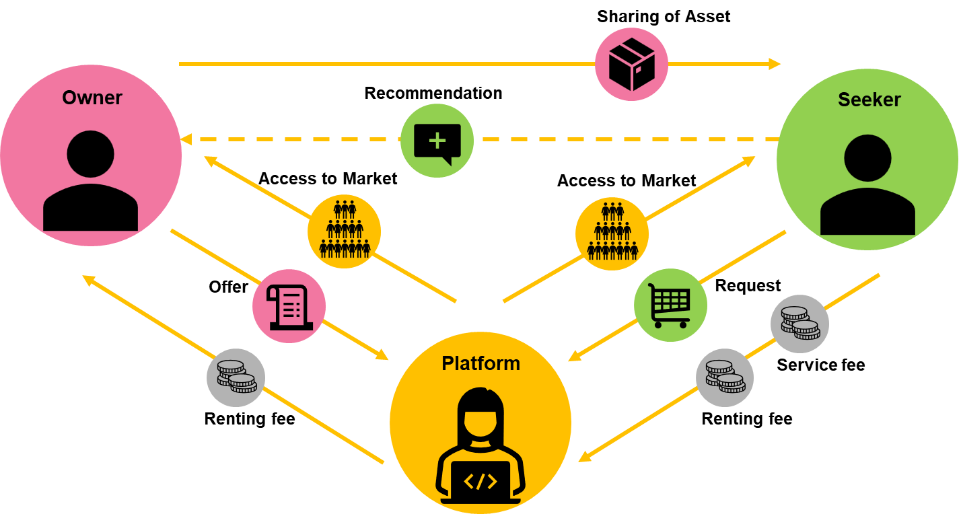
COLLABORATIVE SOCIETY: MODES OF INTERACTION
CASE 1: SHARED ECONOMY
Sharing Economy adapted from: https://bmtoolbox.net/patterns/sharing-economy/
Notes:
A diagram that shows what a general model of sharing economy is like.
Private customers share access to products or services with other private customers – a platform serves as intermediary.

Slide 11
COLLABORATIVE SOCIETY: MODES OF INTERACTION
CASE 1: UBER'S MODEL OF SHARED ECONOMY
Make additional income by being flexible, and without a boss
Avoid car ownership, and avoid inefficient car riding
Drivers
Riders
Looking at the future
Self-driving cars
electric scooters
bike sharing
Uber business model adapted from: https://fourweekmba.com/uber-business-model/
Notes:
Uber's business model is an example for a Sharing Economy.

Slide 12
COLLABORATIVE SOCIETY: MODES OF INTERACTION
CASE 1: UBER'S MODEL OF SHARED ECONOMY
Instances of news for taxi driver protests and strikes around Europe:
https://sverigesradio.se/artikel/stockholm-uber-and-bolt-taxi-drivers-out-on-strike
https://www.aa.com.tr/en/europe/european-taxi-drivers-protest-against-uber-in-brussels/2680288
https://www.politico.eu/article/europe-taxi-driver-block-brussels-uber-files-protest/
Jemielniak, D. and Przegalinska, A. (2020) Collaborative Society. MIT Press, p. 4
​
Notes:
unionized taxi drivers recently protested that apps such as Uber allow almost anyone with a driver's license to become a de facto taxi driver, but legal challenges in some jurisdictions have established that these people, whom the platform portrays as independent "sharers," are actually Uber employees.
to many owners who cannot compete with apps that impose fewer rules governing fares and vehicle equipment.

Slide 13
COLLABORATIVE SOCIETY: MODES OF INTERACTION
CASE 2: AIRBNB'S MODEL OF SHARED ECONOMY
Airbnb business model adapted from: https://bmtoolbox.net/stories/airbnb/
Notes:
Airbnb is a community-based online platform for listing and renting local homes. It connects hosts and travellers and facilitates the process of renting without owning any rooms itself. Moreover it cultivates a sharing-economy by allowing property owners to rent out private flats.

Slide 14
COLLABORATIVE SOCIETY: MODES OF INTERACTION
CASE 2: AIRBNB MODEL OF SHARED ECONOMY
European cities have responded differently to the growing number of short-term rentals (such as Airbnb) and proposed a variety of regulations, although little is known about their efficiency.
While Airbnb opens up some neighbourhoods to more tourists, it has sometimes proved unpopular with existing residents.
Hübscher, M., & Kallert, T. (2023). Taming Airbnb Locally: Analysing Regulations in Amsterdam, Berlin and London. Tijdschrift voor economische en sociale geografie, 114(1), 6-27. https://doi.org/10.1111/tesg.12537
​
Notes:
While Airbnb opens up some neighbourhoods to more tourists, it has sometimes proved unpopular with existing residents.
Some fear property owners are switching from long-term tenancies to short-term rentals, which can be more lucrative.
●the rapid growth of Airbnb has wreaked the hotel industry and the apartment rental market.

Slide 15
COLLABORATIVE SOCIETY: MODES OF INTERACTION
OPEN COLLABORATION
➔Open collaboration is a form of organization and cooperation in which participants share a common goal but are loosely coordinated, yet together they create a product or service and make the final result available to anyone interested.
➔Open collaboration communities often rely on common discussions, but interactions among their participants are usually optional and depend on the depth and complexity of the collaboration.
Jemielniak, D. and Przegalinska, A. (2020) Collaborative Society. MIT Press
​
Notes:
●The idea, which originated in free open source development circles
●operating system that would be available, free of charge, to use, study, change, and redistribute
●one example being in the open knowledge movement, which directly draws from free/open source culture and tradition.

Slide 16
COLLABORATIVE SOCIETY
PEER PRODUCTION
➔ Producing shared values: creation of good or services that possess either some concrete value (e.g., Wikipedia) or potential monetary value (e.g., Yelp).
➔ Content sharing (e.g., 9GAG, Imgur)
➔ Performing a task together, just for fun, sometimes with no concrete end product at all (e.g., Minecraft, Scratch)
➔ Semi-anonymous
Jemielniak, D. and Przegalinska, A. (2020) Collaborative Society. MIT Press
​
Notes:
… consider Wikipedia, The Pirate Bay, 4chan, Tinder, and Twitter, for instance. While only moderately affecting trade, these repositories redefine not only the traditional knowledge hierarchy, but also our trust in intimacy, matchmaking, and friendship, as well as in public and private communication.
peer production's important role in the transformation of collaborative society, and especially to how it embodies aspects of the ongoing change.

Slide 17
COLLABORATIVE SOCIETY
COLLABORATIVE MEDIA PRODUCTION
➔Rise of the amateur
➔User-generated media
➔Long term peer production
➔Consumer co-production
➔Civic engagement or freedom-of-information oriented approach
➔Creating, editing, publishing and distributing media (e.g., Spotify, Deezer, YouTube, Shutterstock)
Jemielniak, D. and Przegalinska, A. (2020) Collaborative Society. MIT Press
​

Slide 18
COLLABORATIVE SOCIETY
COLLABORATIVE SOCIAL ACTIVISM AND HACKTIVISM
➔ Actions and movements relying on increasing number of people join and take part (e.g. #wildfire, #climatechange)
➔ Awareness/advocacy (e.g., #HiddenHeroes or Earth Hour by WWF)
➔ Organization/mobilization (e.g., #OccupyWallStreet movement)
➔ Action/reaction (e.g., #MeToo against sexual abuse, #BlackLivesMatter against racism hashtag campaigns)
Jemielniak, D. and Przegalinska, A. (2020) Collaborative Society. MIT Press
​
Notes:
movement's now-famous hashtag.

Slide 19
COLLABORATIVE SOCIETY
THE MANY FACES OF HACKTIVISM
➔Activism vs. hacktivism?
➔Implicitly being against “the system”
➔Hacking as a form of activism (e.g., Wikileaks)
➔But a "hack" may also refer to cybercrime, or malicious activism
Jemielniak, D. and Przegalinska, A. (2020) Collaborative Society. MIT Press
​
Notes:
the underground use of technology to promote political causes, whereas collaborative social activism, and the self-tracking relies on collaboration without implicitly being against "the system."
For example, check Upload TV fiction series as a form of hacktivism in autonomous cars; what if an owner of an autonomous car hacks his own car's software and make an intentional accident?

Slide 20
Summary/take home
Human collaboration is an innate skill for human species, but a complex phenomenon
We are in an age of networked individualism fostered by perpetual online connectedness.
From a critical perspective, collaborative society entails a great deal of capitalistic philosophy relies on positioning people as individualist, and mainly Homo economicus, rather than as being interested in participatory culture.
The coin has two sides and utilizing tools for positive impact (e.g. connecting people for solidarity, safety, productivity, etc.) is important.

Slide 21
References
Hare, B. (2017). Survival of the friendliest: Homo sapiens evolved via selection for prosociality. Annual review of psychology, 68, 155-186. https://doi.org/10.1146/annurev-psych-010416-044201
Hepach, R., Vaish, A., & Tomasello, M. (2013). A new look at children’s prosocial motivation. Infancy, 18(1), 67-90. https://doi.org/10.1111/j.1532-7078.2012.00130.x
Hübscher, M., & Kallert, T. (2023). Taming Airbnb Locally: Analysing Regulations in Amsterdam, Berlin and London. Tijdschrift voor economische en sociale geografie, 114(1), 6-27. https://doi.org/10.1111/tesg.12537
Jemielniak, D. and Przegalinska, A. (2020) Collaborative Society. MIT Press.
Sommerville, J. A., Enright, E. A., Horton, R. O., Lucca, K., Sitch, M. J., & Kirchner-Adelhart, S. (2018). Infants’ prosocial behavior is governed by cost-benefit analyses. Cognition, 177, 12-20. https://doi.org/10.1016/j.evolhumbehav.2022.10.003
Van de Vondervoort, J. W., & Hamlin, J. K. (2018). The early emergence of sociomoral evaluation: Infants prefer prosocial others. Current Opinion in Psychology, 20, 77 81. https://doi.org/10.1016/j.copsyc.2017.08.014

Slide 22
Disclaimer: The European Commission's support for the production of this publication does not constitute an endorsement of the contents, which reflect the views only of the authors, and the Commission cannot be held responsible for any use which may be made of the information contained therein
https://tedco.se/

