Slide 1
Evaluation of technologies for collaborative interaction

Slide 2
Summary & Learning outcome
The students learn how to evaluate the user experiences with the system. Students list the methods of evaluating user experience, and propose which method works best for their own system. Students also reflect on why studying user experiences is important, and in which phases of the design process this can play a meaningful role.
Students are able to explain the difference between formative and summative evaluation
Students are able to explain the difference between analytical evaluation and user testing
Students are able to come up with examples of methods to evaluate collaborative technologies that fall within either of the four types

Slide 3
Recommended readings
Ramage, Magnus (2010). Evaluating collaborative technologies: a simple method. In: Donelan, Helen; Kear, Karen and Ramage, Magnus eds. Online Communication and Collaboration: A Reader. Abingdon: Routledge, pp. 73–77.
Sharp, Preece, & Rogers. 2019. Interaction Design: Beyond Human-Computer Interaction. Chapter 14. John Wiley & Sons. ISBN: 111954730X, 9781119547303

Slide 4
Content
Why, when, and how to evaluate
Evaluation approaches
Formative versus summative
Analytical versus user testing
An evaluation framework
Summary
References

Slide 5
Why, when and how to evaluate

Slide 6
Why evaluate?
Check that users can use the technology for collaborative interaction
Note that ‘designers are not users’ (Jacob Nielsen)
Get feedback about early design ideas
Evaluation does not have to wait until the final product
Find out which problems occur in the design
Allowing you to fix major problems before final design

Slide 7
When to evaluate?
It depends
If the technology is new, evaluate after initial sketches
If the technology exists, this might be the first step
Evaluation during design is called formative evaluation
Comparison with benchmark or competitive technology for collaborative interaction is called summative evaluation

Slide 8
Formative Evaluation:
during development
Summative Evaluation:
after development
Notes:
In general, there are many different testing methods out there and these can be organized according to some global differences among them.
One such difference relates to when you do the testing: is it during the development to make your product better? or is it after the development to check whether your product meets some requirements or standards?

Slide 9
Formative evaluation: Strengthens or improves the product design
Often formative evaluations are done at an earlier stage than summative evaluations
Formative Evaluation:
during development
Summative Evaluation:
after development
Notes:
Formative evaluations are done when you're in your design process. In them, you're interested in input that can make your product better and on changes that might strengthen it

Slide 10
Formative evaluation: Strengthens or improves the product design
Often formative evaluations are done at an earlier stage than summative evaluations
Formative Evaluation:
during development
Summative evaluation examines and summarizes the effects or outcomes of a product design.
Summative Evaluation:
after development
Notes:
Summative evaluations, instead, occur after the design process. In them, you’re interested in examining and summarizing the effects or outcomes of your product or design. These might happen when the product is already on the market.

Slide 11
How to evaluate?
Analytical evaluation
Involve an expert-role
One who is practiced in usability methods
Usability testing
Testing the technology rather than the user
Use of the technology often recorded
Sometimes a specific hypothesis is tested

Slide 12
Formative evaluation: Strengthens or improves the product design
Often formative evaluations are done at an earlier stage than summative evaluations
Formative Evaluation:
during development
Analytical Evaluation:
without users
User Testing:
with users
Summative evaluation examines and summarizes the effects or outcomes of a product design.
Summative Evaluation:
after development
Notes:
Another difference in evaluation methods is whether they involve users or not in the testing.

Slide 13
Formative evaluation: Strengthens or improves the product design
Often formative evaluations are done at an earlier stage than summative evaluations
Formative Evaluation:
during development
Analytical evaluation: Involves only experts, these experts report on possible problems. This can be seen as a prediction of what will happen when real users use the product.
Analytical Evaluation:
without users
User Testing:
with users
Summative evaluation examines and summarizes the effects or outcomes of a product design.
Summative Evaluation:
after development
Notes:
On the one side, we have analytical evaluations where no user is involved and the evaluation is done by design experts with specific user testing methods. These experts report on possible problems, and these problems can be seen as a prediction of what would happen when real users use the product.

Slide 14
Formative evaluation: Strengthens or improves the product design
Often formative evaluations are done at an earlier stage than summative evaluations
Formative Evaluation:
during development
Analytical evaluation: Involves only experts, these experts report on possible problems. This can be seen as a prediction of what will happen when real users use the product.
Analytical Evaluation:
without users
User Testing:
with users
User Testing: Involves real users, shows what really happens in the lab or in a more informal setting.
The users involved in user testing do not evaluate the product, they only interact with it so that the team/evaluation expert understands their reactions.
Summative evaluation examines and summarizes the effects or outcomes of a product design.
Summative Evaluation:
after development
Notes:
On the other side, we have the actual testing with users. This testing shows what really happens in the lab or in a more informal setting.
The users involved in user testing do not evaluate the product, they only interact with it. It is the team/evaluation experts who study their reactions and use them as inputs to re-design or make changes to the product.

Slide 15
Evaluation approaches

Slide 16
Formative Evaluation:
during development
Analytical Evaluation:
without users
User Testing:
with users
Summative Evaluation:
after development
Notes:
So if we take this diagram again and we plot in different evaluative methods…

Slide 17
Formative Evaluation:
during development
Cognitive walkthrough
Heuristic evaluation
Analytical Evaluation:
without users
User Testing:
with users
Summative Evaluation:
after development
Notes:
…we could start with the cognitive walkthrough and heuristic evaluation. These are both analytical methods so they do not involve any user and they are formative methods meaning that they are focused on finding out which aspects of our products we can improve in early stages of product development.

Slide 18
Cognitive walkthrough
Before you can start a cognitive walkthrough, you need a complete, written list of the actions needed to complete the task with the interface — the ‘happy path’
Sometimes, creating the happy path is all you need to do to realize there is a problem with the interface
If your happy path has many actions, there's no need to continue with the review: you've found a serious problem already
Once you have the happy path, you’re ready to start the walkthrough
1
2
3
Notes:
A cognitive walkthrough is a task-based analytical evaluation method (done by a usability expert) and is formalized as a way of imagining a user’s actions and thoughts when using a product for the first time.
Before the experts start a cognitive walkthrough, they need a list of the actions needed to complete the task in the interface —the so called ‘happy path’.
Sometimes, creating the happy path is all you need to do to realize that there is a problem with your interface. If your happy path has many actions, for instance, there's no need to continue with the evaluation as you've found a serious problem already.
Once you have the happy path, you’re ready to start the walkthrough.

Slide 19
Cognitive walkthrough
One or more expert evaluators perform the evaluation by walking through the steps, placing it in the context of a certain scenario
They ask themselves four questions
1
2
3
Notes:
They ask themselves four questions
1. Will the user try to do the right action?
2. Will the user notice that the correct action is available?
3. Will the user associate the correct action with the effect to be
achieved?
4. If the correct action is performed, will the user see that progress is being made toward solution of the task?

Slide 20
Cognitive walkthrough
One or more expert evaluators perform the evaluation by walking through the steps, placing it in the context of a certain scenario
They ask themselves four questions
The evaluator attempts to come up with a “success story” for each step in the process. If they cannot come up with one, they instead create a “failure story” and assess why the user might not accomplish the task based on the interface design. These insights are then used to improve the design
1
2
3
Notes:
They ask themselves four questions
1. Will the user try to do the right action?
2. Will the user notice that the correct action is available?
3. Will the user associate the correct action with the effect to be
achieved?
4. If the correct action is performed, will the user see that progress is being made toward solution of the task?

Slide 21
Cognitive walkthrough
Advantages:
Can find problems before an expensive user test
Can find problems that would not be found when only testing with a small number of users
Disadvantages:
The value of the data is limited by the skills of the evaluators
Analysis focuses on the words and graphics used on the screen (mostly suited for interfaces)
Lack of info on frequency and severity of problems
Labor intensive
Notes:
The cognitive walkthrough has obvious advantages. It helps designers identify problems before doing an expensive user test or finding problems that you would not be able to find when testing with a small number of users.
But it also has disadvantages: the value of the data is limited by the skills of the evaluators and the evaluation might yield a relatively superficial and narrow analysis that focuses on the words and graphics used on the screen.
Besides, the method is labor intensive and does not provide an estimate of the frequency or severity of identified problems. Finally, the method overlooks the perspective of the user as it is based on experts’ assumptions.

Slide 22
Heuristic evaluation
First developed by Jakob Nielsen for desktop applications.
A cheap and easy evaluation method, and the most popular of the usability analytical methods
Small set of evaluators (3-5) examines a technology and judges its compliance with recognized usability principles
Each individual evaluator inspects the interface alone
After all evaluations have been completed the evaluators meet, exchange their conclusions, and aggregate their findings

Slide 23
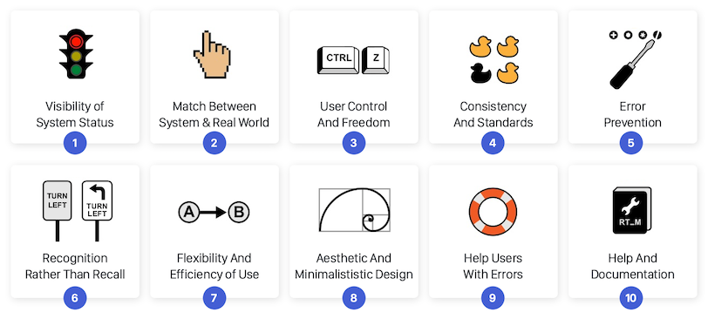
Heuristic evaluation
The most famous heuristics are the 10 usability principles developed by Jackob Nielsen
https://www.interaction-design.org/literature/article/ user-interface-design-guidelines-10-rules-of-thumb

Slide 24
Formative Evaluation:
during development
Cognitive walkthrough
Heuristic evaluation
Analytical Evaluation:
without users
User Testing:
with users
Summative Evaluation:
after development

Slide 25
Formative Evaluation:
during development
Cognitive walkthrough
Usability test: problem identification
Heuristic evaluation
Analytical Evaluation:
without users
User Testing:
with users
Summative Evaluation:
after development
Notes:
On the other hand, we could do usability tests where we do problem identification with the users so we try to find out whether and where users run into issue when using a prototype.

Slide 26
Usability test: problem identification
Can be done on a (paper) prototype, a partly developed product, or an almost finished product
Usually follows the Thinking Aloud protocol
Goal: To understand how the user approaches the interface and what considerations the user keeps in mind when using the interface -> detect usability problems
Notes:
Finally the usability test so this is something that is done with actual users and here I'm going to talk mainly about the usability test for problem identification.
This testing can be done on a paper prototype or a wireframe. It can be done on a partially developed prototype or even almost finished one.
Usually the usability test follows a thinking aloud protocol where you ask the user to perform a specific action on the system. Participants should express out loud which steps they follow, and whatever comes to their mind while performing the task. This includes anything from what they are looking at, thinking and feeling.
The goal is to understand how the user really approaches the interface and what obstacles and problems they might encounter in the process. The aim is to detect problems that might occur when people use the interface.

Slide 27
Usability test: typical misconception
Many people think you do a user test on a finished product to prove/show that the product is good
As you now know: User/Usability testing is not typically done at the end
A usability test is often meant to detect problems, not to show that there are no problems -> a summative test can be done at the end if clear requirements have been defined beforehand (e.g., how long it should take for the user to perform a task)
Notes:
A typical misconception that people have when we're talking about user testing is that they think it is aimed at showing that the product is good. In reality, user testing is not done with this thought in mind. It's a formative test so the core objective is to find problems and not to show that there are no problems.
So you should not use a usability test if you only want to know whether your product is something that people would like or use. For that, you could do a summative test at the end of your project but to perform that properly you need to have established some requirements or metrics beforehand (e.g., how long it should take for the user to perform the task? establish an optimal usability score)

Slide 28
Usability test: users
Most often advised: 3-5 users
The reason for this suggested number is that one user might find only a part of your product’s problems
The second user will find some additional problems, which might overlap with those of the first user or could also be new ones
When do you stop finding new problems?
Notes:
The reason for the suggested number of participants is that one user might find only a part of your product’s problems.
A second user might find some additional problems, which might overlap with those of the first user or could also be new ones.
The more users you include the more overlapping problems you will find. However, you will also find some new problem.
So when is it that you stop finding new problems?

Slide 29
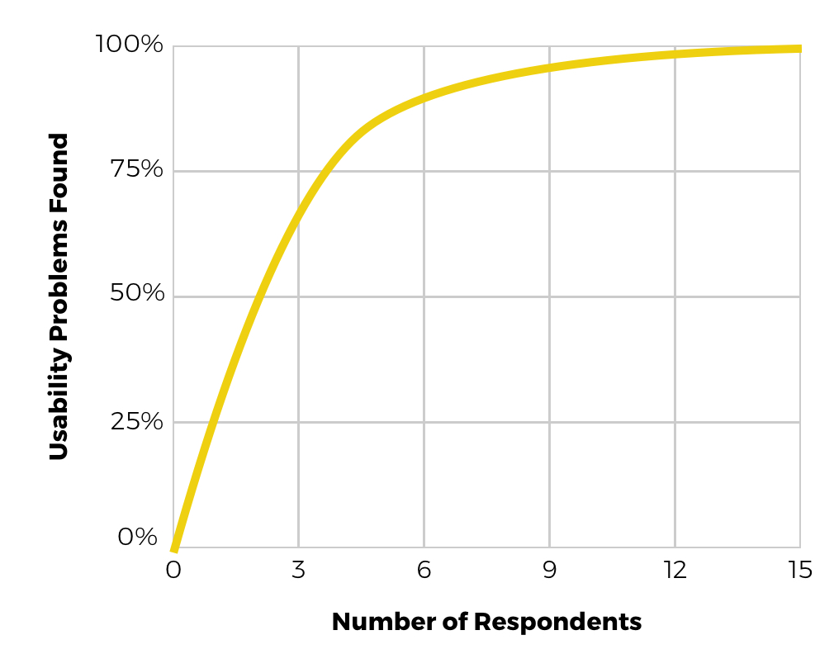
Usability test: users
What this graph tells us:
Testing with zero users gives zero insights
Testing with a single user already gives about 31% of all usability problems
5 users give you insights on 80% of the problems
With 15 respondents, you will find 100% of the problems
Notes:
What this graph tells us is that:
Testing with zero users gives zero insights, so testing with one single user is always better than not testing at all
Testing with a single user already give you about 30% of all usability problems in your design
Testing with an additional user shows that there is some overlap in findings, but also some new insights.
After fifteen respondents you generally won’t find any new problems

Slide 30
Formative Evaluation:
during development
Cognitive walkthrough
Usability test: problem identification
Heuristic evaluation
Analytical Evaluation:
without users
User Testing:
with users
Guidelines checking
Summative Evaluation:
after development
Notes:
Other methods are guidelines checking. This is an analytical evaluation so there is an expert that looks at guidelines and determines whether the product fits those guidelines. The result of this process would take the shape of a report with the number of guidelines followed.

Slide 31
Formative Evaluation:
during development
Cognitive walkthrough
Usability test: problem identification
Heuristic evaluation
Analytical Evaluation:
without users
User Testing:
with users
Usability metrics
Questionnaires (UEQ)
Guidelines checking
User Studies
Summative Evaluation:
after development
Notes:
Finally, we could use user testing metrics, for example checking temporal aspects of the interaction, such as how fast someone is able to complete an action on a website.
Or we could ask participants to fill out experience questionnaires, such as the user experience questionnaire and gather their perception of the system.

Slide 32
Summative methods
Guidelines checking
The team makes a list of guidelines. An evaluator checks whether the product implements all guidelines and reports back to the team
Usability testing metrics
If the team has set up metrics for the final product (e.g., a user should be able to perform a certain task within x seconds), a test can be done to see whether users are indeed able to do so
Questionnaires
Questionnaires such as the User Experience Questionnaire (https://www.ueq-online.org/) could be used to assess UX metrics
Notes:
Guidelines checking: The team makes a list of guidelines. An evaluator checks whether the product implements all guidelines and reports back to the team.
Usability testing metrics: If the team has set up metrics for the final product (e.g., a user should be able to perform a certain task within x seconds), a test can be done to see whether users are indeed able to do so.
Questionnaires: Questionnaires such as the User Experience Questionnaire (https://www.ueq-online.org/) could be used to assess UX metrics.

Slide 33
User testing vs. Analytical methods
User Testing method
Analytical method
HITS
Misses
False alarms
Hits
Notes:
So as we said, we have the user testing methods and the analytical methods done by the experts.
User testing methods will give you a set of problems, and analytical methods will also identify a set of problems.
the hits are those problems that are identified by both users and experts, but then there might be also misses, so problems that user testing contributes identifying but experts could not predict, and false alarms, so issues that experts predict but that do not occur in user testing.
So usually the user testing is considered to be the baseline and if we want to use some additional analytical method, you always have to check if it overlaps with what you found with the user testing methods.

Slide 34
Examples with technologies for collaborative interaction

Slide 35
Example: Discord
Discord is a communications app in which voice, video, and text chat are shared with others
If we want to detect potential problems with the interface, we can do a user study
Ask users to open the app and do several tasks that are specific for the functionality of Discord
While doing the tasks, they could think out loud, allowing us to easily find out what barriers they face in terms of usability
Outcomes of the user study will inspire further development, fixing some issues that harm its usability

Slide 36
Example: Discord (continued)
Now imagine the app were to be used for tracking communication in a school where:
Each class has their own channel
Each channel has its own subgroups for different assignments
Each assignment is performed by several groups of students
The users of the app are groups of groups, where each individual student could be in multiple groups
The user study could take this into account by:
Including tasks in the think-out-loud protocol that span groups
Include users from multiple groups to combine experiences

Slide 37
Example: Miro
Miro is an online collaborative whiteboard that enables distributed teams to work together and brainstorm with digital sticky notes, plan or manage agile workflows
Imagine we have just begun developing the platform and we want to do a heuristic evaluation
We would ask experts to judge the app on usability principles
As the app represents a real-life whiteboard with sticky notes, we would check the extent to which it matches a physical board
We would also want to check the amount of control users have
Together this will inform us about the expected usability

Slide 38
Summary
A number of different evaluation approaches were introduced that can be used to evaluate the design and use of technologies for collaborative interaction
The approaches can be classified as formative or summative, and analytical or user testing
Example evaluation approaches of existing apps were shown

Slide 39
References
Collazos, C. A., Guerrero, L. A., Pino, J. A., Renzi, S., Klobas, J., Ortega, M., Redondo, M. A., & Bravo, C. (2007). Evaluating Collaborative Learning Processes using System-based Measurement. Educational Technology & Society, 10 (3), 257-274
Damianos, L., Hirschman, L., Kozierok, R., Kurtz, J., Greenberg, A., Walls, K., ... & Scholtz, J. (1999). Evaluation for collaborative systems. ACM Computing Surveys, 31(2)
Mandryk, R. L., & Inkpen, K. M. (2004, November). Physiological indicators for the evaluation of co-located collaborative play. In Proceedings of the 2004 ACM conference on Computer supported cooperative work (pp. 102-111).
Malone, T. W., and Crowston, K. (1994). The interdisciplinary study of coordination. ACM Computing Surveys, 26(1), 87-119.
Neale, D. C., Carroll, J., & Rosson, M. B. (2004). Evaluating computer-supported cooperative work: Models and frameworks. 112-121. Paper presented at Computer Supported Cooperative Work - Conference Proceedings, CSCW 2004, Chicago, IL, United States.
Olsson, T., Jarusriboonchai, P., Woźniak, P. et al. Technologies for Enhancing Collocated Social Interaction: Review of Design Solutions and Approaches. Comput Supported Coop Work 29, 29–83 (2020).
Ramage, Magnus (2010). Evaluating collaborative technologies: a simple method. In: Donelan, Helen; Kear, Karen and Ramage, Magnus eds. Online Communication and Collaboration: A Reader. Abingdon: Routledge, pp. 73–77.
Reddy, M. C., Shabot, M. M., & Bradner E. (2008). Evaluating collaborative features of critical care systems: A methodological study of information technology in surgical intensive care units, Journal of Biomedical Informatics, 41 (3), 479-487
Sharp, Preece, & Rogers. 2019. Interaction Design: Beyond Human-Computer Interaction. Chapter 14. John Wiley & Sons. ISBN: 111954730X, 9781119547303
Sharp, Preece, & Rogers. 2019. Interaction Design: Beyond Human-Computer Interaction. Chapter 15. John Wiley & Sons. ISBN: 111954730X, 9781119547303
Sharp, Preece, & Rogers. 2019. Interaction Design: Beyond Human-Computer Interaction. Chapter 16. John Wiley & Sons. ISBN: 111954730X, 9781119547303

Slide 40
Thanks for listening Disclaimer: The European Commission's support for the production of this publication does not constitute an endorsement of the contents, which reflect the views only of the authors, and the Commission cannot be held responsible for any use which may be made of the information contained therein

