Slide 1


Designing for Mobile Co-located Collaborative Interaction
https://tedco.se/
Notes:
To use this materieal it is recommended to have a fair idea about the contents of
Lundgren, S., Fischer, J. E., Reeves, S., & Torgersson, O. (2015). Designing Mobile Experiences for Collocated Interaction.
Paper presented at the Proceedings of the 18th ACM Conference on Computer Supported Cooperative Work &amp; Social Computing, Vancouver, BC, Canada. https://doi.org/10.1145/2675133.2675171
Hello,
Today we will be talking designing for mobile co-located interaction, that is how mobile technologies can be used as a tool for mediating collaborative activities

Slide 2
Summary & Learning goals
The students are introduced to the concept of designing for co-located collaborative interaction mediated by technology. A framework for designing co-located mobile interactions is presented that can be a useful tool for work in this area.
Learning goals:​
The students will be able to
recognize the need and possibilities for co-located interactions.
describe relevant factors for mediating co-located interactions
analyse the design of technologies for co-located interactions
Notes:
In this lecture we will look into designing for co-located interaction mediated by technology mainly through
the lens of a framework for designing co-locatef mobile interactions
The learning goals are
recognize the need and possibilities for co-located interactions.
describe relevant factors for mediating co-located interactions
analyse the design of technologies for co-located interactions
reflect on the consequences of using technology to support co-located interaction

Slide 3
Recommended readings
Lundgren, S., Fischer, J. E., Reeves, S., & Torgersson, O. (2015). Designing Mobile Experiences for Collocated Interaction. Paper presented at the Proceedings of the 18th ACM Conference on Computer Supported Cooperative Work &amp; Social Computing, Vancouver, BC, Canada. https://doi.org/10.1145/2675133.2675171
Olsson, T., Jarusriboonchai, P., Woźniak, P., Paasovaara, S., Väänänen, K., & Lucero, A. (2020). Technologies for Enhancing Collocated Social Interaction: Review of Design Solutions and Approaches. Computer Supported Cooperative Work (CSCW), 29(1), 29-83. doi:10.1007/s10606-019-09345-0
Notes:
There are two recommended readings related to this presentation
The first one talks about designing mobile experiences for co-located interaction and presents a framework that can be used for design and analysis, the second is a review of work in this area.
The presentation order is that things based on the second paper come first

Slide 4
Contents
Collaborative Interaction
Co-located Collaborative Interaction
Areas for Improvement
Co-located Mobile Interaction
Bursting the Mobile Bubble
Designing for Co-located Interaction
Key Applications
Example
Summary
References
Notes:
Here is an outline of what we will talk about today
It starts out with some general words about collaborative interaction followed by co-located interaction and possible areas for improvement
We then look specifically at co-located mobile interaction and how to deal with an idea called bursting the mobile bubble
Then we present a framework targeting designing for co-located interaction, some key applications of its use and some example before summing it all up.

Slide 5
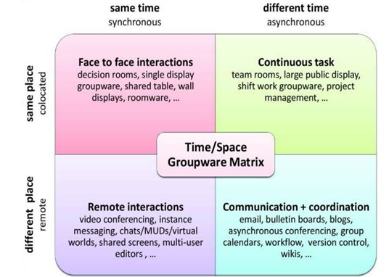
COLLABORATIVE INTERACTION
Photo credit: https://public-images.interaction-design.org/literature/articles/heros/566d806939506.jpg?tr=w-1024
Notes:
Technologies mediating collaborative interaction can broadly be classified according to this well-know groupware matrix.
It categorizes systems into the two dimensions time and space where thinsg can happen at the same place or in different places and at the same time or different times
For instance, online meetings with sound and audio is an example of same time different place.
This kind of collaborative interaction mediated by technology is also something that have become ubiquitous in recent years with extended use of software like Zoom, Teams, Skype and Discord

Slide 6
COLLABORATIVE INTERACTION
Co-located
interaction
Photo credit: https://public-images.interaction-design.org/literature/articles/heros/566d806939506.jpg?tr=w-1024
Notes:
Today we will focus specifcally at the upper left square.
That is face to face interactions playing out at the same time and same place with examples such as shared tables and wall displays mediating collaboration

Slide 7
Co-located Collaborative Interaction
Relatively rather little studied in CSCW/HCI
Main focus so far on the other quadrants
Lots of opportunities
Notes:
The upper left square represents what we can call co-located collaborative interaction and the software
examples mentioned are examples of technologies mediating co-located collaborative interaction
Technologies mediating co-located collaborative interaction have perhaps not been the
main focus of research in computer-supported cooperative work and human-computer interaction, rather the focus has been on the other quadrants.
This means that there are lots of unexplored possibilities for design of collaborative technologies mediating collaborative interaction

Slide 8
Why Co-located Collaborative Interaction?
There’s more to explore
Studying co-located collaborative interaction can be helpful for developing succesful hybrid technologies where co-located interaction is one important part
…
Notes:
So why should we be intersrting in the design of technologoes mediating co-located collaborative interaction?
One reason is that there is more to explore another one is that designing for co-located interaction can be helpful for developing developing succesful hybrid technologies where co-located interaction is one important part

Slide 9
Areas for Improvement
Two broad (wicked) problems:
The use of current technology disrupting ongoing social interactions
  Can this be avoided?
Lack of social interaction in co-located situations where it would be desirable.
  Can technology be used to mediate social interaction?
Olsson, T., Jarusriboonchai, P., Woźniak, P., Paasovaara, S., Väänänen, K., & Lucero, A. (2020). Technologies for Enhancing Collocated Social Interaction: Review of Design Solutions and Approaches.
Notes:
Olsson et al identified two broad areas where there is room for better technogies
One is that the use of current technologies often can often disturb ongoing social interactions
Another one lack of social interaction in co-located situations where it would be desirable.
Which leads to the question if technology can be used to mediate social interaction?

Slide 10
Current technologies disrupting
People’s interactions are disturbed by the presence of e.g., mobile devices
People who have conversations without mobile devices reported higher levels of connectedness and empathy than those who simultaneously use mobile devices
The technnology locks us in to our mobile bubbles
Could design to support social interaction instead
Olsson, T., Jarusriboonchai, P., Woźniak, P., Paasovaara, S., Väänänen, K., & Lucero, A. (2020). Technologies for Enhancing Collocated Social Interaction: Review of Design Solutions and Approaches.
Notes:
That current technologies can be disturbing is probably not new.
Everyone has probably experienced a situation where another person is more engaged in their mobile device than the people around them.
That technology can limit social interactions is not only a feeling but is supported by studies.
For instance people who have conversations without mobile devices reported higher levels of connectedness and empathy than those who simultaneously use mobile devices
Studies like this show how technology can lock us into to our mobile bubbles where the mobile device becomes something of a shield he the environment
But it does not have to be like this. As designers of mobile technology we can instead aim to design to support social interaction instead

Slide 11
Lack of social interaction
Investigate possibilities in co-located situations where social interaction would be desirable.
Design to support e.g., communities of practice
Meeting familiar strangers
Enhancing communication and collaboration in schools
…
Many possibilties to support interaction
Olsson, T., Jarusriboonchai, P., Woźniak, P., Paasovaara, S., Väänänen, K., & Lucero, A. (2020). Technologies for Enhancing Collocated Social Interaction: Review of Design Solutions and Approaches.
Notes:
There are also situations where there is a lack of social interaction and technology has a potntial improve the situation
This could for instance be communities of practice, that is groups of peapoe sharing imilar interests and needs
Meeting familar strangers, that is people we meet repeatdely, for instance while commuting, but typically donät interact with
Developing soft mediating communication and collaboration among students in schools
And so on and so forth

Slide 12
Enhancement
The goal could be to use technology to enhance co-located interaction
  technology not only enabling social interaction but taking an active role in deliberately attempting to improve its quality, value or extent.
Beyond simply supporting
Focus areas
  facilitating
  inviting
  encouraging.
Olsson, T., Jarusriboonchai, P., Woźniak, P., Paasovaara, S., Väänänen, K., & Lucero, A. (2020). Technologies for Enhancing Collocated Social Interaction: Review of Design Solutions and Approaches.
Notes:
An idea presented in the paper by Olsson et al is that we should not simply be satisfied by coming up with some technology that can bu used to mediate co-located interaction.
Rather, the goal should be to enhance co-located interaction through the use of technology. We will not go into a lot of details about this, but it’s an idea or proposal that worth considering when working with designing technology mediating collaborative interaction. Enhancement is defined as
technology not only enabling social interaction but taking an active role in deliberately attempting to improve its quality, value or extent.
The authors mention three focus areas facilitating, inviting and encouraging
Facilitating interaction refers to making it easier to converse, collaborate or otherwise socially interact, or to support desirable feelings, equality or suitable interaction dynamics while doing so. This role aims to relieve tension and minimize other negative experiences, maximize interaction related aspects and feelings that are considered desirable, and generally help make the best out of a social situation.
Inviting interaction is about the role of informing people of the available proximal social possibilities, which can motivate to spontaneously engage in new encounters. It is about signaling one’s interests and availability with the help of a digital medium in situations where the social opportunities (or social affordances) can seem non- existent, vague, or too excessive, or when people are not intentionally searching for company. Given that the current use of devices may lead to isolating oneself, this is also about avoiding the risk of isolation in social situations.
Encouraging interaction is about incentivizing or persuading people to start interacting or maintaining ongoing interaction. This means not only providing oppor- tunities, but also utilizing computational features that nudge and stimulate people to take action (for example, to grab the given social affordances or to get involved in collaborative activity partly mediated by technology).

Slide 13
Co-located Mobile Interaction
Or Bursting the Mobile Bubble
What?
  Current apps lock us in
  Shield to environment
  Users are in their mobile bubbles
Notes:
One specific case for how technology can be used to support co-located collaborative activities is co-located mobile interaction, or bursting the mobile bubble through design,
We will therefore look into this as a case and present a framework supporting design for co-located mobile interaction
The meaning of the phrase bursting the mobile bubble is to create apps that counter the current trend where apps rather tend to lock us in so that we as users of mobile technologies end up in our own mobile bubbles

Slide 14
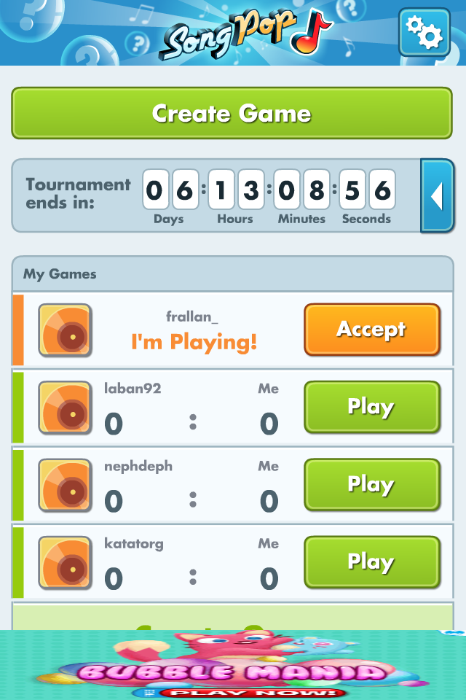
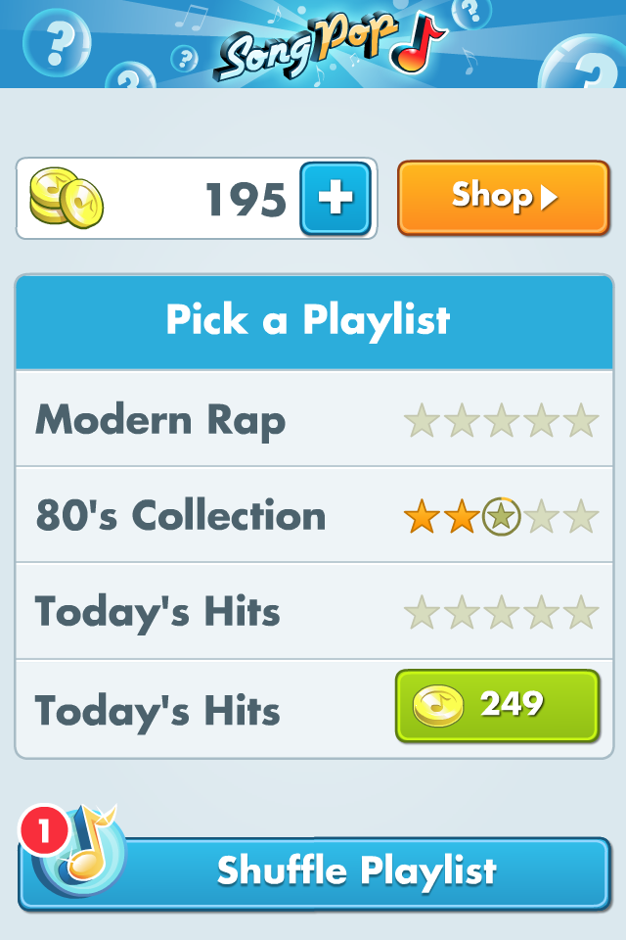
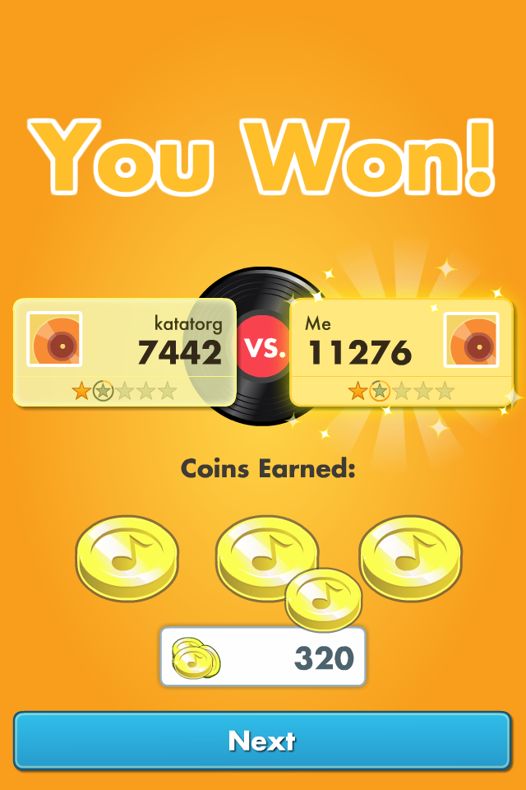
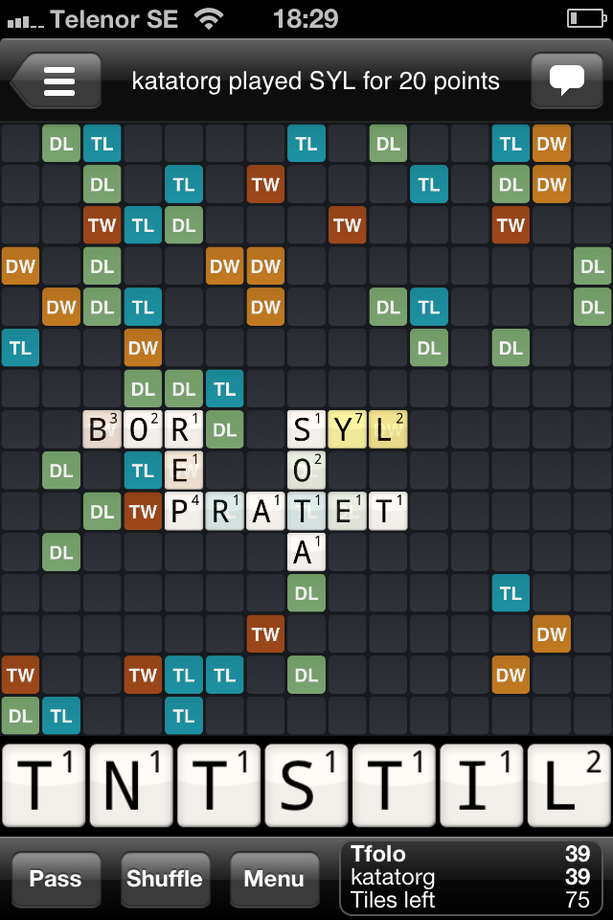
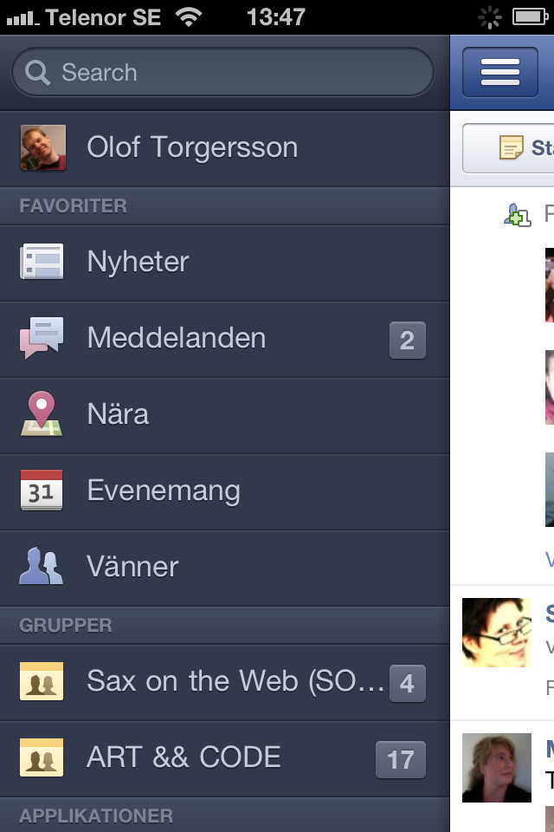
Bursting the Mobile Bubble
Music, single-player games, facebook, news,…
Also all sorts of social multi-player games & social tools
Distance – in the bubble
Notes:
One could argue that there are a lot of applications that mediates or even supports collaborative interaction
In some sense this is true, but if we look at the majority of the applications we find that they rather are designed to mediate interaction or collaborative activities taking place at distance
In terms of the matrix we looked at in the beginning they all play out in the lower row

Slide 15
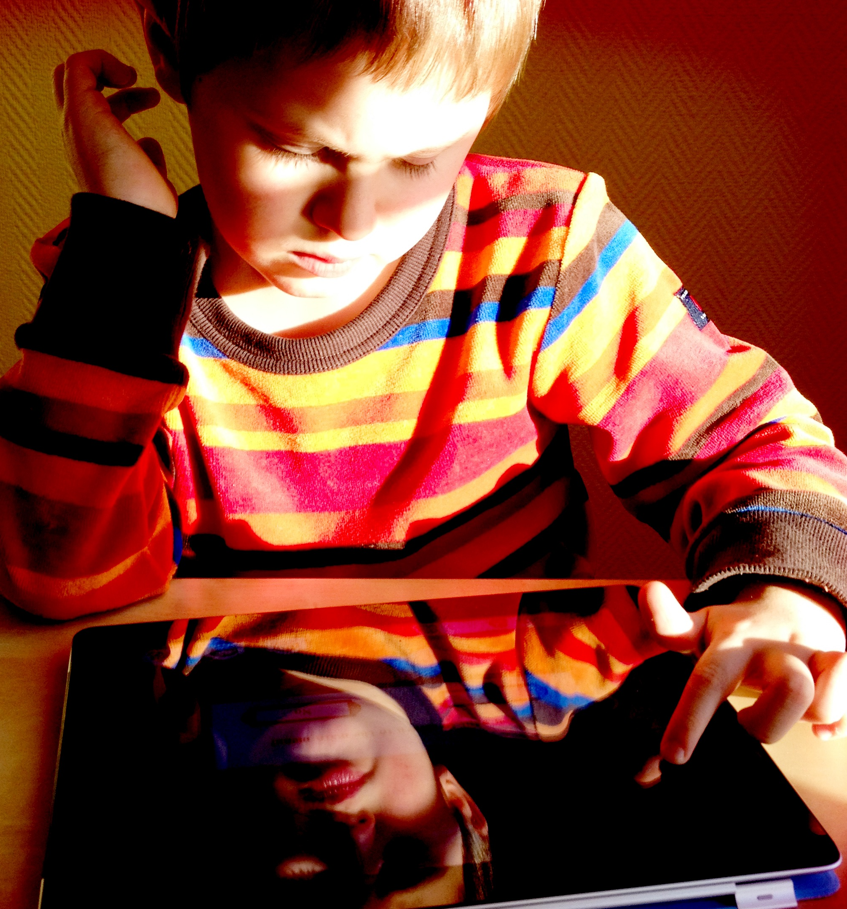
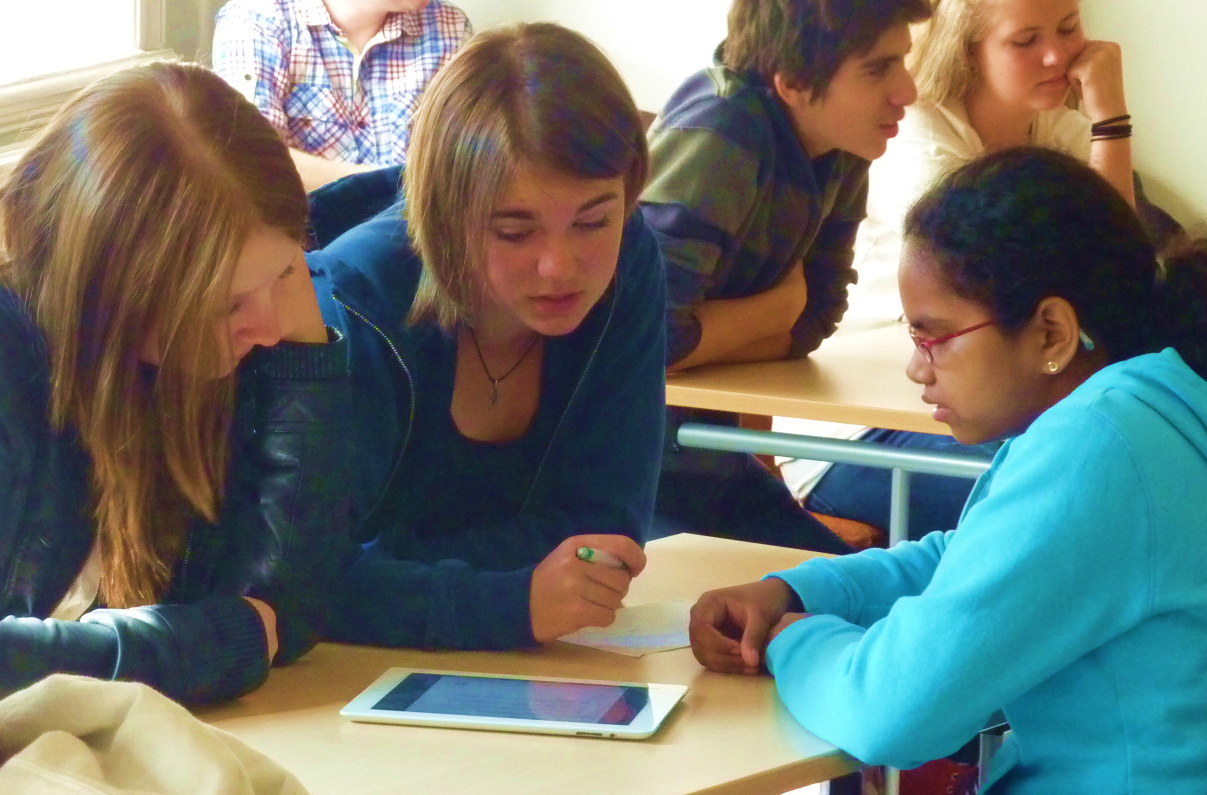
Bursting the Mobile Bubble
No!
Yes!
“…how we might support collocated, face-to-face situations using mobile devices.”
Notes:
When we talk about designing for bursting the mobile bubble the goal is different, it’s not about designing for one persone using one device alone it is about designing for several persons using one or more devices to perform a collaborative activity at the same time and the same place

Slide 16
Bursting the Mobile Bubble
Apps to do things together where you are
  Games
  Design
  Music
  Work
  …
Several units communicating?
Notes:
Designing for bursting the mobile bubble can involve apps for any kind of task ranging from games to work related tasks
Since the idea is to have several persons involved in the same activity it becomes rather natural to involve several communicating devices that work together to support collaboration
In this pictue we see a re-design of the game settlers of catan where the main board is on a bigger device like a table and the players’ private information appear on the mobile phones

Slide 17
Bursting the Mobile Bubble
Take a Leap
  Course project
  Master’s course
Movie
  https://vimeo.com/151787586
Notes:
Here is another exampel of how collaborative interaction can be mediated through mobile devices
It is a game called Take a leap develop as a course project at Chalmers university of technology in Gothenburg Sweden
These exampels are illustrations of that there are many opportunities to explore how mobile devices can be used to do things together at the same time and place

Slide 18
Designing for Co-located Interaction
Framework targeting design of mobile co-located interaction
Attempts to capture and describe important factors
Contains 2 representations
  Map
  Properties and values
Analytical & Generative
Notes:
We will now look into a framework for designing co-located mobile experiences
The framework tries to collect and organise knowledge relevant for designing mobile co-located interactions in a way that can be useful when working co-located technologies mediating collaborative interactions
The framework contains 2 representations, a map and a representation based on properties and values
The framework can be used both as an analytical tool and as a generative tool that can help faciltitate design

Slide 19
Map
Notes:
The map representation of the framework shows the four perspectives and the relationships between them.
The social is about the social experience of the design
The other perspectives are the technological perspective, the spatial perspective and the temporal perspective.
The idea is that each perspective captures factors that are relevant for the design om face-to-face interactions mediated by mobile technologies.
Looking at the design problem from the different angles can help the designer to explore the design space of co-located interaction.
The map also illustrates relations between the different perspectives. For instance the physical closeness and the social interactions influence things like combination of actions

Slide 20
Properties
 | PROPERTY | STATES | DESCRIPTION
SOCIAL | FocuS | collaboration | communication | competition | combined | What it is that users do together, i.e., what the focus of their social actions are intended to be.
 | Coordination of Action | timing actions | combining actions | combined | Whether, and if so, how actors perform coordinate actions together.
 | Framing | public | private | combined | The main social situation where the activities are carried out.
TECHNOLOGICAL | Information Symmetry | symmetrical | asymmetrical | Whether all users should have access to the same type of information or not.
 | Interaction Abilities | symmetrical | asymmetrical | Whether different users have different abilities/possibilities to interact with or in the system.
 | Information Distribution | free | unfolding | limited | shared | combined | In which way information is being distributed to users and spectators
 | Event Triggers | information-based | time-based | proximity-based | combined | What users or the system need to do in order to trigger an event that may change or cause progress in the system
SPATIAL | Proximity | people | devices | objects | locations | combined | To which things proximity matters, and what needs to be proximate to what.
 | Location(s) | One or more | none | One or more specific locations or places that matter for the experience
 | Movement | on the go | sedentary | combined | Whether users move through the space as part of the experience.
TEMPORAL | Synchronisation | user-driven | system-driven | combined | This property describes the synchronisation of actions within a temporal frame, if any.
 | Engagement | continuous | intermittent | sporadic | Users’ temporal patterns of action within the experience.
 | Pacing | high-paced | slow | user-paced | combined | How the intensity of action is distributed across the experience, e.g. number of actions per time-frame.
Notes:
The property and value representation divides each perspective into a number of properties that can have different values.
The idea of organising the perspectives into properties is to try to capture factors that are relevant for design from a number of different perspectives.
We will take a look into each one of the perspectives.

Slide 21
The Social Perspective
  Which kinds of activities are
  common in the social situation at hand?
  Private or public?
  Users’ abilities and skills
  Relationship between users.
  Users’ roles: Working? Playing?
  Performing? Visiting?
  Are there spectators?
  If so, do they know/care that users are engaged in an experience?
Three properties: Focus, Coordination of Actions and Framing.
Notes:
The social perspective is about what kind of activities that are common in the social situation where the design is situated.
When looking at the design from this perspective the designer looks into things like
Is the context where it plays out private or public?
What are the users’ abilities and skills?
What is the relationship between users?
What are the users’ roles, are they working? playing?
performing? visiting?
Are there spectators?
And if there are spectators, do they know/care that users are engaged in a shared experience?
A set of possibilities are described by the three properties connect to this perspective and their values.

Slide 22
Social Properties
Focus: What is the main activity it’s designed for?
  [collaboration | communication | competition | combined].
Coordination of Action: What do users do in relation to or with each other? Shapes interplay.
  [timing actions | combining actions | combined].
Framing: The main social situation for the activity
  [public | private | combined]
Notes:
The three properties of the social perspective are focus, coordination of action and framing
Full descriptions and discussion about each property can be found in the paper.
Focus is what the main activity is designed for?
The possible values are collaboration, communication, competition and combinations of these.
This idea is that activities can be collaborative, communicative or competitive
The cooridnation between participanst can mainly be achieved by timing actions or combining actions, that is doing actions in a sequence or combining them together
The framing property is about where the activity plays out, is it public or private, or can it be a combination of both?
If we decide on values for thesess properties when designing something, different combinations will lead to different designs

Slide 23
The Technological Perspective
  Hardware possibilities
  Hardware limitations
  Combination of devices
  How many users per device?
  Means to automatically collect
  information
  (Technical) means of communication
  Generation/provenance/ownership of content
Four properties: Information Symmetry, Interaction Abilities, Information Distribution, and Event Triggers.
Notes:
The technological perspective deals with things like
Hardware possibilities
Hardware limitations
Combination of devices
How many users per device?
The means to automatically collect and distribute information
(Technical) means of communication
And generation/provenance/ownership of content
A set of possibilities are described by the four properties connected to this perspective namely
Information Symmetry, Interaction Abilities, Information Distribution, and Event Triggers.

Slide 24
Technological Properties
Information Symmetry
  [symmetrical | asymmetrical]
Interaction Abilities: How users can act/interact
  [symmetrical | asymmetrical]
Information Distribution: Who knows what when
  [free | unfolding | limited | shared | combined].
Event Triggers: What the users or the system need to do to trigger a change/cause progress
  [information-based | time-based | proximity-based | combined].
Notes:
The four properties of the technological perspective are Information Symmetry, Interaction Abilities, Information Distribution, and Event Triggers.
Details about each one can be found in the paper.
They try to capture various waus the the technical set-up can affect oc co-located mobile design
Information symmetry is about what information each particpant gets. Do they all share the same information or do they see different things?
Interaction abilities is about what users can do. Is there an assymmetry or are the abilities the same for everyone?
Information distribution is about who knows what when.
Is all information free or does it unfold over time, is it limited somehow or shared between the persons involved in the co-located mobile activity?
Event triggers is about what brings the activity forward. Is it information, or time or perhaps the proximity between users and devices?
Again we can both analyse existing apps with respect to these or take them as starting point for a new design.

Slide 25
The Spatial Perspective
  Size and boundaries
  How we move through it
It has three properties: Proximity, Location(s) and Movement.
Notes:
The spatial perspective is about size and boundaries and how we move through an activity
There are three properties Proximity, Location(s) and Movement.

Slide 26
Spatial properties
Proximity: Which things need to be close in order for an activity, or event to play out.
  [people | devices | objects | locations | combined]
Location(s): Whether there are any specific locations or places within the spatial boundaries that matter for the experience
  [one or more | none]
Movement: If/how movement is part of the experience.
  [on the go | sedentary | combined].
Notes:
The three spatial properties are
Proximity: Which things need to be close in order for an activity, or event to play out.
[people | devices | objects | locations | combined]
Location(s): Whether there are any specific locations or places within the spatial boundaries that matter for the experience
[one or more | none]
This is about whether the co-located activity only can take place in certain environments
If it is relevant anywhere the value is none
Movement: If/how movement is part of the experience.
[on the go | sedentary | combined].

Slide 27
The Temporal Perspective
  Temporal behavior of software
  Temporal character of
  experience
  Rhythm
Three properties: Synchronisation, Engagement and Pacing.
Notes:
Finally the temporal perspective deals with the temporal behaviour of software and the temporal character of the experience, this involves things like if there is some specific rythm that charatcerizes the activity.
The three properties are Synchronisation, Engagement and Pacing

Slide 28
Temporal Properties
Synchronization: Whether and in which way synchronization is prompted
  [user-driven | system-driven | combined]
Engagement: Users’ broad temporal patterns of action
  [continuous | intermittent | sporadic]
Pacing: The way in which actions are distributed over time
  [high-paced | slow | user-decided | combined]
Notes:
The three properties capturing temporal properties are as follows
Synchronization: this is about whether and in which way synchronization is prompted
basically there are two options, that synchronization is drien by the user’s action or by the system. It can also be combined
Engagement: is about users’ broad temporal patterns of action
for instance, this can be continuous that is the users need to be active all the time throughout an activity or sporadic which means that users only need to do something now and then
Pacing: this is about the way in which actions are distributed over time the possibilities are
high-paced, slow, user-decided and combined
Again we can see if we set out to design something a user-driven activity that is continuous and high-paced will be different from a system-driven sporadic and slow activity

Slide 29
Relations
Notes:
The map of relations is an attempt to illustrate that the perspectives influnce each other, eg the physical closeness to collaborate by combining actions is shaped by the social and spatial perspectives

Slide 30
Key Applications
Analysis
  Describe existing designs & applications
  Categorization
  Understanding
  …
Design
  Generative tool
  Pick properties & values
  Restricts and stimulates design
Notes:
We have now walked through the framework and its four perspectives and various properties.
A key question is in what way this can be useful for design of collaborative co-located mobile activities mediated by technology.
When we consider this it might be good to keep in mind is that what the framework does is to try to describe, collect and systemize knowledge related to designing mobile co-located interactions.
With htis in mind there are two main application areas
The first is to use the framework for analysis. We can use it to describe existing designs and applications. This can be useful for understanding individual applications but also to categorize collactions of apps or for understadning things like if there are common properties in apps for co-located interaction that contribute to their sucess.
The second key application is to use the framework as a generative tool for design.
The idea here is that we can pick a number of properties and values from the perspectives and use as constraints for design.
This could be approached in different ways, we could study the framework and find desirable properties and values and decide to base the design on these or for less restricted situations we could simple randomize a number of properties and values and use these as a starting point for ideation.
For instance a high paced activity using combined actions a symmetrical information will be very different from a slow paced one using timed actions and limitied information access

Slide 31
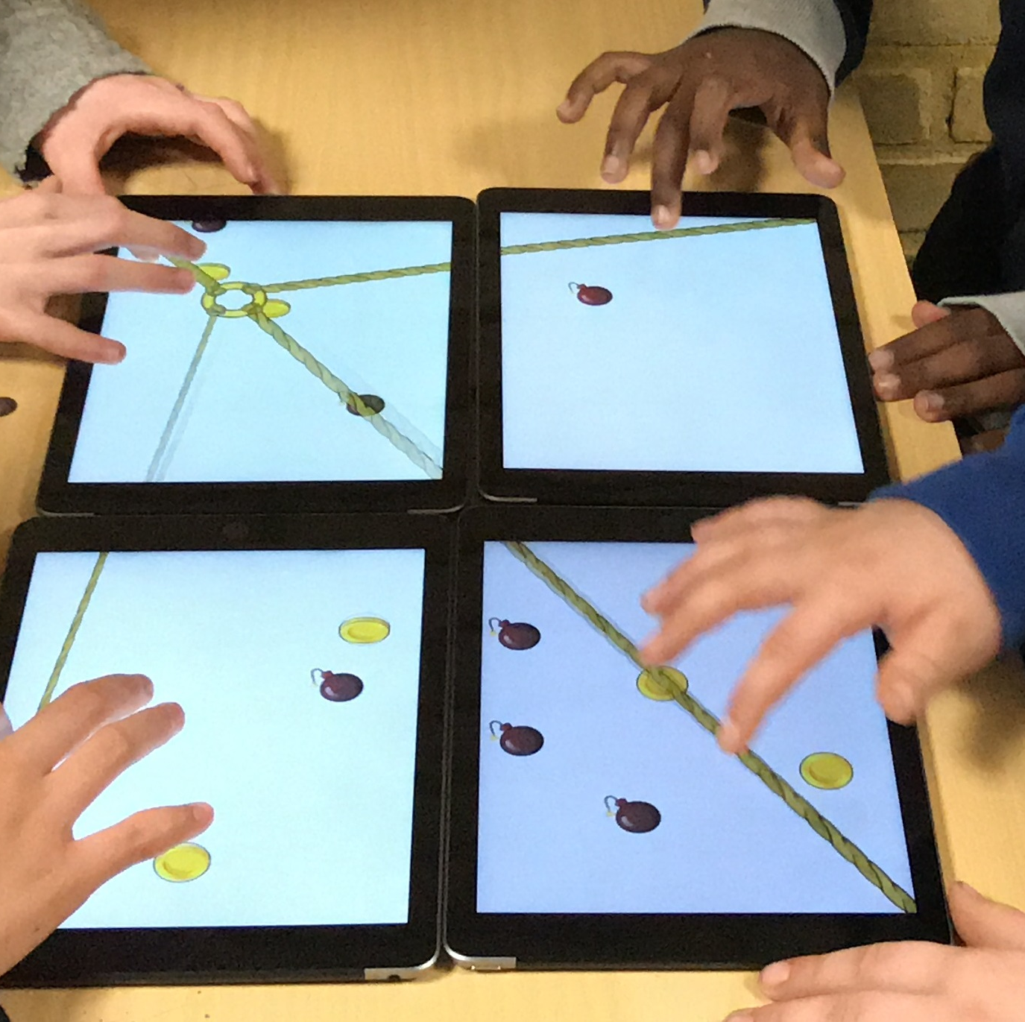
Example - StringForce
Designed for children to practice collaboration
using the tablets that are common in schools
Notes:
Let’s look at an example of a collaborative co-located activity, the game StringForce, based on the use of four coupled tablets forming a large screen

Slide 32
StringForce
Shared goal – catch coins & avoid bombs
Collaborative action – move ring by pulling and releasing rope
Coordination through verbal communication
Symmetrical
Fast-paced
Notes:
StringForce is a 4 player game played on 4 tablets and is therefore an example of a co-located mobile activity.
The goal behind the game is to let the players practice collaboration.
There is a shared goal which is to use the ring attached to four ropes to catch coinas while avoiding bombs
This is done through a collaborative action where the players together move the ring around by pulling and releasing rope
The players need to coordinate their actions through verbal communication when playing and together decide where to move the ring.
The game is symmetrical since all players have the same abilities and fast paced since the bombs move around so the players need to be active all the time to avoid them.

Slide 33
StringForce Properties
Perspective | Property | State(s)
SOCIAL | Focus | collaboration, communication
 | Coordination of Action | combined
 | Framing | combined
TECHNOLOGICAL | Information Symmetry | symmetrical
 | Interaction Abilities | symmetrical
 | Information Distribution | free
 | Event Triggers | combined
SPATIAL | Proximity | people, devices
 | Locations(s) | none
 | Movement | sedentary
TEMPORAL | Synchronisation | system-driven
 | Engagement | continuous
 | Pacing | fast-paced
Notes:
Here is an analysis of StringForce in terms of the framework for co-located interaction
Similar games are likely to share the same propert values

Slide 34
Summary/take home
Designing for synchronous co-located interaction is one specific form of collaborative interaction mediated by technologies worth investigating further
One opportunity is to design mobile technologies that enhance co-located activities
The framework for designing for co-located mobile interaction can be a support for both analysis and design
The application StringForce was presented as one example of a co-located mobile collaborative technology supporting collaborative interaction
Notes:
So here’s a summary of what we have talked about today
Designing for synchronous co-located interaction is one specific form of collaborative interaction mediated by technologies worth investigating further
One opportunity is to design mobile technologies that enhance co-located activities
The framework for designing for co-located mobile interaction can be a support for both analysis and design
The application StringForce was presented as one example of a co-located mobile collaborative technology supporting collaborative interaction

Slide 35
Recommended readings
Lundgren, S., Fischer, J. E., Reeves, S., & Torgersson, O. (2015). Designing Mobile Experiences for Collocated Interaction. Paper presented at the Proceedings of the 18th ACM Conference on Computer Supported Cooperative Work &amp; Social Computing, Vancouver, BC, Canada. https://doi.org/10.1145/2675133.2675171
Olsson, T., Jarusriboonchai, P., Woźniak, P., Paasovaara, S., Väänänen, K., & Lucero, A. (2020). Technologies for Enhancing Collocated Social Interaction: Review of Design Solutions and Approaches. Computer Supported Cooperative Work (CSCW), 29(1), 29-83. doi:10.1007/s10606-019-09345-0

Slide 36

Thanks for listening
Disclaimer: The European Commission's support for the production of this publication does not constitute an endorsement of the contents, which reflect the views only of the authors, and the Commission cannot be held responsible for any use which may be made of the information contained therein

