Slide 1
User Research in Designing Technology for Collaborative Interaction
https://tedco.se/

Slide 2
Summary & Learning outcome
The students are introduced to relevant factors for performing field research when designing technology for collaborative interaction (distinctions from dyads to communities), and three types of methods to achieve it (ethnography, artifact ecology, and network analysis).
LEARNING OUTCOME
Students will be able to name three types of methods for doing field research in the design of technologies for collaborative interaction.
Students will be able to describe relevant aspects of doing field research in the design of technologies for collaborative interaction in oral and visual form.
Students will be able to apply three types of methods for doing field research in the design of technologies for collaborative interaction.

Slide 3
Recommended readings
Sharp, Preece, & Rogers. 2019. Interaction Design: Beyond Human-Computer Interaction. Chapter 8. John Wiley & Sons. ISBN: 111954730X, 9781119547303
Martin, David & Rodden, Tom & Rouncefield, Mark & Sommerville, Ian & Viller, Stephen. (2001). Finding Patterns in the Fieldwork. DOI: 10.1007/0-306-48019-0_3.

Slide 4
Content
Why user research?
How user research?
User research concerns for collaborative technologies
Who is the user?
User research methods for collaborative technologies
User research ethics
Summary
References

Slide 5
Why user research?
Why user research?
“If there is any one secret of success, it lies in the ability to get the other person's point of view and see things from that person's angle as well as from your own.”
Henry Ford, 1922
“Designers are not users”
Jakob Nielsen, N/N group
https://quotepark.com/quotes/843670-henry-ford-if-there-is-any-one-secret-of-success-it-lies-in/
https://www.youtube.com/watch?v=gZeXyVJC-Jg
Notes:
Interesting quotes for why we need to know the user from big designers.

Slide 6
Why user research?
Why user research?
General human needs give us a basic understanding, of e.g. friendships
says nothing about a particular user or user groups’ needs for friendship
or in what way to support that
That is why we need to discover user needs
How are user needs used?
Guiding us to “direct” a design,
learning more about why
guiding us in starting to think in terms of design ideas.
formulate requirements
evaluate how a design is doing
Notes:
How user needs differ from more general and overarching human needs

Slide 7
User research concerns for collaborative interaction
Technology shape communication and collaboration between people.
In designing for collaborative interaction, it is very difficult to separate technical issues from social concerns (Ellis, 1991)
Key concerns:
Spatially oriented features – focus on the physical nature of the task and the observable arrangements within the context.
Task oriented features – focus on the principles of social organisation used to structure and manage the cooperative task
Notes:
Some key concerns in designing for collaborative interaction – spatially (physcial) and task (social) oriented features. These will be further elaborated in the next slides.

Slide 8
User research concerns for collaborative interaction: Spatially oriented
Spatially oriented - the observable arrangement of task and physical nature of the setting.
Key features:
Resources - what are the various resources in the setting used to support the task taking place and how are they shared.
Actors – who is involved in the cooperative task taking place and how do they orientate to each other.
Activities – what are the main observable techniques for structuring activities and how are these represented.
Martin, David & Rodden, Tom & Rouncefield, Mark & Sommerville, Ian & Viller, Stephen. (2001). Finding Patterns in the Fieldwork. 10.1007/0-306-48019-0_3.

Slide 9
User research concerns for collaborative interaction: Task oriented
Task oriented - the socially organised nature of tasks and how these are manifest in practice within particular settings
Key features:
Awareness of task—how and through what means are those involved in the task aware of the tasks of others, how do they exploit this awareness and how do they make others aware of their own task?
Distributed Coordination—how do those involved in the work coordinate their activities and what practical techniques do they use to do this?
Plans and procedures—what techniques do those involved in the context use to orient their task in practice to the formal plans, procedures, representations and artefacts of tasks?
Martin, David & Rodden, Tom & Rouncefield, Mark & Sommerville, Ian & Viller, Stephen. (2001). Finding Patterns in the Fieldwork. 10.1007/0-306-48019-0_3.

Slide 10
Who is the user?
Who is the user?
Collaborative interaction can involve
a few individuals, a pair, a group or groups of groups,
it can be within or between organizations,
it can involve an online community that spans the globe.
What are the distinctions from dyads to globe-spanning communities?
Notes:
The users of technologies for collaborative interaction span from individuals to globe-spanning communities.

Slide 11
Who is the user? Group
Who is the user? Group
Generally, a group is defined as a relatively closed and fixed ensemble of people sharing the same ‘goal’ and communication.
However…
The term ‘group’ is blurred and often used for any social interaction.
Johansen (1988) mentions “teams, projects, meetings, committees, task forces” etc. as examples of “groups”.
Bahrdt (1984): use the term ‘group’ if its members perceive themselves as a “we”.
The notion of a shared goal is murky and dubious.
Decision making in a group involves the interaction of multiple goals of different scope and nature (Bannon, 1989)
Notes:
Focusing in on the users as a group collaboratively interacting through some technology, and realising that there are no clear definiations.

Slide 12
Who is the user? Individuals in Group
The group members are individuals
with a personal background (experience, training, educational, motivation, skills)
and attitude towards technology, satisfaction, knowledge, values, and personality.
Groups are not stable, they can be formed spontaneously in response to the situation.
In a hospital, a group (“task force”) is formed ad hoc to deal with an emergency situation.
Project teams - groups with a quasi-permanent character.
A group of friends
Researchers who cooperate at “arm’s length”, without direct communication and without necessarily knowing each other
Summary:
Users of collaborative technologies are individuals with various backgrounds who identifies with one or more persons as ‘we’, and who may or may not share common goals
We need to understand the individuals, their relations and artefacts, and the networks and ecologies surrounding them.
Notes:
There are no clear definiations for who the user is, so we need to make user research to understand them.

Slide 13
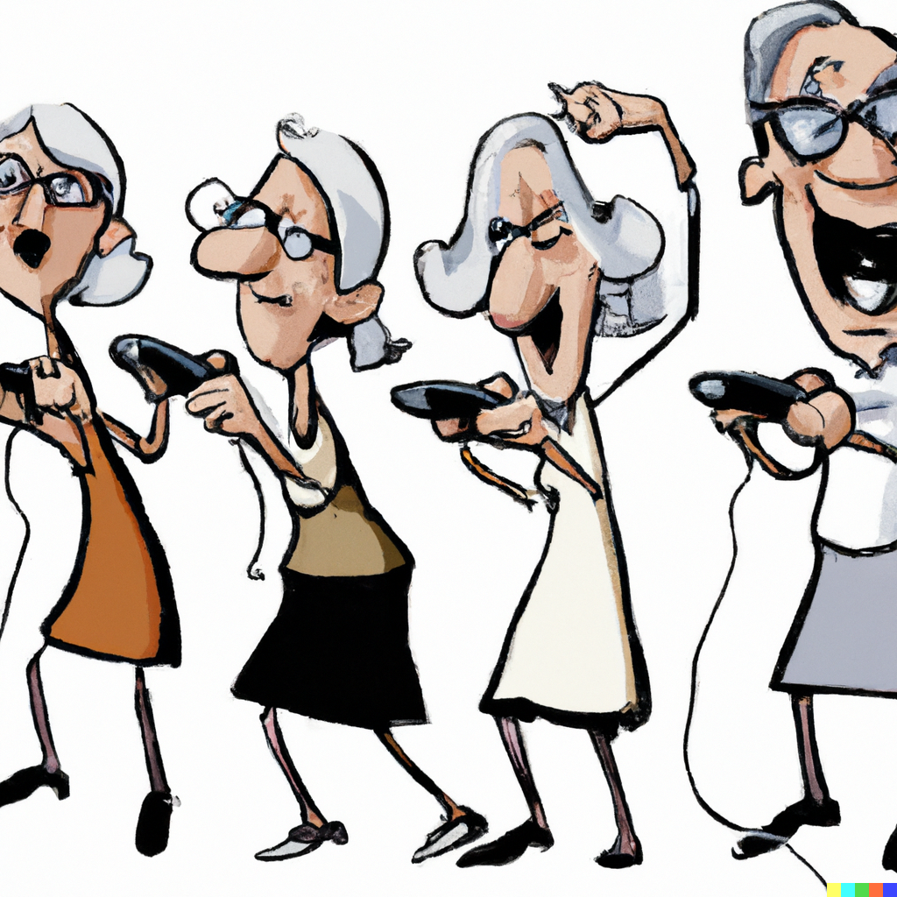
Who is the user? Communities of practice
People in a group are so diverse, need to find unifying factors other than e.g., age or disease.
Communities of practice
“a group whose members regularly engage in sharing and learning, based on their common interests. One might think of a community of practice as a group of people playing in a field defined by the domain of skills and techniques over which the members of the group interact. Being in the field provides members with a sense of identity – both in the individual sense and in a contextual sense, that is, how the individual relates to the community as a whole”
(Lesser, E. L. and Storck, J. Communities of Practice and Organizational Performance. IBM Systems Journal, Vol.40, No. 4 (2001).
Figure generated by DALL-E
Notes:
One approach to understanding users is that of communities of practice.

Slide 14
Who is the user? Identifying stakeholders by stakeholder mapping
Designing technologies for collaborative interaction poses complex challenges, which require a multi-stakeholder approach.
Designers should be aware of and understand all the direct and indirect stakeholders.
Designers require competences to explore the broader perspective on people and the societal context in which products, systems, or services will be integrated.
In case designers lack these competencies:
cause unforeseen consequences, e.g. excluding specific user groups
design solution will be experienced as naïve
design will never end up in practice
Direct stakeholders:
Groups – individuals or organizations – who interact directly with the system or its output.
Indirect stakeholders:
All other parties who are affected by the use of the system.
Often ignored in the design process.
Example, digital medical records systems have often been designed with many of the direct stakeholders in mind (e.g., insurance companies, hospitals, doctors, and nurses), but with too little regard for the values (e.g.privacy) of a rather important group of indirect stakeholders: the patients.
Friedman et al, 2013
Notes:
In order to understand the user, we first of all need to identify who they are. We make a distinction between direct and indirect stakeholders, and the method stakeholder mapping can be useful (further elaboration in next slide).

Slide 15
Who is the user? Identifying stakeholders by stakeholder mapping
How:
Create a list of direct and indirect stakeholders
Draw the relations between stakeholders.
From this map, identify key stakeholders (indirect or direct), and list their most important values.
Are there any tensions between stakeholder values?
Private photo, 2019.
Notes:
Instructions for how to make a simple stakeholder mapping.

Slide 16
User research methods: User data
Primary data
- when data is specifically collected to meet the needs set out by the brief
Ethnographic methods
Qualitative data e.g. observations
Quantitative data e.g. questionnaire
Artifact ecology analysis
The relationships of artifacts to practices, in the context of individuals or groups of people
Network analysis
Connections between people
Secondary data
- when the data used has been collected from a 3rd party source such as:
Anthropometric data (ergonomics)
User group data
Published studies
Surveys
National Statistics
Other sources
Usability data
Wearables
Open data
Notes:
In user research, there are different types of data that can be relevant to collect, and we seperate ebtween primary and secondary data.

Slide 17
User research methods: Triangulation
Understand context
Study of real situations
Members point of view
System interactions
Visualisations
Relations & participation
Ethnographic data
Qualitative analysis
Artifact ecology analysis
Automatic tracking data
Quantitative analysis
Network analysis
Notes:
There are many methods for user research, some of them listed here, and are relevant to use in triangulation, as the example here demosntrate.

Slide 18
User research methods
Network analysis
Large scale of use gives rise to “big data” and give insight into how and when people communicate and share information.
but the insights are often more shallow—lacking the rich detail associated with deep study.
Artefact ecology analysis
The relationships of artifacts to practices, in the context of individuals or groups of people.
Interviews and visual mappings
Ethnography
Observations, interviews, focus groups
Small scale, qualitative approaches to data collection and analysis offer the opportunity to obtain very rich, deep insights about very specific phenomena —often in a bounded or limited context, and might face challenges related to generalization, verification, and validation.
Traditionally, network analysis and ethnography were separated.
Now complementary:
large-scale statistical analysis for finding correlations and patterns,
ethnography enabling us to discover what they mean and identify other patterns to look for.
Notes:
Examples of user research methods relevant in the design of technologies for collaborative interaction. These methods will be further elaborated in the next slides.

Slide 19
User research methods: Network analysis
When a computer network connects people or organizations, it is a social network.
Social network analysis seek to describe
networks of relations,
prominent patterns in such networks,
trace the flow of information through them,
discover what effects these relations and networks have on people and organizations.
A distinction is often made between
Positional analysis - the positions that individuals or units hold in a social structure
Similarity
Relational analysis - the interactions among those units and defines sub-groups and structure
Proximity
Both help in understanding a network structure, but they describe rather different things about how the network is put together.
Laura Garton, Caroline Haythornthwaite, Barry Wellman, Studying Online Social Networks, Journal of Computer-Mediated Communication, Volume 3, Issue 1, 1 June 1997, JCMC313, https://doi.org/10.1111/j.1083-6101.1997.tb00062.xx

Slide 20
User research methods: Network analysis
Method to analyze the connections across individuals or groups or organisations.
Can be used for e.g.
Discussion forums
Mailinglists
Social media
Wikis
Intranets
A network of networks, with ties between individuals, and ties between network clusters. Image generated by DALL-E.

Slide 21
User research methods: Network analysis
Limitations
Advantages
Not all of the interaction takes place inside the computer
Go for a coffee discussing the task
Interpretation is hard without ’insider knowledge’, i.e. replication is difficult
Combination with other methods is useful – ’triangulation’
Focus on interaction
rather than on individual behavior
Allows us to examine how the configuration of networks influences how individuals and groups, organizations, or systems function.
Notes:
Limitations and advantages of the method network analysis.

Slide 22
User research methods: Artifact ecology analysis
Artifact ecology - the relationships of artifacts to practices, in the context of individuals or groups of people.
Originally personal artifact ecologies (Jung 2008): ``a set of all physical artifacts with some level of interactivity enabled by digital technology that a person owns, has access to, and uses‘’
Later expanded to workplace and communitiy artefact ecologies to understand the interplay between
place,
the shared technologies,
the members’ own technologies
the practices that exist, develop, or are challenged by these technologies.
Focus on how artifact ecologies are shaped in community settings by personal and community relationships, for the purpose of design.
Relationships between artifacts in artifact ecologies evolve dynamically over time.
Interview and visual mapping methods
Visual analysis of artifact ecologies in programming workshops. Private photos.

Slide 23
User research methods: Ethnography
What people say they do and what they actually do are not always the same.
Ideal behavior is what every "good" member of the community should do
Manifest behavior is what people actually do.
Asking people about their behavior will yield responses closer to the ideal than the manifest.
People may distort, knowingly or unknowingly, accounts of their own behavior.
Some explanations of why this distinction exist:
Everyday life is too complex to tell – life stories heavliy reduced
People often not aware of their actual behaviours
What we know about what we do is tacit, unarticulated
We might find details of everyday life too mundane or trivial to raise them
Participants may be concerned with their image and report what’s socially acceptable
Participants respond in a certain way to please the researchers
(Ref: Blomberg J., Giacomi J., Mosher A., Swenton-Wall P. Ethnographic Field Methods and Their Relation to
Design. Participatory design Principles and practices. Lawrence Erlbaum Associates, 1993. 123-155 )

Slide 24
User research methods: Ethnography
Focus on what people actually do and not solely on their accounts of behavior
Particular behaviors can only be understood in the everyday context in which they occur
Principles:
Natural settings
Study activities in their everyday settings
the forest, the office, the car, on a plane
Holism
Focus on relations among activities and people (interactions) and not on single tasks or isolated individuals.
Understand social system as a functioning whole
Descriptive
Describe before you prescribe
Users/members point of view
As opposed to your point of view (which you already know)
(Ref: Blomberg J., Giacomi J., Mosher A., Swenton-Wall P. 1993 )

Slide 25
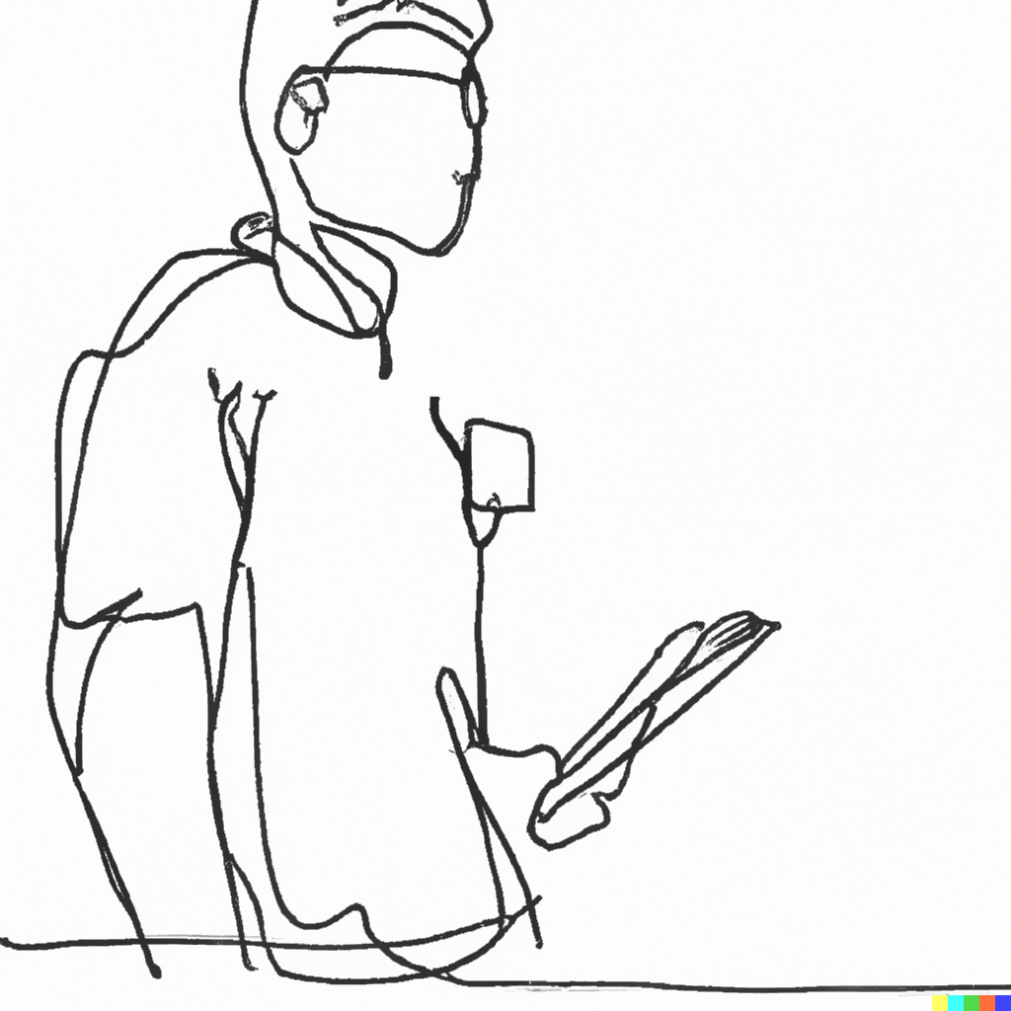
User research methods: Ethnography
Interviews
in depth information
Focus group
in need of quick feedback on concepts/ideas
to collect user impressions
multiple points of view are desirable
Observations
context of use is in focus
familiarize with unknown environments
what people actually do
Many more methods are available.
Figures generated by DALL-E

Slide 26
User research - Summary
Users in collaborative interaction are individuals with various backgrounds who identifies with one or more persons as ‘we’, and who may or may not share common goals
We need to understand who the users are; individuals, relations, artefacts, and the networks and ecologies surrounding them.
User research concerns
Task oriented features – focus on the principles of social organisation used to structure and manage the cooperative task: resources, actors, activities.
Spatially oriented features – focus on the physical nature of the task and the observable arrangements within the context: awareness, distributed cognition, plans and procedures.
Apply a mixed method approach - using only one will not provide you with all the information you need
Ethnography (e.g. interview, focus group, observation)
Artifact ecology analysis
Network analysis
User research data (primary and secondary) are used for eliciting requirements, formulating the problem, design, and evaluation.

Slide 27
References
Martin, David & Rodden, Tom & Rouncefield, Mark & Sommerville, Ian & Viller, Stephen. (2001). Finding Patterns in the Fieldwork. 10.1007/0-306-48019-0_3.
Bannon, L., & Schmidt, K. (1989). CSCW: Four characters in search of a context. In Proceedings of the first european conference on computer supported cooperative work, Gatwick, London, 13–15 September 1989 (pp. 358–372).
Casey Fiesler, Jed R. Brubaker, Andrea Forte, Shion Guha, Nora McDonald, and Michael Muller. 2019. Qualitative Methods for CSCW: Challenges and Opportunities. In Conference Companion Publication of the 2019 on Computer Supported Cooperative Work and Social Computing CSCW '19. Association for Computing Machinery, New York, NY, USA, 455–460. DOI:https://doi.org/10.1145/3311957.3359428
Blomberg J., Giacomi J., Mosher A., Swenton-Wall P. Ethnographic Field Methods and Their Relation to Design. Participatory design Principles and practices. Lawrence Erlbaum Associates, 1993. 123-155
https://www.ibm.com/cloud/learn/data-mining
https://www.academia.edu/1145603/Uses_and_limitations_of_communication_network_analysis_in_the_evaluation_of_CSCW_applications
Correia, A., Paredes, H. & Fonseca, B. Scientometric analysis of scientific publications in CSCW. Scientometrics 114, 31–89 (2018). https://doi.org/10.1007/s11192-017-2562-0
Robert Johansen (1988): Groupware. Computer Support for Business Teams, The Free Press, New York and London, 1988.
Clarence A. Ellis, Simon J. Gibbs, and Gail Rein. 1991. Groupware: some issues and experiences. <i>Commun. ACM</i> 34, 1 (Jan. 1991), 39–58. DOI:https://doi.org/10.1145/99977.99987
Rob Kling. 1991. Cooperation, coordination and control in computer-supported work. <i>Commun. ACM</i> 34, 12 (Dec. 1991), 83–88. DOI:https://doi.org/10.1145/125319.125396
Pumareja, D., & Sikkel, N. (2002). An evolutionary approach to groupware implementation: the context of requirements engineering in the socio-technical frame. Centre for Telematics and Information Technology, University of Twente.
Mittleman, D., Briggs, R., Murphy, J., & Davis, A. (2008). Toward a taxonomy of groupware technologies. In Proceedings of the 14th international workshop on groupware: Design, implementation, and use (pp. 305–317).
Ackerman, M. S. (2000). The intellectual challenge of CSCW: The gap between social requirements and technical feasibility. Human–Computer Interaction, 15(2), 179–203.
Harper, R. R., Hughes, J. A., Shapiro, D. Z. (1989): Working in harmony: An examination of computer technology in air traffic control. In: EC-CSCW 89 - Proceedings of the First European Conference on Computer-Supported Cooperative Work 13-15 September, 1989, Gatwick, London. pp. 73-86.
Friedman B., Kahn P.H., Borning A., Huldtgren A. (2013) Value Sensitive Design and Information Systems. In: Doorn N., Schuurbiers D., van de Poel I., Gorman M. (eds) Early engagement and new technologies: Opening up the laboratory. Philosophy of Engineering and Technology, vol 16. Springer, Dordrecht. https://doi.org/10.1007/978-94-007-7844-3_4
Stephen P. Borgatti and Martin G. Everett. 1992. Notions of Position in Social Network Analysis. Sociological Methodology Vol. 22 (1992), pp. 1-35 (35 pages). https://doi.org/10.2307/270991

Slide 28
Disclaimer: The European Commission's support for the production of this publication does not constitute an endorsement of the contents, which reflect the views only of the authors, and the Commission cannot be held responsible for any use which may be made of the information contained therein
https://tedco.se/

