Slide 1
EXTENDED REALITY (XR) SYSTEMS THAT MEDIATE COLLABORATIVE INTERACTION
https://tedco.se/

Slide 2
Summary & Learning Goal
The students are introduced to the taxonomy for synchronous collaborative interaction in social extended reality (XR) environments. This includes understanding the main components for designing XR platforms that mediate collaboration. Opportunities and challenges of current virtual systems in mediating collaborative interaction are presented for future design considerations.
Students will be able to;
• identify different components of designing XR systems that mediate collaboration.
describe relevant mediating features for designing and evaluating XR systems for collaboration
critically reflect on the opportunities and challenges of the XR systems that mediate collaboration.

Slide 3
Content / Outline
Introduction to a brief history of XR and XR taxonomy
Main challenges and opportunities offered by XR systems in mediating collaborative interaction
Main components of XR system design: Environments, Avatars, Interaction
Future Directions

Slide 4
Recommended readings
Schäfer, A., Reis, G., & Stricker, D. (2022). A Survey on Synchronous Augmented, Virtual, and Mixed Reality Remote Collaboration Systems. ACM Computing Surveys, 55(6), 1-27. https://doi.org/10.1145/3533376
Barrett Ens, Joel Lanir, Anthony Tang, Scott Bateman, Gun Lee, Thammathip Piumsomboon, and Mark Billinghurst. 2019. Revisiting collaboration through mixed reality: The evolution of groupware. International Journal of Human-Computer Studies 131 (2019), 81-98. https://doi.org/10.1016/j.ijhcs.2019.05.011

Slide 5
BRIEF HISTORY OF EXTENDED REALITY (XR) MEDIATED COLLABORATIVE WORK
BRIEF HISTORY OF VIRTUAL SYSTEMS THAT MEDIATE COLLABORATION
Computer-Supported Cooperative Work (CSCW) has long been concerned with understanding and designing technologies to support collaboration. From this field, rich theories and practices about how people work together have influenced the design of collaboration technologies.

Slide 6
BRIEF HISTORY OF EXTENDED REALITY (XR) MEDIATED COLLABORATIVE WORK
BRIEF HISTORY OF VIRTUAL SYSTEMS THAT MEDIATE COLLABORATION
Some of the earliest examples of collaboration technology in virtual environments:
“Ultimate Display” by Ivan Sutherland (1965) - the real and digital spaces were seamlessly combined,
“oN-Line System” (1968) or “The Mother of All Demos” (1969) by Engelbart and English - first illustrated video conferencing and screen sharing in a real-time collaborative text editor,
a head mounted display (HMD) by Sutherland (1968) - combined two small cathode ray tubes with transparent optical elements to overlay virtual images on the real world which was known as the first fully working AR system,
Video Draw (1990) and Video Whiteboard (1991) by Tang and Minneman, and Clear Board (1993) by Ishii et al. - using cameras and half-silvered mirrors to provide a more realistic rendition of a virtual collaborator’s eye gaze,
teleconference applications where people used tracked AR displays to view live virtual video of remote collaborators superimposed over the real world (e.g., Billinghurst and Kato, 2002).
Schäfer, A., Reis, G., & Stricker, D. (2022). A Survey on Synchronous Augmented, Virtual, and Mixed Reality Remote Collaboration Systems. ACM Computing Surveys, 55(6), 1-27. https://doi.org/10.1145/3533376

Slide 7
INTRODUCTION: EXTENDED REALITY (XR)
What is Extended Reality according to you?
How does collaborative interaction differ in different realities (e.g. virtual, augmented, mixed)?

Slide 8
INTRODUCTION: EXTENDED REALITY (XR)
WHAT IS EXTENDED REALITY (XR)?
Extended Reality is an umbrella term for technologies that merge immersive digital environments with the physical world. The term broadly involves different yet interlocking technologies: virtual reality (VR), augmented reality (AR) and mixed reality (MR).
Mixed Reality (MR)
Real Environment
Augmented Reality (AR)
Augmented Virtuality
Virtual Reality (VR)
Adapted from: Milgram, P., & Kishino, F. (1994). A taxonomy of mixed reality visual displays. IEICE TRANSACTIONS on Information and Systems, 77(12), 1321-1329. http://citeseerx.ist.psu.edu/viewdoc/summary?doi=10.1.1.102.4646
Notes:
Discuss with the class how these terms differ:

Slide 9
OPPORTUNITIES OF XR FOR COLLABORATIVE INTERACTION
Augmented Reality (AR), Mixed Reality (MR) and Virtual Reality (VR) technologies are developing slowly but steadily. They are becoming more mature and open new ways for remote collaboration.
Instance:
Companies Explore Virtual Worlds As Collaboration Tools
https://www.cio.com/article/274106/collaboration-companies-explore-virtual-worlds-as-collaboration-tools.html

Slide 10
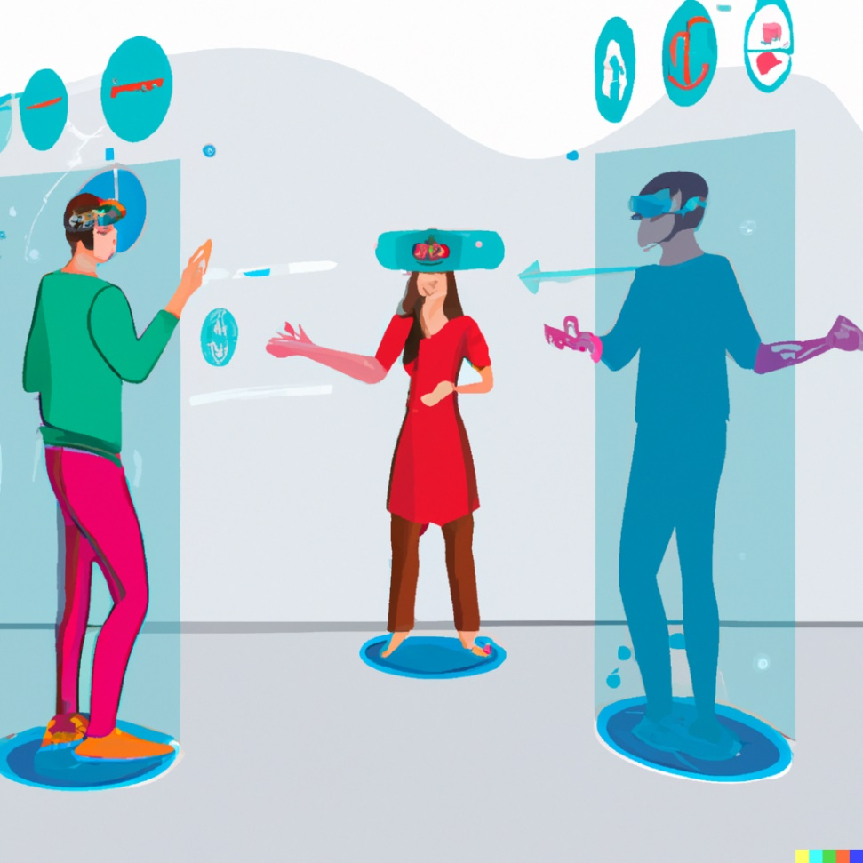
XR IN MEDIATING COLLABORATIVE INTERACTION
POSSIBILITIES OF THE VIRTUAL CONTINUUM FOR COLLABORATIVE INTERACTION
Augmented Reality (AR) - support collaborative interaction by aligning digital content with the physical world around the collaborators, drawing attention to the material, and stimulating collaboration among people both in the real and the virtual spaces
Virtual Reality (VR) - mimic the feeling of real social interaction, and further create its own realm of communication through transformed social interactions (i.e., it can present a different reality for different users depending on their individual needs.)
Mixed Reality (MR) – a combination of both AR and VR hardware and thus the possibilities for collaborative interaction
Image created by Dall-E with the description "multiple people interact collaboratively in extended reality". Retrieved in December 2022.

Slide 11
TOWARDS TAXONOMY FOR SHARED-SPACE TECHNOLOGIES
SPATIAL APPROACHES TO TECHNOLOGY MEDIATED COLLABORATIVE WORK
Spatial metaphors (e.g., virtual office) gained importance as much as the process of work itself in Computer-Supported Cooperative Work (CSCW) field, and spatial approaches focused on five broad categories:
Media-Spaces
Spatial video-conferencing
Collaborative Virtual Environments (CVEs)
Telepresence systems
Collaborative Augmented Environments
Benford, S., Greenhalgh, C., Reynard, G., Brown, C., Koleva, B. Understanding and Constructing Shared Spaces with Mixed-Reality Boundaries, ACM Transactions on Computer-Human Interaction 5 (3) (1998) 185–223. http://portal.acm.org/citation.cfm?doid=292834.292836
Notes:
Media-spaces involve the enhancement of existing workspaces (typically offices) with integrated audio/video communication facilities as a basis for providing a range of general communication services
Video-conferencing involves the use of combined video and audio communications to support focused meetings. This can be contrasted to the mediaspace objectives of supporting peripheral awareness and long-term working relationships.
CVEs involve the use of networked virtual reality systems to support group work [Benford et al. 1994]. The key concept behind CVEs is that of shared virtual worlds: computer-generated spaces whose occupants are represented to one another in graphical form.
Telepresence involves allowing participants to experience a remote physical space through computer and communications technologies. This may include the ability for the remote participant to view the space, to navigate the space, and even to interact with objects in the space.

Slide 12
TAXONOMY FOR SHARED-SPACE TECHNOLOGIES
Taxonomy for shared-space technologies (by Benford et al., 1998)
Transportation,
Artificiality,
Spatiality.​
​
Synthetic
(generated from computer data)
Augmented Reality
Virtual Reality
*Projected CVEs
*Immersive CVEs
*Tangible bits
*Desktop CVEs
Artificiality
*CVEs with video faces
hybrid
*Video conf. with shared data
*Phone/Video conf./media space
physical
(generated from the real world)
Physical Reality
Telepresence
local
(remain in the physical world)
partial
remote
(leave your body behind)
Transportation
Benford, S., Greenhalgh, C., Reynard, G., Brown, C., Koleva, B. Understanding and Constructing Shared Spaces with Mixed-Reality Boundaries, ACM Transactions on Computer-Human Interaction 5 (3) (1998) 185–223. http://portal.acm.org/citation.cfm?doid=292834.292836
Notes:
Based on the approaches to shared real and virtual spaces, Benford and colleagues introduced a taxonomy that classifies shared-space technologies according to the three dimensions; Transportation, Artificiality, and Spatiality.
Transportation characterizes the essential difference between the concepts of local and remote. For example, one extreme is a face-to-face co-located AR collaboration, while the other extreme would be immersive telepresence or immersive shared VR systems.
Spatiality concerns their level of support for fundamental physical spatial properties such as containment, topology, distance, orientation, and movement. This classification was new for its time in terms of focusing on the spatial dimension in CSCW research.
Artificiality; comparable to Milgram’s Reality-Virtuality continuum, rather depicts the extent of how much portion of the scene is synthetic or physical.

Slide 13
INTRODUCTION: XR TAXONOMY
In addition to Benford’s taxonomy for shared-space technologies, Barret et al. (2019) further suggested classification based on the collaborators' roles in XR systems that mediate collaboratşve interaction namely;
Symmetry; symmetry is a concept commonly associated with collaboration when the collaborators have the same basic roles and capabilities in XR.
Asymmetry; often arises from properties of different technologies when there are mixed by collaborators and also result from differences in user roles, from differences in ability to access information, or from the nature of a specific collaborative task.
Barrett Ens, Joel Lanir, Anthony Tang, Scott Bateman, Gun Lee, Thammathip Piumsomboon, and Mark Billinghurst. 2019. Revisiting collaboration through mixed reality: The evolution of groupware. International Journal of Human-Computer Studies 131 (2019), 81-98. https://doi.org/10.1016/j.ijhcs.2019.05.011
Notes:
Asymmetry - often arises from properties of different technologies when these are mixed by collaborators. For instance, a head-mounted AR display may contain an outward-facing camera, which captures a view of the wearer’s surroundings, whereas a webcam on a desktop computer will capture the collaborator’s face. These differences in the physical setup often lead to differences in the functionality available to each collaborator. Asymmetries can also result from differences in user roles, from differences in ability to access information, or from the nature of a specific collaborative task

Slide 14
XR IN MEDIATING COLLABORATIVE INTERACTION
WHY IS COLLABORATIVE INTERACTION IMPORTANT IN XR TECHNOLOGIES?
Communication e.g. in education, work, health, everyday life
Networking (e.g. video and teleconferencing systems)
Immersive 3D experiences (e.g. believable person embodiment and interaction)
Reducing travel costs, office space, time, carbon emissions
Creating novel possibilities in different fields (e.g. human-computer interaction, computer graphics, medicine, training, cognitive sciences, etc.)
Notes:
Especially in a time of pandemic, climate crisis, remote collaboration, home schooling, home office, etc.

Slide 15
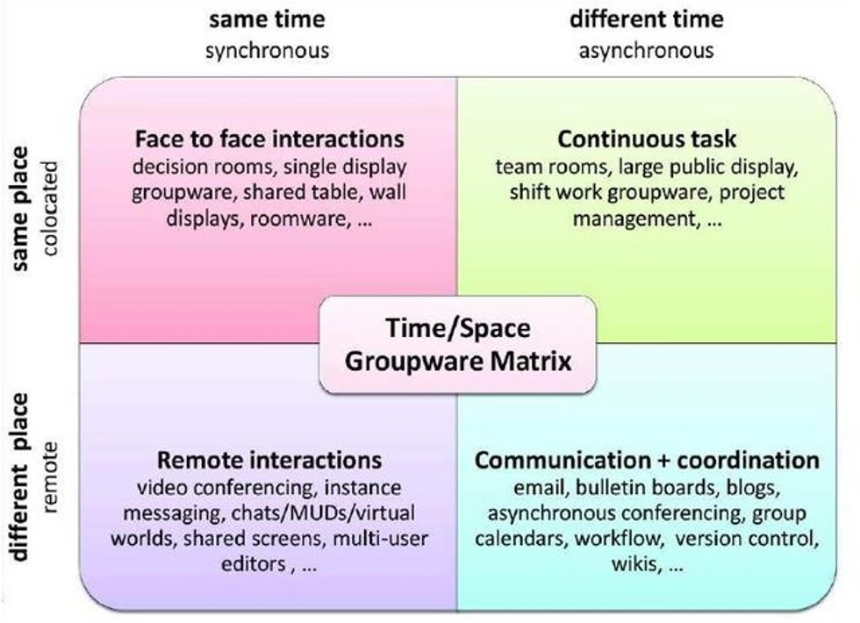
COLLABORATIVE INTERACTION IN XR
Robert Johansen. 1988. Groupware: Computer support for business teams. The Free Press.
https://public-images.interaction-design.org/literature/articles/heros/566d806939506.jpg?tr=w-1024
Notes:
Even though all the conditions in Time/Space Matrix is relevant for AR/VR/MR platforms, we mostly focus on synchronous and remote collaboration systems which use either of these technologies in which physical co-location of collaborators is not required and they collaborate in real-time.

Slide 16
REMOTE & SYNCHRONOUS COLLABORATIVE INTERACTION IN XR: CHALLENGES
WHAT ARE THE MAIN CHALLENGES FOR REMOTE & SYNCHRONOUS COLLABORATION USING XR
User representations in virtual environments
Type of collaborative interaction possible in a shared virtual space
Enabling non-verbal communicative cues (e.g. shared gaze awareness)

Slide 17
REMOTE & SYNCHRONOUS COLLABORATIVE INTERACTION IN XR: KEY COMPONENTS
THE KEY COMPONENTS THAT EACH REMOTE & SYNCHRONOUS COLLABORATION XR SYSTEM NEED TO IMPLEMENT
Environment
Avatars
Interaction

Slide 18
REMOTE & SYNCHRONOUS COLLABORATIVE INTERACTION IN XR: KEY COMPONENTS
1. ENVIRONMENT
Refers to a simulated environment that stimulates the sensory impressions of a user;
in VR; 3D modelled space
In AR; 3D modelled objects superimposed onto the real world,
shared annotations, virtual pointers, tactile and auditory cues etc.
Notes:
Sensorama, created by Morton Heilig in the early 1960s. It featured a simulated motorcycle ride with 3D visuals, stereo sound, olfactory cues (aromas) and tactile cues (seat vibration and wind from fans). In recent literature, most virtual environments are not as comprehensive and complete as the prototype created by Heilig, but rather focus on specific areas that are mostly visual or acoustic stimuli.

Slide 19
REMOTE & SYNCHRONOUS COLLABORATIVE INTERACTION IN XR: KEY COMPONENTS
1. ENVIRONMENT: SOME INSTANCES
Interaction in a Collaborative Augmented Reality Environment
https://www.youtube.com/watch?v=kr6Awen6aaY
Work in the metaverse
https://www.youtube.com/watch?v=uVEALvpoiMQ
CoVAR: A Collaborative Virtual and Augmented Reality System for Remote Collaboration
https://www.youtube.com/watch?v=K_afCWZtExk
Microsoft Mesh
https://www.youtube.com/watch?v=Jd2GK0qDtRg

Slide 20
REMOTE & SYNCHRONOUS COLLABORATIVE INTERACTION IN XR: KEY COMPONENTS
2. AVATARS
Represent entities or identities in virtual environments to others:
Realistic and cartoon graphics (how 3D model of avatar is rendered)
Avatar type (e.g. full body, upper body, head&hands, hands only)
Reconstructed model avatar; system creates an avatar that resembles to the user from face reconstruction
Video avatar; system implements avatar as video projections
Audio avatar; invisible form of avatar relying on audio communication
AR Annotations; visual annotations (e.g. text, pictures, freehand drawings)

Slide 21
REMOTE & SYNCHRONOUS COLLABORATIVE INTERACTION IN XR: KEY COMPONENTS
2. AVATARS: SOME INSTANCES
Empathic Computing Lab - Mini-Me: An Adaptive Avatar for Mixed Reality Remote Collaboration https://www.youtube.com/watch?v=YrdCg8zz57E
Spatial - Collaboration with lifelike avatars in VR/AR/Web
https://www.youtube.com/watch?v=NVujUnsKuhs
Software Enables Avatar to Reproduce Our Emotion in Real Time
https://www.youtube.com/watch?v=0AFFWPkcOmE

Slide 22
REMOTE & SYNCHRONOUS COLLABORATIVE INTERACTION IN XR: KEY COMPONENTS
3. INTERACTION
Refers to the possibilities offered by interaction types which are not mutually exclusive
Shared 3D object manipulation
Media sharing
AR annotations
2D drawings
AR Viewpoint sharing
Mid-air drawing in 3D
Hand gestures
Shared gaze awareness
Convey facial expression
Notes:
Shared 3D object manipulation; possibility to interact and manipulate shared 3D objects in a virtual space
Media sharing; possibility to share documents, images, videos and other form of media
AR annotations; remotely annotated input in form of 2D drawing, text, or simple pointers.
2D drawings; possibility to place a virtual surfaces such as a whiteboard
AR Viewpoint sharing; possibility to share a user’s view perspective, reconstruct the environment from a local scene, move independently through the virtual environment
Mid-air drawing in 3D; possibility to create 3D paintings which can then be observed from multiple users in different angles
Hand gestures; enable multiple users to interact with objects via hand tracking or motion capture gloves
Shared gaze awareness; allow precise tracking and transmission of gaze awareness and exclude systems that indicate gaze perception by head rotation only
Convey facial expression; transmit facial expressions to other users

Slide 23
REMOTE & SYNCHRONOUS COLLABORATIVE INTERACTION IN XR: KEY COMPONENTS
3. INTERACTION: SOME INSTANCES
CollaboVR: A Reconfigurable Framework for Creative Collaboration in Virtual Reality
https://www.youtube.com/watch?v=ZJ6tfc4djuA
Physics based Multiple 3 Point Tracked VR Avatar Interaction
https://www.youtube.com/watch?v=SaGezfGzFQs
Extended Mid-air Ultrasound Haptics for Virtual Reality
https://www.youtube.com/watch?v=Ahr2ZLrFbFE

Slide 24
REMOTE & SYNCHRONOUS COLLABORATIVE INTERACTION IN XR: USE CASES
MAIN USE CASES FOR REMOTE & SYNCHRONOUS COLLABORATION IN XR
Meeting
Co-design
Remote expert
Events…

Slide 25
REMOTE COLLABORATIVE INTERACTION IN XR
WHAT ARE THE OPPORTUNITIES FOR REMOTE & SYNCHRONOUS COLLABORATION SYSTEMS?
Allowing many users to join and participate in virtual meetings
Offering interaction possibilities (e.g. mid-air drawing, media and screen sharing, haptic touch)
Persistent virtual objects which exist through multiple sessions (e.g. a drawing from a session before is still present in the next session)
Placing arbitrary 3D objects in a shared virtual environment.
Reconstructed, personalised avatars and user created avatars through an application programming interface which is provided by the developers .
Availability on multiple platforms: desktop, mobile devices (e.g. wearables) and web browser.
Schäfer, A., Reis, G., & Stricker, D. (2022). A Survey on Synchronous Augmented, Virtual, and Mixed Reality Remote Collaboration Systems. ACM Computing Surveys, 55(6), 1-27. https://doi.org/10.1145/3533376​

Slide 26
REMOTE COLLABORATIVE INTERACTION IN XR
WHAT ARE THE CHALLENGES FOR REMOTE COLLABORATION SYSTEMS?
Some systems are enterprise solutions, tailored to the specific needs of companies, what renders them unattractive or even inaccessible to the general public
Lack of transmission of nonverbal communication cues by means of an avatar
Limited choices for virtual environments provided by the developer or need expert knowledge for creating them
Privacy issues and regulations for access to and visibility of personal data or space and intellectual output protection
Schäfer, A., Reis, G., & Stricker, D. (2022). A Survey on Synchronous Augmented, Virtual, and Mixed Reality Remote Collaboration Systems. ACM Computing Surveys, 55(6), 1-27. https://doi.org/10.1145/3533376​

Slide 27
COLLABORATIVE INTERACTION IN XR
FUTURE DIRECTIONS
Complex Collaboration Structures in Time, Space, and Symmetry Lack of transmission of nonverbal communication cues by means of an avatar
Convergence and Transitional Interfaces
Empathic Collaboration
Collaboration Beyond the Physical Limits
Social and Ethical Implications
Barrett Ens, Joel Lanir, Anthony Tang, Scott Bateman, Gun Lee, Thammathip Piumsomboon, and Mark Billinghurst. 2019. Revisiting collaboration through mixed reality: The evolution of groupware. International Journal of Human-Computer Studies 131 (2019), 81-98. https://doi.org/10.1016/j.ijhcs.2019.05.011

Slide 28
FUTURE DIRECTIONS: COLLABORATIVE INTERACTION IN XR
Complex Collaboration Structures in Time, Space, and Symmetry Lack of transmission of nonverbal communication cues by means of an avatar encompasses design considerations such as;
The size of the collaborating group
Supporting mixed presence in the group
The synchronicity of the collaborating group
The roles of the members in the groups (as well as the dynamic nature of these roles)
Barrett Ens, Joel Lanir, Anthony Tang, Scott Bateman, Gun Lee, Thammathip Piumsomboon, and Mark Billinghurst. 2019. Revisiting collaboration through mixed reality: The evolution of groupware. International Journal of Human-Computer Studies 131 (2019), 81-98. https://doi.org/10.1016/j.ijhcs.2019.05.011
Notes:
For example; massive multiplayer online games support hundreds to thousands of people playing in a shared virtual environment. VR platforms such as Sansar(https://www.sansar.com), AltspaceVR (https://altvr.com), VRChat(http://vrchat.net), or EON Reality (https://eonreality.com/) enable casual interaction between tens to hundreds of people in virtual worlds.

Slide 29
FUTURE DIRECTIONS: COLLABORATIVE INTERACTION IN XR
Convergence and Transitional Interfaces;
Instead of Milgram’s MR continuum, artificiality aspect of collaborative virtual platforms allows users to move from pure physical space to AR and to pure VR environment
With convergence of AR and VR technology, it is envisioned that transitional interfaces would be also applied to MR remote collaboration.
Enable users to start conversations in VR, then transition to AV or AR as a user starts sharing a part of or entire physical environment he or she is in.
Transition can also happen through different dimensions such as Time, Space, Symmetric/Asymmetric roles, skills or tools that are accessible to the users.
Barrett Ens, Joel Lanir, Anthony Tang, Scott Bateman, Gun Lee, Thammathip Piumsomboon, and Mark Billinghurst. 2019. Revisiting collaboration through mixed reality: The evolution of groupware. International Journal of Human-Computer Studies 131 (2019), 81-98. https://doi.org/10.1016/j.ijhcs.2019.05.011

Slide 30
FUTURE DIRECTIONS: COLLABORATIVE INTERACTION IN XR
Empathic Collaboration,
MR collaboration will grow from seeing the reality of another to feeling the reality of another.
MR collaboration will grow and expand to share invisible features and status of the physical reality; e.g. sharing internal status of people, sharing multi-sensory features of physical surroundings.
Affective Computing (how computers can capture / recognize emotions?); e.g. sharing gaze, facial expressions, physiological measures (heart rate, body temperature, skin conductivity, or even brain activity, might help with building empathy between collaborators); sharing nonvisible multi-sensory features (haptic, olfactory, gustatory, etc.)
Barrett Ens, Joel Lanir, Anthony Tang, Scott Bateman, Gun Lee, Thammathip Piumsomboon, and Mark Billinghurst. 2019. Revisiting collaboration through mixed reality: The evolution of groupware. International Journal of Human-Computer Studies 131 (2019), 81-98. https://doi.org/10.1016/j.ijhcs.2019.05.011
Notes:
Currently, the main focus of many shared experience and telepresence systems has been on capturing, sharing and presenting a remote person and his or her physical surroundings, with focus on the audio-visual sensory channel. The future of MR collaboration will enable these aspects in this slide.

Slide 31
FUTURE DIRECTIONS: COLLABORATIVE INTERACTION IN XR
Collaboration Beyond the Physical Limits,
potential to alter our perception making space-time malleable, giving us the flexibility to alter ones reality.
exploring multi-scale collaboration combined AR and VR technologies both in co-located and remote contexts; e.g. sharing an AR user’s 3D reconstructed environment with a VR user who could be in a regular scale or a giant scale
leveraging the physicality of objects in the surrounding environment to create more realistic experiences in VR.
Barrett Ens, Joel Lanir, Anthony Tang, Scott Bateman, Gun Lee, Thammathip Piumsomboon, and Mark Billinghurst. 2019. Revisiting collaboration through mixed reality: The evolution of groupware. International Journal of Human-Computer Studies 131 (2019), 81-98. https://doi.org/10.1016/j.ijhcs.2019.05.011

Slide 32
FUTURE DIRECTIONS: COLLABORATIVE INTERACTION IN XR
Social and Ethical Implications,
Enabling and understanding novel methods of communication and collaboration, focusing on technical, usability and human factors issues.
Novel collaborative MR technologies may enable new forms of social interactions. However, their impact on user behavior in social situations remains mostly unclear; e.g. negative feelings such as shame, unfairness, loneliness, uncertainty and tensions among users
Social acceptance; privacy concerns, filtering shared information, social proximity
Barrett Ens, Joel Lanir, Anthony Tang, Scott Bateman, Gun Lee, Thammathip Piumsomboon, and Mark Billinghurst. 2019. Revisiting collaboration through mixed reality: The evolution of groupware. International Journal of Human-Computer Studies 131 (2019), 81-98. https://doi.org/10.1016/j.ijhcs.2019.05.011

Slide 33
Summary/take home
Synchronous remote interaction in XR systems is one form of collaborative interaction that can be supported by technologies which gain importance
There are benefits and challenges in incorporating collaborative XR into educational, work, or everyday settings which create room for further exploration in technology and design studies
Further studies can adress problems and opportunities in terms of engagement, interactivity and motivation in different fields of activities (e.g. Collaborative learning, co-design, etc.) in different aspects (e.g. temporality, spatiality, artificiality of roles, avatars, communicative cues, etc. of the collaborating actors).

Slide 34
References
Schäfer, A., Reis, G., & Stricker, D. (2022). A Survey on Synchronous Augmented, Virtual, and Mixed Reality Remote Collaboration Systems. ACM Computing Surveys, 55(6), 1-27. https://doi.org/10.1145/3533376
D. N. E. Phon, M. B. Ali and N. D. A. Halim, "Collaborative Augmented Reality in Education: A Review," 2014 International Conference on Teaching and Learning in Computing and Engineering, Kuching, Malaysia, 2014, pp. 78-83, doi: 10.1109/LaTiCE.2014.23.
Peng Wang, Shusheng Zhang, Mark Billinghurst, Xiaoliang Bai, Weiping He, Shuxia Wang, Mengmeng Sun, and Xu Zhang. 2019. A comprehensive survey of AR/MR-based co-design in manufacturing. Engineering with Computers (2019), 1-24. https://doi.org/10.1007/s00366-019-00792-3
Barrett Ens, Joel Lanir, Anthony Tang, Scott Bateman, Gun Lee, Thammathip Piumsomboon, and Mark Billinghurst. 2019. Revisiting collaboration through mixed reality: The evolution of groupware. International Journal of Human-Computer Studies 131 (2019), 81-98. https://doi.org/10.1016/j.ijhcs.2019.05.011
Ryan Anthony J de Belen, Huyen Nguyen, Daniel Filonik, Dennis Del Favero, and Tomasz Bednarz. 2019. A systematic review of the current state of collaborative mixed reality technologies: 2013-2018. AIMS Electronics and Electrical Engineering 3, 2 (2019), 181. https://doi.org/10.3934/ElectrEng.2019.2.181
Milgram, P., & Kishino, F. (1994). A taxonomy of mixed reality visual displays. IEICE TRANSACTIONS on Information and Systems, 77(12), 1321-1329. http://citeseerx.ist.psu.edu/viewdoc/summary?doi=10.1.1.102.4646

Slide 35
Disclaimer: The European Commission's support for the production of this publication does not constitute an endorsement of the contents, which reflect the views only of the authors, and the Commission cannot be held responsible for any use which may be made of the information contained therein
https://tedco.se/

